Slide 1
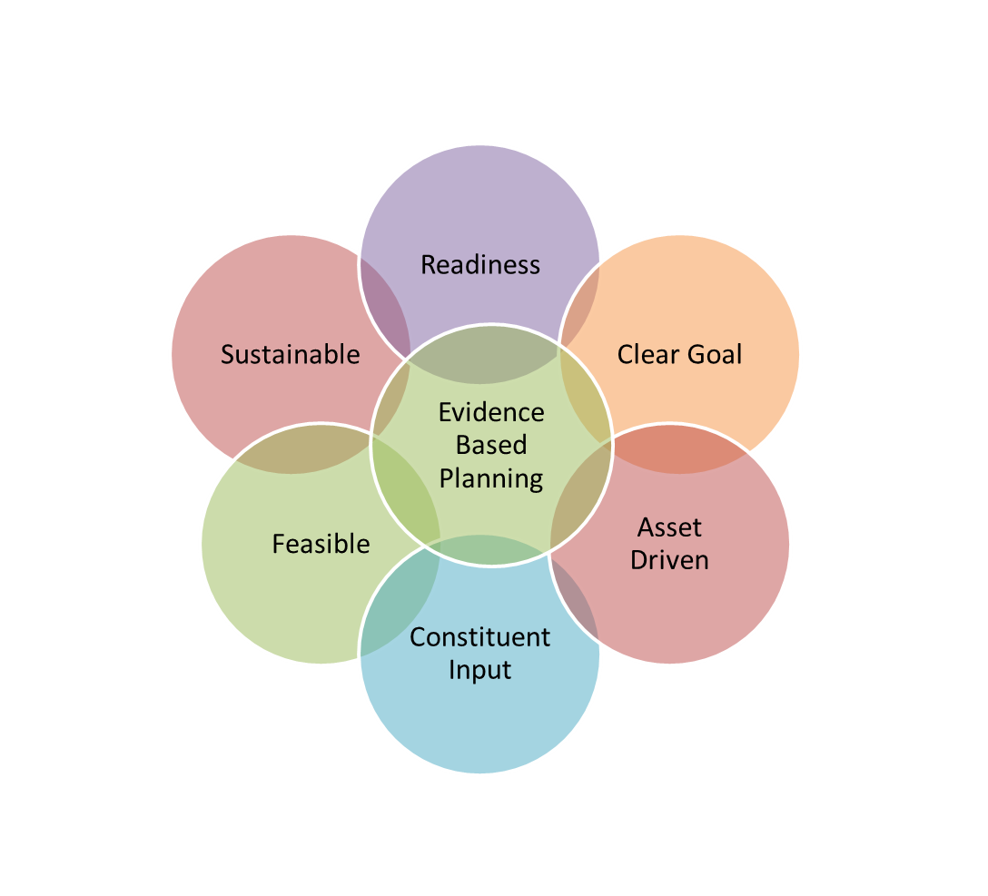
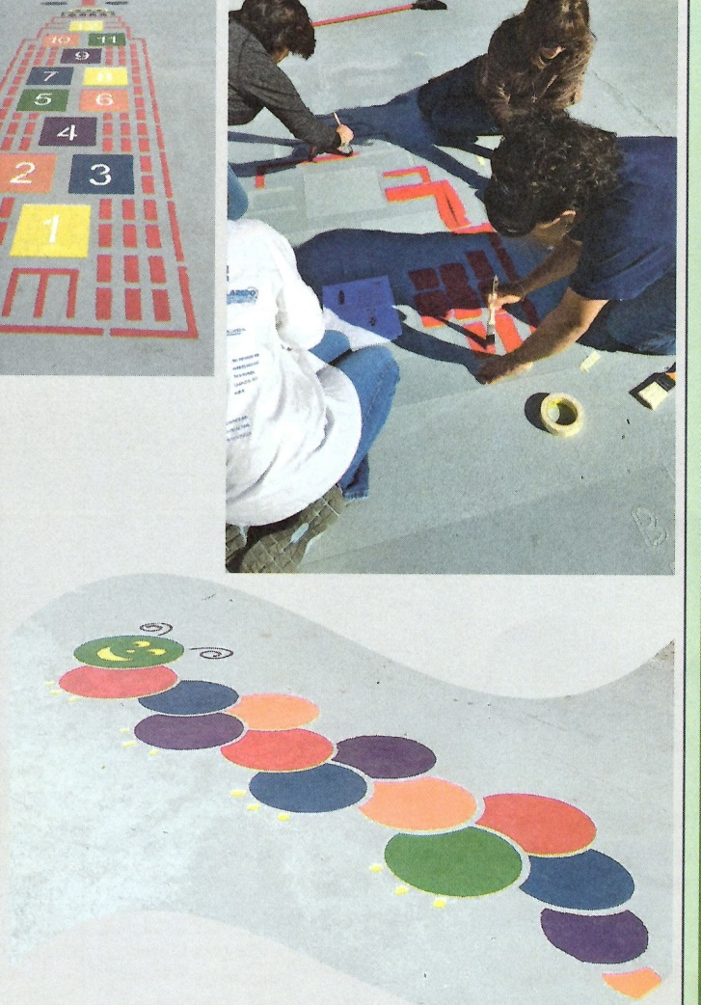
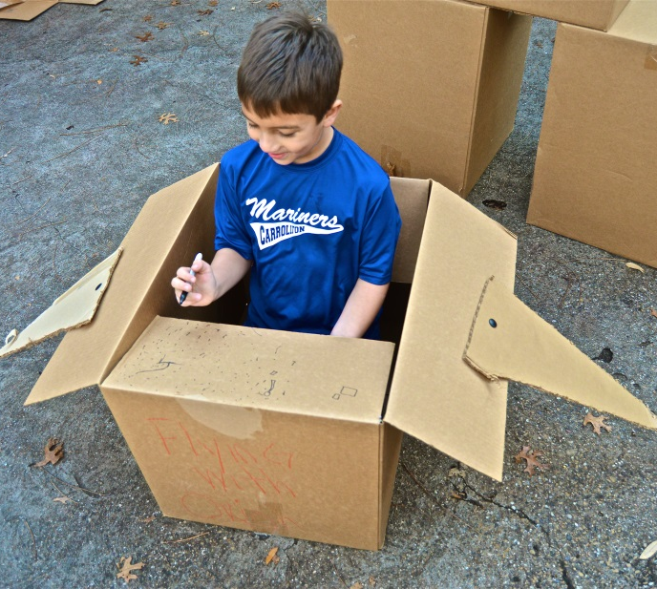
PRACTICE PLANNING
for
PLAY AND P.A.
Creating places for
PLAY AND P.A.
through community driven approaches
Determine Need
Place (s) where intervention is needed:
Why?
Target audience:
Type of intervention (Pop up Play; Painted Place, Wayfinding)
Key intended outcome(s)
Who are the decision makers, permitted agencies, permissions grantors you need to get approvals from?
Who/ what agencies can assist with a safety plan?
Physical resources available (from who/ what agency?
Key Players (leaders, sponsors, partners)
Workshop Agenda
Issues and Environmental Change
What, Why, How and Impact of:
Pop Up Play
Painted Places
Wayfinding
Practice Planning
How would you get citizen input and participation for design, volunteers, and attendance/use?
How would you program or change the site?
How will you sustain the change/ program?
How would you measure the impact?
Presented for
Funded by the Centers for Disease Control (CDC), the Working On Wellness (WOW) grant is working to reduce obesity rates in Hidalgo County by increasing opportunities to engage in physical activity and increasing access to fresh fruits and vegetables..

Slide 2
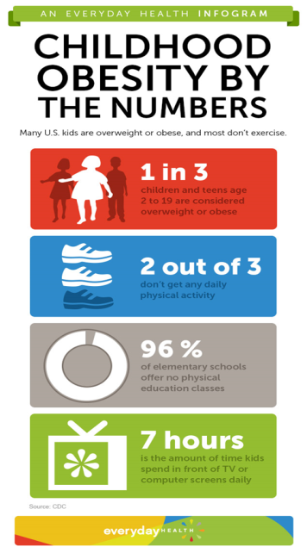
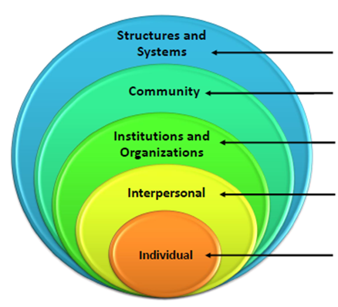
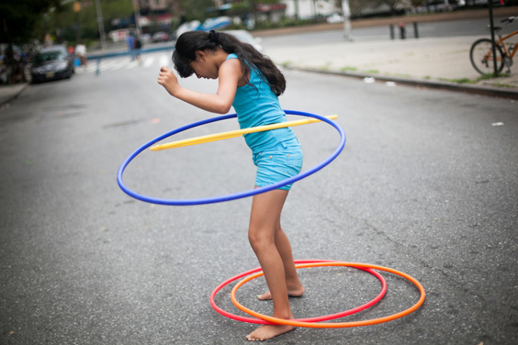
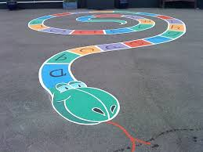
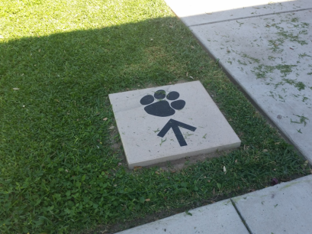
Creating places for PLAY AND P.A through community driven approaches
Tactical
1) of or relating to small- scale actions serving a larger purpose 2) androit in planning or maneuvering to accomplish a purpose
Principles:
-participatory
-temporary - low cost
-flexible - iterative
Issues
Increasing need versus scarcity of land
Community Issues: Community interaction / support; Physical Activity ; Economic Impacts
Cost of install and upkeep
Gauge community capacity
Figure out what works quickly
Health and Social Ecological Model
From everyday health and cdc.gov
Play streets, Pop up Play, Open Streets
Painted Places
Wayfinding
When a city street or area is closed to traffic or other uses to create an area where kids can play and be active.
Bright games or art work painted on cement or asphalt surfaces.
Knowing where you are and where you are going
Impacts
Encouragement ; Increased Knowledge ;
Increased Use, and Community Pride
Principles
Connect places; be predictable; be inclusive; keep information simple
Provide support for decision; confirmation, turn, and mile marker
Basic Overview of Logistics
Impacts
Welcome addition and improves safety
Make the dullest of school grounds seem more vibrant
Add curriculum, learning and teaching opportunities
Encourage physical activity and creativity and play
Community partners and community projects
See the school as wider community resource
Inclusive project to school staff, community , parents, & students
Grassroots
Do “for” yourself
Small win
Using existing resources– working with what you have
Gauge impact/ usability/ feasibility
Accessible
Builds community
Basic Overview of Logistics
Get permission and approvals
Review case studies or other painted places
Brain storm ideas and get input
Practice ideas with chalk / pilot test
Have the right leaders approve for safety, etc.
Devise and get application guidelines approved
Get community support
Plan day/ time and gather materials needed
Recruit volunteers and host the “paint day”
Train teachers and community leaders on ways to integrate the painted spaces
with curriculum and physical activity
Basic Overview of Logistics
Identify where needed
Get location, permits, permission, safety plan
Input, support, partners, volunteers
Account for equipment, supervision, police, and safety
Publicize, communicate, have kick off event
Repetition is key***
Observe where people are walking or could walk
Get permission and approvals
Review case studies on wayfinding
Brain storm ideas and get input
Practice ideas / pilot test
Have the right leaders approve for safety, etc.
Devise and get prep and application guidelines approved
Get community support and community input
Gather materials needed
Recruit volunteers
Host the events or special days
http://www.nyc.gov/html/doh/images/cdp/hula-hoop.jpg
storybookmural.co.uk

