Slide 1

The Life Cycle
of
NIFA
Reporting
(Data Gateway)
Laurie Fortis
Stephanie Pearl
Notes:
Ask about audience composition
Raise your hand if you are an evaluator, money folks (there to talk to OGFM, some PDs

Slide 2
Objectives
1) Describe why your reporting matters to various audiences
2) Understand who uses your reporting data for what purposes
3) Effectively classify your projects and understand why it matters to do so
4) Conduct project searches in NIFA’s Data Gateway
5) Effectively initiate and report on your projects
6) Understand NIFA’s communications channels for publicizing your work

Slide 3
Part I: Your reporting matters!

Slide 4
Why report outcomes and impacts?
Congress cares about your outcomes and impacts!
https://www.youtube.com/watch?v=fOhDcUY-7GA&feature=youtu.be&t=3h35m32s
Notes:
House Ag Committee Hearings for REE (NIFA, ARS, NASS, ERS)
March 18, 2016
House Ag Committee Chairman Mike Conaway
NIFA Director Sonny Ramaswamy
https://youtu.be/fOhDcUY-7GA
3:35:32-3:37:19
Why are high-quality outcomes and impacts so important to report?
We really do read them!
We use them at the federal level to demonstrate the public value of these federal funds
Develop and justify NIFA’s annual budget requests
Plan, monitor, and evaluate programs
Communicate with USDA Secretary, U.S. Congress, the White House, and the American people

Slide 5
Why Does NIFA Report?
NIFA Mission: Invest in and advance agricultural research, education, and extension to solve societal challenges.
Your Results = Our Success!
Quantitative and Qualitative
Commercialization
Solutions
Steps Toward Breakthroughs
Your Stories
Data Gateway
Notes:
NIFA reports so that the American Public knows the value of agricultural research and how it impacts all of us
We use your qualitative and quantitative results, your patents and publications, your breakthroughs and the steps toward those breakthroughs, to share your solutions to societal challenges and tell the story so everyone knows it.
In order for NIFA to effectively report, you and your project directors need to understand the data-elements of your Reports. Today we want to talk about those data elements and how important they are in the context of the Data Gateway. The Data Gateway is just that, it’s our Gateway to all the information you provide to us in REEport, aligned with our grant management system.

Slide 6
Who cares about your research? How do we share this information?
Notes:
We already know who cares about the work you do. But how does NIFA report the information you provide?–

Slide 7
How Does NIFA Use Your Results:
Funding of topic areas for annual reports to Congress
Funding by Program
Funding by State
Funding by Institution
Evaluations
Success Stories/Vignettes
Portfolios
Notes:
We group your results by topic, program, state and institution -depending on the audience. When the Secretary visits a school to announce a program, he wants to be able to say how much funding is being awarded to your State.
Beyond the top line numbers, he wants to talk about what matters to your stakeholders and your institution. The importance of the data on the applications, such as what type of Land grant you are, and your name on the application, all have effects on the data when we aggregate it. Showing our awards by organization type, is important. because the success of your institution, is also a measure NIFA’s success.
Evaluation are a big focus for all our programs because NIFA is limited in how we can collect information. Evaluators can survey to get your feedback, analyze how the research is doing in a larger context, and make recommendations to fill gaps and improve our programs. supplementing the report information that you provide to NIFA to give the results context.
The Success Stories are used in NIFA Publications like the Annual Report and the NIFA Budget Explanatory Notes which are presented to Congress by our Director each year during the budget hearings.
And last is the Portfolio Review Cycle. This 5 year planning and evaluation cycle breaks the major NIFA Topic Areas into 9 Portfolios: The portfolios use Knowledge Areas to identify their investments. Knowledge Areas represent the topics of your projects according to the MANUAL OF CLASSIFICATION FOR AGRICULTURAL AND FORESTRY RESEARCH, EDUCATION, AND EXTENSION, which has been in place since 1966
I will touch on classifications in a few slides to make this more clear for you.

Slide 8
Qualitative Data
Project Title, Objectives, Non-technical Summary, Outputs, and Collaborators from Project Initiation
Accomplishments and Products in Progress and Final Reports
Annual Reports (Plan of Work)
Classifications
Notes:
The qualitative information in the Data Gateway allows us to search for results in different ways:
Titles offer specific subjects that can be found using a term search, in addition to the keywords. Non-technical summaries might have the common name or major issue that we could search for.
Stephanie will go over the qualitative information primarily, but I want to mention that the Objectives of your projects, should align with the RFA objectives, and the Outcomes/Accomplishments should indicate the success of the project in meeting the Objectives for evaluations.
Collaborating/Partnering States (for multistate projects) Collaborating/Partnering Organizations show regional efforts
The Collaborating Countries field is a little different. It is intended to show which projects are working with other nations, not the U.S.– collaborating countries are outside the U.S.
In addition to the obvious fields like accomplishments, products, progress, and annual report fields, that Stephanie will go over, I want to emphasize the
Classifications that are assigned to each project in the initiation report, using the three tiers of classifications including the Knowledge Area, Subject of Investigation, and the Field of Science- determine how we report your project.. I have more about these fields later on.

Slide 9
Quantitative Data
Number of Projects
Amount of Funding (Competitive and Non-Competitive Grants; and Expenditures) reported separately via percentages applied to the CRIS Classifications chosen for a project.
Number of Students, Staff, and Scientists (jobs/pipeline) via CIP codes and FTEs
Number of Patents or PVPs (Commercialization)
Number with Behavior Change (Plan of Work)
Notes:
The Quantitative Data we can find in the Data Gateway includes the program details like the number of projects and their funding, and the amount you report spent on each project, each year.
For Quantitative Data it’s important that the data is complete and accurate. As Administrators, I would like to emphasize the importance of making sure these fields are filled out correctly. The Importance of expenditures used with qualitative information, together, show what the taxpayer is getting for their contribution. It shows how much your Partners work with you to leverage your award to make bigger impacts, integrating your work on a larger scale for the production of the food we eat.
Award amounts are only reported at the Project Level from our Grant Management Systems. Since capacity awards are further divided into projects the REEport Financial Report is used to report funding. We hope to present both Grant and Capacity Programs using this information in the future.
We can demonstrate how many jobs were supported by the funding using FTEs (Full Time Equivalent) the those reports
Classification of Instructional Program codes (CIP codes) allow us to have details about the number of students, and what fields they are in, which indicates if they are in an Agricultural field, or an allied field, since both will be needed to fill all the jobs anticipated in agriculture in the future.
Patents and PVP information entered into REEport is not accurate when incorrect Patent numbers are entered, or when ‘none’ is entered in this field.
And the Plan of Work captures the Extension outputs and other outcomes of our AREERA programs that bring new or improved methods to our producers and consumers. All of these reports and fields are essential to us.

Slide 10
Part II: How you classify your projects matters – a lot!
Project classifications affect how we find and use your data. Let’s discuss best practices.
Notes:
This part of our talk is about how we use some of our more complicated fields. Some of the information is in the weeds, so I’m trying to keep it high level. The reason I present this to you, here at NERAOC, is because you are the gatekeepers. You review these projects and have the opportunity to help make sure these fields are accurate- so we can promote your successes, evaluate our programs, and show the value of science in agricultural production.
If you have any questions about any of these fields, please feel free to contact me for more details.

Slide 11
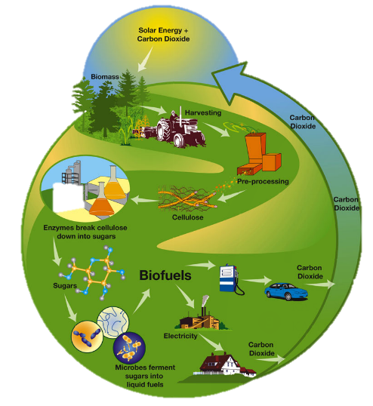
Bioeconomy-Bioenergy-Bioproducts Portfolio:
CRIS Classifications:
Non-Food
KA 511 Products & Processes
KA 512 Storing & Marketing
Notes:
As I mentioned before, classifications are used to report our Portfolios at NIFA. Using an Example, The Bioeconomy-Bioenergy-Bioproducts Portfolio only has two Knowledge Areas that apply to this topic, both are in the Non-Food category of the classifications, which only has these two Knowledge Areas. Any project assigning these KAs to the work performed, has the associated percentage for that classification set, used to weight the funding of the project applied to this Portfolio and these Knowledge Areas. But what does that mean?

Slide 12
Why Do Classifications Matter?
Knowledge Area (KA)
Topic Area: Food and non-food products: development, processing, quality, and delivery
KA 511 Non-Food Products & Processes
KA 512 Non-Food Storing & Marketing
Subject of Investigation (SOI)
SOI 2355 Perennial Grasses
Field of Science (FOS)
FOS 1080 Breeding
25% of Accession No. 1010000
Notes:
The classifications of our projects allow us to report by topic in a structured way. They also provide continuity so programs can be articulated over the long-term, allowing results to be captured over time to show how the topic moves forward in an area or field.
Continuing with our Bioenergy Example: When a project is entered into REEport…
Each of the Classification Sets that can be assigned on the Classification page of Project Initiations, are used to describe the work of a project. Each set includes a KA, SOI, FOS and the percent of the project going toward that aspect of the project. Up to 10 Classification Sets can be used to describe the work. But keep in mind that if you use different Knowledge Areas, you are breaking up how the funding will be reported.
In this example, the Information in Bold text is entered on one line in the REEport Project Initiation.
This information tells me that 25% of this project is dedicated to breeding Perennial Grasses for Bioenergy/Bioproducts Production.

Slide 13
What’s in a Word?
When CRIS Classifications Fall Short to Represent the Topic
Used to supplement searches for other topics not included in the CRIS Classifications including Crosscuts
Used to “tag” projects by NIFA Staff
Keywords or terms might include:
Bioenergy, “Renewable Resources”, Bioproducts, Coproducts, “Anaerobic Digest*”
Notes:
But what happens when the CRIS topics, Knowledge Areas, Subjects, or Fields fall short? For bioenergy, if people don’t use these KA’s then we must find the projects another way. We use Keywords to supplement classifications. Some of our staff depend on the keywords to quickly find their projects. For reporting, we try to use a combination of both. If I need tell Congress how much work we are funding about Stink bugs. We would use the pest management KA, but stink bug isn’t a subject. I would have to use insects, which is too general. I would use these classifications, but I also need to use the name of the insect in a keyword search too.
Can Anyone tell me Why I added quotes around these example Keywords or phrases that have more than one word?
if you search the Data Gateway for a phrase like these, you must enclose it in quotes or the results will return projects with both words occurring anywhere in the text fields searched. The difference between these two searches is over 1000 projects.
By default the term search box will add the joiner AND between each word of a two word phrase:
Renewable Resources = 1554 Projects, “Renewable Resources” = 545 Projects
If using the phrase in a series with other keywords, separated by a comma, it will place the AND joiner where the comma is.
i.e. Renewable Resources, Bioenergy = Renewable Resources AND Bioenergy =Renewable AND Resources AND Bioenergy= 506 projects
"Renewable Resources" AND Bioenergy = 121 Projects "Renewable Resources" OR Bioenergy = 2932 Projects
Renewable Resources = 1554 Projects, “Renewable Resources” = 545 Projects ; Bioenergy = 2,508 Projects If you add these up you get 3,053 projects.
Why the difference. Some of the projects result from both searches and are only counted once in the combined search.

Slide 14
How do we use Award Information?
Grant Management System:
Competitive Awards = NIFA Obligations to Recipient Institutions
Award Information includes: FYXX – FDCXX - XXXXX
Fiscal Year Awarded
Funding Information and Program Information using the Financial Data Code (FDC)
Classifications
Portfolios (Topic Areas)
Notes:
Next I would like to talk about the award number information. NIFA still reports grant funding by using the amount we award to each project.
Within the award number you can find the FY = Fiscal Year that the award was made, and the- FDC = Funding Data Code; This code has a description that includes the Program title information with the FDC number that is embedded in the award number.
To review: The Classifications determine the Portfolio projects fall under, and the subjects of investigation, with the Knowledge Areas are used to break out funding by topic.
Using these two elements and the award number information, I can isolate the projects for a topic in most programs at NIFA for example.
If you type in Bioenergy in the FDC filter search box, then you will see all the current and past programs that funded Bioenergy projects since 2002, the earliest data available in the Data Gateway. I can tell some of these details by looking at the FDC name and seeing that one FDC is integrated and another is FASE funding. These are AFRI FDCs. If I filter by Program Area first for AFRI, then search the Bioenergy FDC codes, I will only see 6 results in the FDC filter box. Representing the 5 AFRI programs for Bioenergy and 1st Bioproduct program after AFRI was created.

Slide 15
Summary of What We Do:
Classifications determine the Portfolio, which are used to measure the performance of our programs. Terms supplement classifications.
Objectives and Progress/Accomplishments/ Outcomes for evaluation of program success.
REEport Financial Reports are used to report Capacity funding and jobs
Other key fields also support success stories
Key project information can allow us to find associated projects by funding line or topic

Slide 16
Part III: Searching for projects in NIFA’s Data Gateway
Classifications put to work:
How NIFA, you, and the public can find progress reports of NIFA-funded research
nifa.usda.gov/data

Slide 17
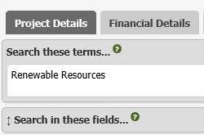
How Can You Search for Specific Projects?
*Accession Number: 1XXXXXX
Project Number: Your Number
Multistate Project Number
Award Number: 2016-33610-12345
Program Code: i.e. A3101
Expand the box to see pre-selected (default) search fields when entering terms
*Project Director:
(Last Name, First Name or initial)
nifa.usda.gov/data
Notes:
There are no grants.gov or proposal numbers in the Data Gateway for grants. This slide shows which are the numbers are available, but only the Accession number, which is still the award identifier used to track both grants and capacity funding, and the Project Director are selected when you open the Data Gateway to search. By default. If you search by these other numbers you must also select that field in the “Search in these fields box’ to match the number you use.
Our Program Staff tend to look at projects by program code, or project director for grants
When searching for a specific project, whatever number you use must be entered in the Search these terms…box. To search for more than one project by number, separate each one with “OR” to produce results that include any of the projects.
To exclude a project from the results use “NOT”.

Slide 18
How Can You Find Projects by Topic?
To find multiple projects at once (topics):
Use terms and “Search in these fields” boxes:
Initiation Reports: Keywords, Methods, Objectives, Non-Technical Summary, Project Title, or Recipient City Name for specific locations
Progress Reports: Accomplishments, Patent Title, Progress, Publications
To see all the projects that have Progress, Publications, Accomplishments, or Patent Titles - uncheck all the other fields in the “Search in these fields…” box.
Then refine your results by Filtering:
Sponsoring Agency, State, Recipient Institution, Years, Program
Area, Classifications, FDC, or Funding Source
nifa.usda.gov/data
Notes:
To find multiple projects at once, you can search a specific topic or term, and select which fields to search for the term in the “Search in these fields” boxes.
This slide lists some of the key fields and what report they come from.
You can select any of the fields in this box, and unselect the rest of the fields, to see all the projects with data for that field. That means I can select only patents, and all the projects reporting patents will be returned in my results. Then you can filter by your institution, year, program area, classification or other fields to see what is happening in a smaller subset of projects.

Slide 19
How To Use Filters to Find Projects?
Search Classifications for:
Overall Topics: Knowledge Areas
Subject: Subject of Investigation
Scientific Discipline: Field of Science
Narrow down projects by:
Sponsoring Agency, Financial Data Code (FDC), Project Status, Recipient Organization, and/or Recipient State
Look for grants by:
Initial Award Year, Award Amount Range or Program Area
Look for capacity projects by: Funding Source
Look for capacity and grant projects by:
Progress: Report Fiscal Year
You can now multi-select, and search within filters
Notes:
You can now multi-select filter values in the Data Gateway. Previously, you cold only choose one program, or one knowledge area at a time. Now you select more than one under each and every filter.
There are filters for all three types of classifications, and You can apply one or more values of each one, to filter your results.
You can do it quickly to select more than one at a time, or you can select them slowly allowing it to search as each selection is added, to watch the results change with each selection
Make sure all your selections shows up next to the Filters: line in the Search Box at the top of the page.
Grants have many fields that capacity projects don’t, such as the initial award year, Program Area, and Award Amounts. Capacity projects can be broken out by funding source, and for both kinds of projects, we can search by progress report.

Slide 20
Assisted Searching: Project Details
For searching using one or more Classifications, Program Areas, Projects, or a set of projects for a particular Program, State, Institution, or Topic
Search by Keyword or Phrase using ‘terms’ search box:
Enclose phrases in quotes i.e. “Climate Change”
Use AND, OR, NOT joiners between terms
Use * as a wildcard character
Includes Project Initiation and Progress fields under the “Show these fields in the results…” box.
You can now multi-select filter values, or start to type the value in the filter search box to select values under filters
nifa.usda.gov/data
Notes:
There are now three types of searches. The first one released was the Project Details. This mimics the old CRIS system’s, Assisted Search.
This is where I recommend most people search. It is the most developed page, and offers almost all the fields available in REEport.
It includes the Project Initiation and Progress report fields for the results output, so you can export a spreadsheet with the text of the project non-technical summaries of all the projects you select at once.
Now that this page includes multi-select functionality, and a search box for each filter, I am having trouble finding a reason to use the new Advanced Search.

Slide 21
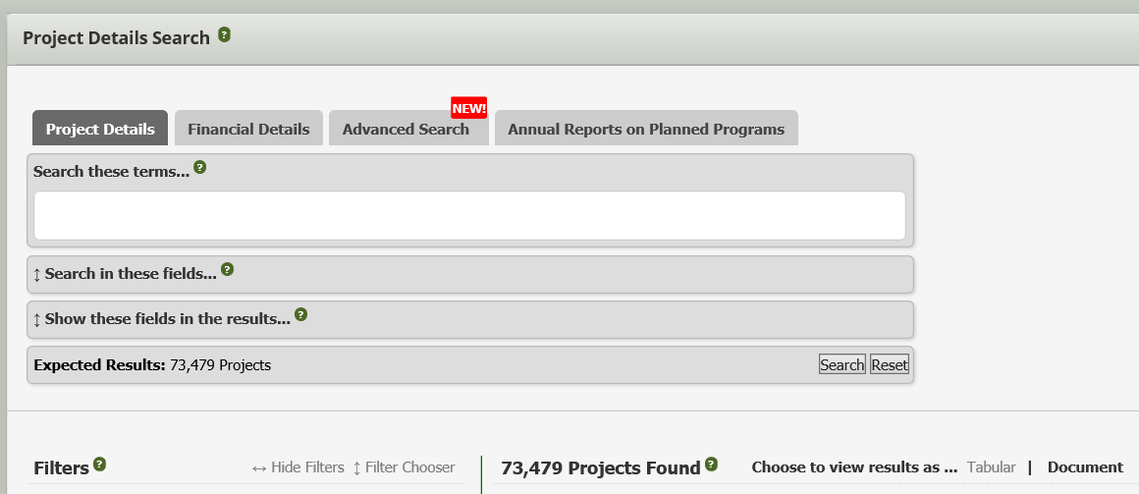
Two Ways to View Results:
Document View accommodates large text or multiple entry text fields in Progress Reports including the Progress Details fields and Project CRIS Classifications
Tabular View (Default) – similar to Financial Details
nifa.usda.gov/data
Notes:
One major new feature of the project details search are two potential views for the results. The Tabular view presents the information in a table, and does not fit the large text fields.
The Document view is the original view. You must use this view to see fields with a lot of text, like the Progress Details fields, or if the data element has multiple values such as the classifications, patents, or publications which can have more than one entry.

Slide 22
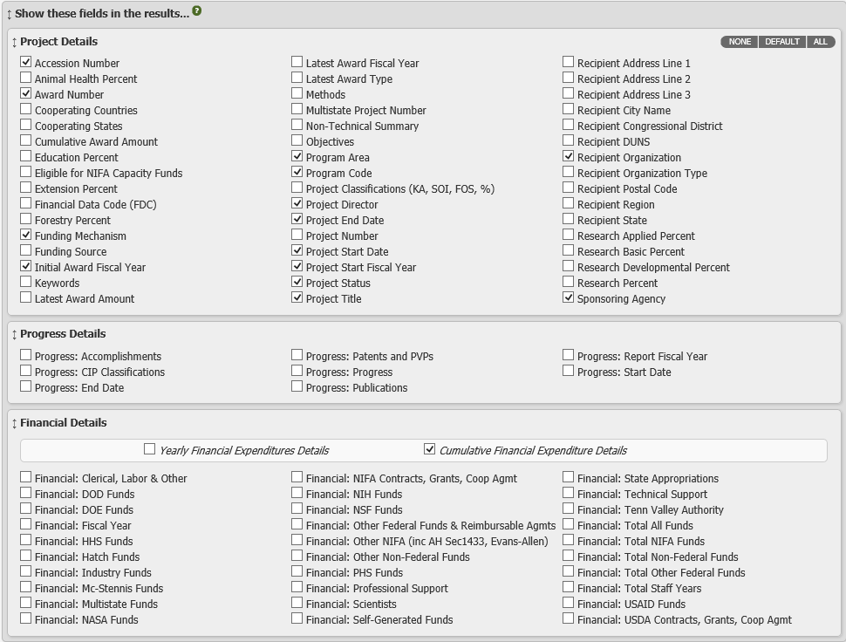
Notes:
There are so many results fields now, that I can’t fit it on a slide. Project Details has the ability to view virtually all the information you enter into REEport. If you ever have any questions please reach out to me for guidance.

Slide 23
When to Use Financial Details
The only source of funding information for Formula/Capacity projects, available for export.
When you only need information from the REEport Financial Report for the projects you are reporting on.
Can still search by project using all the same identifiers with the addition of Department.
Note that, in order to view funding in this search, weighted by Classification topics, you need to choose the Project Classifications field in the “Show these fields in the results…” box and click search.
nifa.usda.gov/data
Notes:
The nice thing about the Data Gateway is you can download the information into Excel, for your own Reports.
The financial details search is the only search that allows you to export funding right now. You can search by any of the project numbers I showed before, or by department.
Please be aware that you must go into the “show these fields in results” and select the Project Classifications field to see the project funding weighted by the Classification string (KA, SOI, FOS and Percentage). When you export fields like the Classifications with multiple values, it adds a new line to each project, for each item.
This increases the number of results accordingly. For the entire dataset in this search, the results increase from over 36,000 to more than 104,000.
The filters available include reporting Fiscal Year, Organization, Funding Source, State, Program Area, and by Classifications.

Slide 24
When to Use Advanced Search
Replaces the CRIS Professional Search
Best when using multiple values for multiple fields, ranges, or excluding specific values in a search.
Use for longer searchers where dependent or nested criteria are needed to isolate the projects you need.
These are the same fields as Project Details, but with additional search functionality.
See the Data Gateway Resource Page for a full list of data elements and the values available.
nifa.usda.gov/data
Notes:
The advanced search replaces our old CRIS system’s Professional Search tool.
This is used when creating a complicated search that might include ranges for fields, or nested conditions, within a search.
When using the Matching condition or the Missing condition, you need to know the data elements or fields, and the values you are searching for. To bring you this information and other resources, we created a new resources page connected to the Data Gateway.

Slide 25
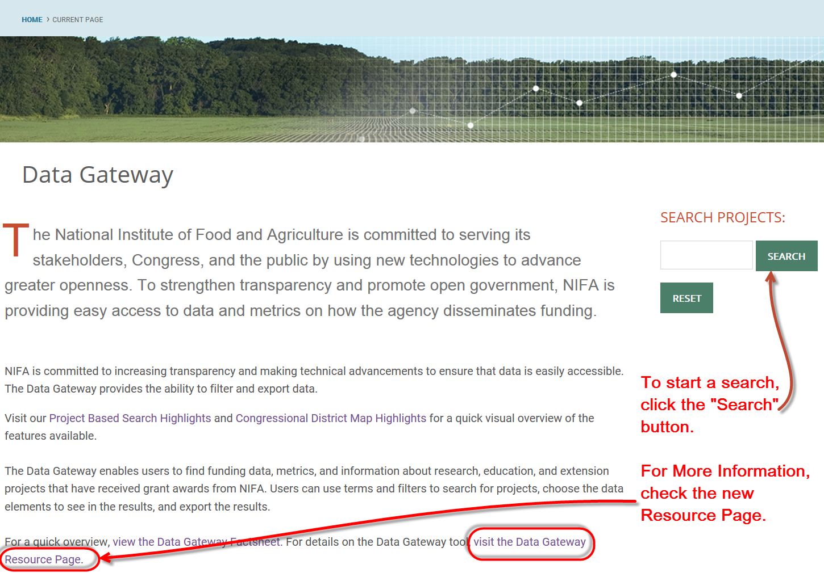

Slide 26
Part IV: What makes for a good progress report?
Tips on how to effectively write about planned and past project progress

Slide 27
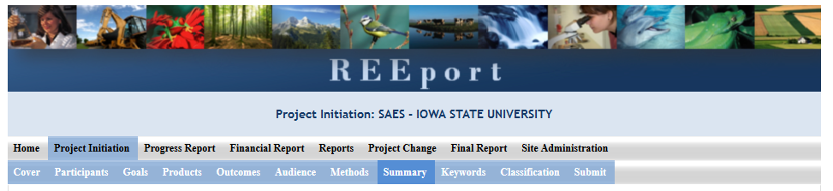
Project Initiation
REEport – Project Initiation
Notes:
Check: Specifically, when does this happen

Slide 28
Project Initiation
Goals
Goal: broad statement of your project’s purpose
Corresponding objectives: specific, measurable, attainable actions required for achieving goal
Methods
Efforts: experiments, analyses, focus groups, instruction, workshops, outreach
Evaluation: How will you assess whether your milestones and objectives have been met
Most of this information already exists in your project proposal
You will refer to these each year when you complete your progress report
Notes:
Goals – same as the goals under planned programs in the Plan of Work
Objectives: Use a numbered list (or paragraph)
For those of you who went to Lynn’s session on Monday, to be more precise here, you would know that this is actually performance measurement that we want: Instead of evaluation, think of it as performance measurement – what will you do to know that you’ve reached your goals

Slide 29
Project Initiation: Outcomes
In what ways do you anticipate your project will effect change?
Change in Knowledge:
Occurs when a participant (scientist, trainee, citizen, etc.) learns or becomes aware.
2) Change in Action:
Occurs when there is a change in behavior or the participants act upon what they have learned (adoption of techniques and methods or a change in practice).
3) Change in Condition:
Occurs when a societal condition is changed due to a participant's action.
Most of this information already exists in your project proposal
You will refer to these each year when you complete your progress report
Notes:
These also influence your outcome and impacts statements in the annual report

Slide 30
Project Initiation: Non-technical summary
Arguably the most important section of your report!!
This is your opportunity to clarify the importance of your project in non-technical terms that people without scientific backgrounds can understand
This is the part that will be accessed by legislators who make decisions about funding allocations, general public, community leaders, and taxpayers

Slide 31
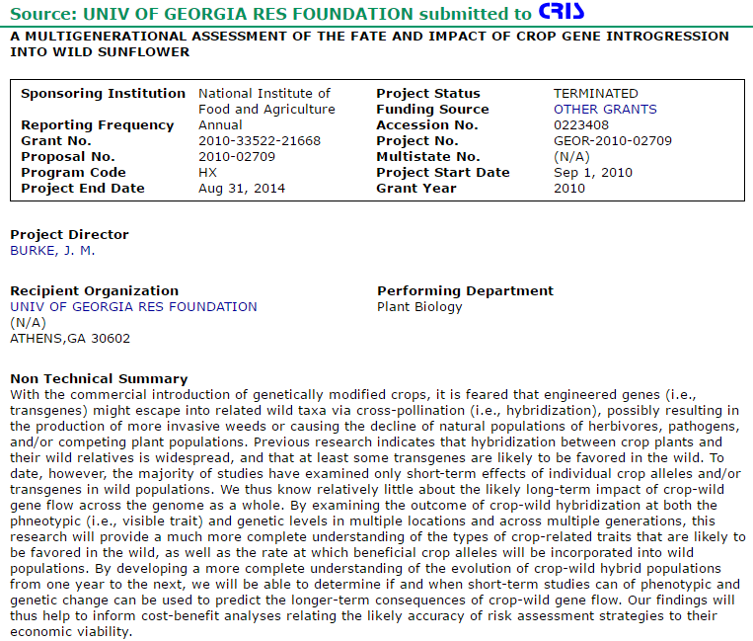
Non-technical summaries are prominently displayed at the top of your public-facing progress report
Notes:
But it appears at the top of your progress report, as it is displayed in REEport
(This should be different from your objectives list. Do NOT copy and paste the same text here.) ???l
This is what NIFA accesses to determine the outcomes of your projects
Significance statmenet – what is the project, why does it matter

Slide 32
Project Initiation: Non-technical summary
1) What is the context of your project?
What is the problem you are addressing and why does it matter? (Address the “so what?” of your work.)
2) How will you approach these issues?
Brief, non-technical description of your methods
3) What do you hope to accomplish through your work?
Anticipated outcomes/impacts
4) Why is this work important? How will your anticipated outcomes relate to the broader context?
How will your results affect the broad context of your project? (Consider your goals here.)
Notes:
This is equivalent to your
Plan of Work:
Brief summary under the plan overview about plan of work
Brief summary about each planned program
Somewhat -- Annual Report – executive summary

Slide 33
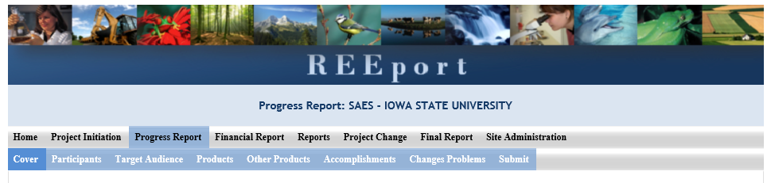
Progress Report
Notes:
Check: Specifically, when does this happen

Slide 34
Progress Report: Products
Publications
Patents and Plant Variety Protections
Notes:
Only include the publications from the most recent reporting period
These correspond to the “outputs” in your annual report

Slide 35
Progress Report: Other Products
Activities: datasets produced, analyses conducted, assessments
Events: conferences, workshops, trainings, symposia
Services: consulting, counseling, tutoring
Other products: multimedia, germplasm, software, maps, new techniques, students graduated
Don’t simply list – include context
What outputs did you generate to fulfill your objectives?
Notes:
Actions achieved to date

Slide 36
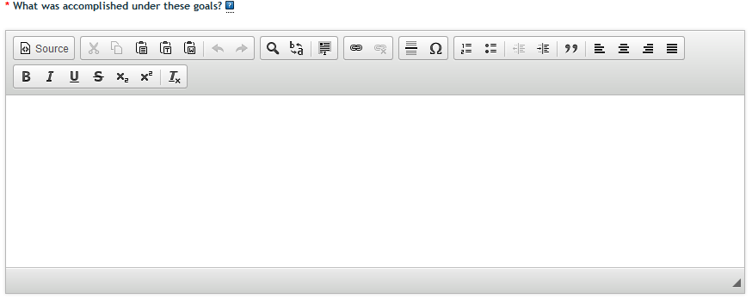
Progress Report: Accomplishments
This is where you describe your progress toward accomplishing your goals and anticipated outcomes
Ask yourself: What do your results suggest so far?
Notes:
To discuss with group: This is a simplification of what is in the help text. I think that the help text is redundant with the other sections.

Slide 37
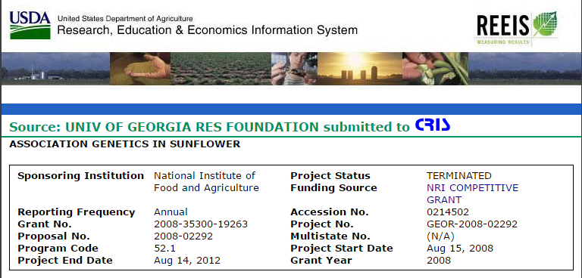
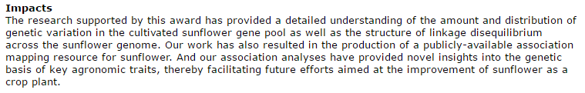
Accomplishments are publicly displayed as impacts
Notes:
These are displayed as impacts in via the Data Gateway to the public.
Often, when we talk about impact stories, this is what we’re referring to
Impacts – what is the broader public value of their work?

Slide 38
Progress Report: Accomplishments
Describe the general context of your work
-Restate the relevant portion of the context you described in your non-technical summary in the project initiation
-Restate the relevant goals
For each objective addressed in the given reporting year, describe
The work you conducted
General description of your methods (non-technical)
Results (with quantitative and qualitative indicators, as appropriate)
Realized and anticipated outcomes
What changes in knowledge, action, or behavior have you seen thus far?
Based on your results, what changes in knowledge, action, or behavior do you anticipate?
Issue
What’s been done
Results
Notes:
This is equivalent to the outcome or impact statements in your annual report
Use a numbered list
Consider how the field would differ in the absence of your work – what would the consequences be for whom if your results were to go away?

Slide 39
Helpful Hints
Write for the audience (Congress, NIFA)
Why is the project important to constituents?
What result do you want to achieve through communicating your impact?
Avoid:
Jargon
Acronyms
Passive voice
Notes:
These are just some guidelines to keep in mind while filling out the section of REEport that says, “What was accomplished under these goals?”
Remember, this is what is displayed as “impacts” on the outward facing website (slide 17)
Remember, in this section you will be describing the problem, methods/approaches, and realized results

Slide 40
Part V: How does NIFA tell your story?
Overview of NIFA’s communications efforts

Slide 41
 | Measurement | Communications
Purpose | Meet legislative requirements for data-driven decision making Demonstrate public value | Highlight the best examples Relate to public value
Products | Report against strategic and program goals Performance-based (outcome measures) Cost-Benefit analyses | NIFA Annual Report NIFA Website and Brochures “Impact” Statements
Qualities | Rigorous and comprehensive Independent and objective Meet standards of evidence Required | Anecdotal Biased due to self-selection Deliberate story-telling Feel-good human stories Requested
Methodology | Quantitative and Qualitative (mixed methods) Done over time with deliberate planning | Typically qualitative Done quickly (on demand)
Notes:
Change marketing: we’re not selling, we’re inorming
Add social media

Slide 42

NIFA’s outreach channels
Success stories in “Fresh from the Field”
Press releases
Graphical handouts
Social media
Annual reports
Budget justification
These are all available on the NIFA website and distributed via email distribution lists
bit.ly/NIFAsubscribe
Notes:
NIFA Update, social media, Congressional testimony
Change products to channels – travel packets, VIP data calls
Change the top to outreach
Press releases
Infographics
Explanatory notes (NIFA’s budget proposal or budget request – no, budget justificat), budget brochure

Slide 43
 | Measurement | Communications
Purpose | Meet legislative requirements for data-driven decision making Demonstrate public value | Highlight the best examples Relate to public value
Products | Report against strategic and program goals Performance-based (outcome measures) Cost-Benefit analyses | NIFA Annual Report NIFA Website, Brochures, and Social Media “Impact” Statements
Qualities | Rigorous and comprehensive Independent and objective Meet standards of evidence Required | Anecdotal Biased due to self-selection Deliberate story-telling Feel-good human stories Requested
Methodology | Quantitative and Qualitative (mixed methods) Done over time with deliberate planning | Typically qualitative Done quickly (on demand)

Slide 44
How does NIFA decide what to communicate?
Topics of Congressional interest
Examples: Citrus greening, precision ag
Major advancements in the field
Possess a “wow!” factor
Timely items within the scope of the news cycle
Examples: Food safety at Thanksgiving, Water or drought research on World Water Day, Veterans Stories on Veterans Day
Compelling stories of how NIFA-funded projects affect individuals’ lives
Projects with well-written progress reports are more likely to be communicated
bit.ly/NIFAsubscribe
Notes:
Not all projects make for sexy stories – but that’s okay
We want to be able to track your work so that we can discuss it, upon request
But, the more clearly you complete your progress reporting, the more likely we are to use your material
Tied to issues of public importance
Change marketed to communicated
NIFA-funded
Add: need to be easily understood – need to connect to the so what

Slide 45
Share Your Science at any time of the year!
What to communicate
Manuscript publication in a major journal
Photos, videos, press releases, other publicity of your work
Updates on major accomplishments
How to communicate it
Email your NPL directly
Email ImpactStories@nifa.usda.gov
Twitter: @USDA_NIFA #NIFAimpacts
Seek assistance from your university’s public affairs office
Notes:
Other ways/opportunities to share your research
Let your NPL know when your manuscript has been accepted(check, vs. submitted) – we can promote
Impactstories – press releases, photos, heads up about things
#NIFAimpacts – some comments on tweeting about your work
Add: we’ll tak eanything – photo, newspaper, video
They’re awards and what they’re attempting to achieve

Slide 46


Notes:
Overview of Share Your Science

Slide 47
Take-home messages
We really do read and use your progress reports!
Your progress reports are publicly displayed
Accurate, high-quality reporting affects our ability to measure the impact of our programs and show the societal value of our programs to legislators
Notes:
These are just some guidelines to keep in mind while filling out the section of REEport that says, “What was accomplished under these goals?”
Remember, this is what is displayed as “impacts” on the outward facing website (slide 17)
Remember, in this section you will be describing the problem, methods/approaches, and realized results

