Slide 1
Rowlett Creek Watershed Characterization Project Stakeholder Meeting #4
Thursday July 28th, 2022

Slide 2
Agenda
11:00 Welcome/Introductions
11:10 Rowlett Creek Characterization project update
11:40 Discussion & Next Steps
12:00 Adjourn
Notes:
Sign in sheet https://docs.google.com/spreadsheets/d/1m3W-K-7M6NLZXK1Xlq5unvLSHiKxhifLaee9i3Vcv8A/edit?usp=sharing

Slide 3
https://agrilife.org/lid/rowlett-creek-watershed-characterization

Slide 4
Funding Sources
Funding provided by the Texas Commission on Environmental Quality through a Clean Water Act Section 319(h) grant from the U.S. Environmental Protection Agency, with local match funding from Texas A&M AgriLife Extension, Southern Methodist University and the City of Plano

Slide 5
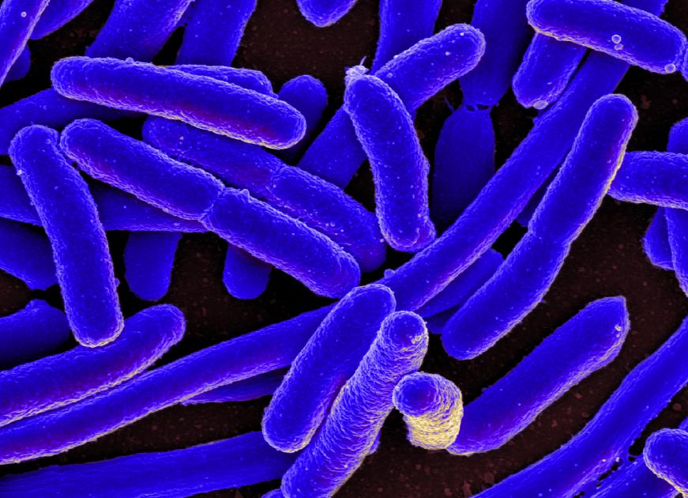
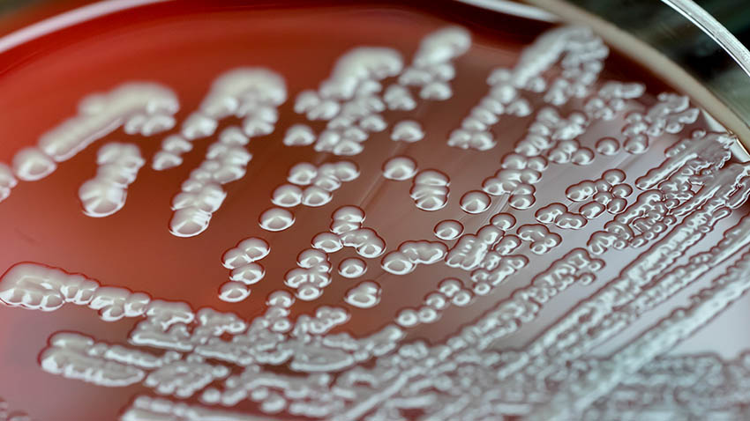
Rowlett Creek Water Quality
Rowlett Creek was placed on the 2014 Texas Integrated Report -303(d) List (IR) for bacteria and is still currently listed in the 2020 IR.
Rowlett Creek was also listed on the 2014 Texas IR for Water Bodies with Concerns for Use Attainment and Screening Levels as having a concern for nitrate and is still currently listed in the 2020 IR.

Slide 6
Using Load Duration Curves for Data Analysis

Slide 7
What Are We Currently Measuring?
Loadings
Collect flow and water quality samples
Parameter concentration x flow = Loading
What parameters are we testing:
Bacteria (E. coli)
Total Suspended Solids (TSS)
Nitrate/Nitrite Nitrogen
Total Kjeldahl Nitrogen
Ammonia Nitrogen
Total Phosphorus

Slide 8
What Will the Data Tell Us
Establishes baseline knowledge
Monitoring results can show changes over time
Are there any trends?
Does the time of year matter?
Data can show potential areas of concern
Is land use a major factor?
Are parameters highest in a particular tributary?
OR...is something else entirely different going on that we haven’t considered?

Slide 9
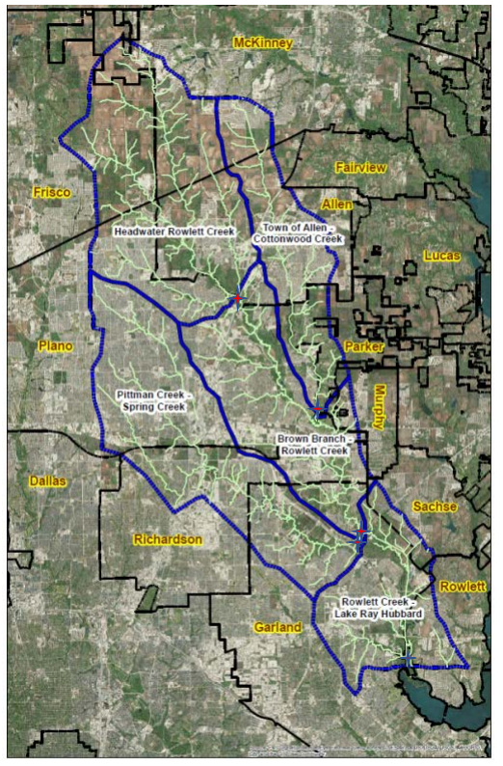
How Will We Use the Data?
To Promote group discussion and provide basis for informed decisions
To calculate Load duration curves
Ultimately, use information to make decision for integration in the WPP

Slide 10
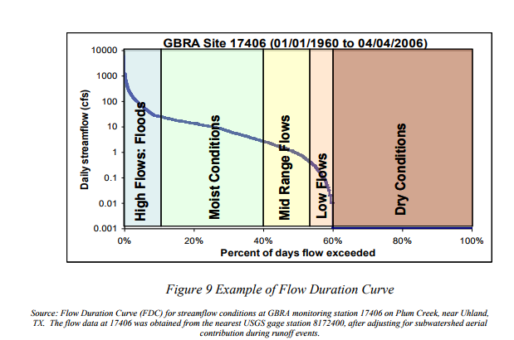
Load Duration Curves (LDCs)
LDCs use the collected field data to quantify pollutant loads
Parameter concentration x Flow = Loading
LDC graphs are useful for interpreting gaps between allowable vs. actual loads
Gaps represent the pollutant load reduction needed to reach the water quality goals of the WPP

Slide 11
Load Duration Curves (LDCs)
Load Duration Curves for Sites 1 and 5 have already been developed
LDCs for Sites 2, 3, and 4 are in progress

Slide 12
Proposed Steering Committee Members
Contributing Partners
City #1 :Keith White (Plano)
City #2 : Wade Williams (Murphy)
City #3: Sean Aucoin (Frisco)
City #4: Jessica Staggs (Dallas)
Counties
Collin
Dallas: Nathan Davidson
Water Authority
NTMWD: David Cowan
Education
Collin College: Kenny Neal
Plano ISD: Mark Yoder
Private Owners/Residents
Rep #1: Mikel Wilkins
Rep #2: Pete McKone
Rep #3
Rep #4
Local Agencies
SWCD Rep: Rick Foster
AgriLife Extension Agents: Brad Voss; Chase Brooks
TPWD: Adam Whisenant
Industry/Businesses
Rep #1: Mayra Lopez (Raba Kistner)
Rep #2
NGOs
Jordan Bach (North Texas paddling)

Slide 13
Upcoming Calendar
Texas Watershed Stewards Workshop (July 28th 1-4 PM)
Steering Committee Meeting (TBD September)
Stakeholder Meeting # 5 (September 28th from 2-4 PM)

Slide 14
Questions, Discussion

Slide 15
Fouad H. Jaber, PhD, PE
Professor and Extension Specialist
Biological and Agricultural Engineering
Texas A&M AgriLife Extension
Dallas Research and Extension Center
f-jaber@tamu.edu
972-952-9672
Therese Mehta, MSc., PE
Watershed Coordinator
Biological and Agricultural Engineering
Texas A&M AgriLife Extension
Dallas Research and Extension Center
Therese.Mehta@ag.tamu.edu
www.facebook.com/agrilifeecoeng/

