Slide 1
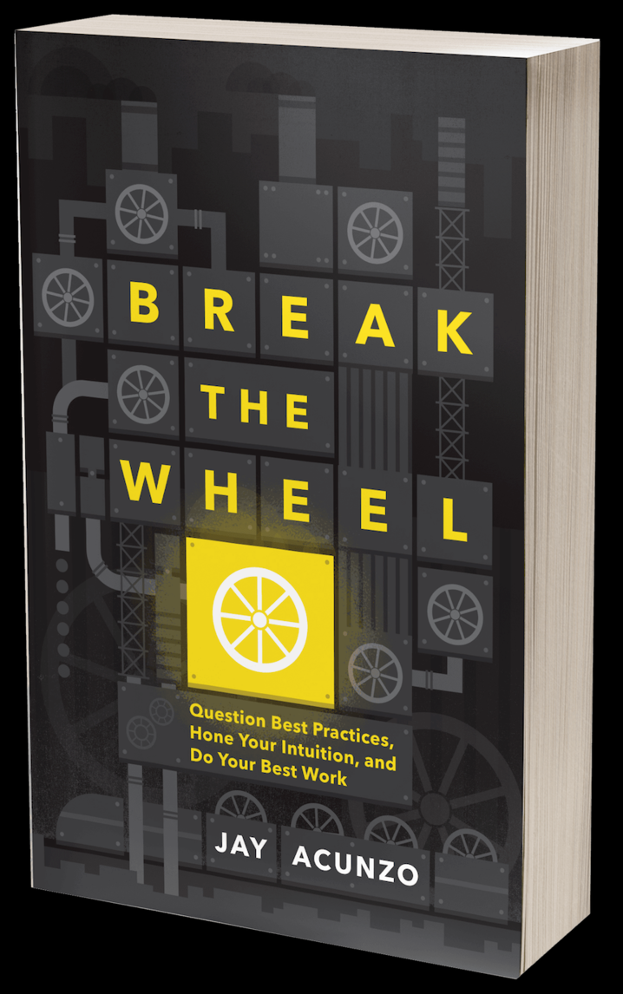
Break the Wheel:
Question Best Practices, Hone Your Intuition, and Do Your Best Work
By Jay Acunzo

Slide 2
Break the Wheel: Question Best Practices, Hone Your Intuition, and Do Your Best Work - Jay Acunzo
Assess why ‘Best Practices’ are the worst advice
Basically encourages ‘Thinking Outside the Box’
The world is full of "best practices"
Advice, ideas, experts
Institutional traditions
Metrics & deliverables
“…we are trapped in the endless cycle of stale approaches and trendy tactics that holds us back.”

Slide 3
Break the Wheel: Question Best Practices, Hone Your Intuition, and Do Your Best Work - Jay Acunzo
What/who truly matters?
Decisions should be guided by realistic assessments of what truly matters.
Often forgotten/ignored but the audience (customer, stake holders….) should be central in any decision-making process.
Sledgehammer approach: (Julie/Allen)
Question every prescribed best practice and use Six fundamental, situational questions to guide decision-making processes

Slide 4
Similarities with Patrick Lencioni's: The Advantage: Why Organizational Health Trumps Everything Else in Business
Why do we exist?
How do we behave?
What do we do?
How will we succeed?
What is most important, right now?
Who must do what?

Slide 5
Piece of your context | Trigger Question Spark your curiosity to begin your investigation | Confirmation Question Identify clues to ensure your on the right path
You The person or people doing the work | What is your aspirational anchor? A declaration of how you’ll make a difference in your life an others (worlds strongest coffee) | What is your unfair advantage? Being you and what makes you stand out
Your Audience The person or people receiving the work | What is your first principle insight? Understand the needs of your audience | Who are your true believers? Focus on them and create a snowball effect
Your Resources The means to make the work happen | What are your constraints? What are the boundaries of the world we work in? | How might you expand? How can we maximize impact and move beyond even with these constraints

