Slide 1
The Truth About Leadership
James M. Kouzes Barry Z. Posner
Steve Hague, Melanie Karns, Lee Tarpley

Slide 2
Ten Truths About Leadership
You make a difference
Credibility is the foundation of leadership
Values drive commitment
Focusing on the future sets leaders apart
You can’t do it alone
Trust Rules
Challenge is the crucible for greatness
You either lead by example or you don’t lead at all
The best leaders are the best learners
Leadership is an affair of the heart

Slide 3
Credibility is the Foundation of Leadership
Truth Two

Slide 4
Focusing on the Future Sets Leaders Apart
Leaders look long-term
You have to spend more time in the future
Insight: Explore your past experience
Outsight: Imagine the possibilities
Foresight: Be optimistic
Truth Four

Slide 5
Focusing on the Future Sets Leaders Apart

Slide 6
McDonaldization
McDonaldization is a term developed by sociologist George Ritzer in his book The McDonaldization of Society.
McDonaldization becomes manifested when a society adopts the characteristics of a fast-food restaurant.
The process of McDonaldization can be summarized as the way in which "the principles of the fast-food restaurant are coming to dominate more and more sectors of American society as well as of the rest of the world."

Slide 7
Education
Efficiency - Computer graded exams limit the amount of time necessary for instructors to grade their students.
Calculability - Letter Grades and Grade Point Averages are used and calculated to measure a student’s success over the course of their academic career.
Predictability - Course availability and requirements have become more standardized amongst universities. Making it easier to find similar courses and content at different locations.
Control - Courses are structured very specifically and must meet certain requirements and follow certain guidelines. Courses begin and end at the same time on the same predetermined days and last for a specific number of weeks.
McDonaldization
Notes:
Focused on efficiency of transfer control

Slide 8
Focusing on the Future Sets Leaders Apart
Do we see this creeping into AgriLife services?
The promotion and tenure process?
What are the pros and cons of this approach?
McDonaldization
Notes:
https://en.wikipedia.org/wiki/McDonaldization

Slide 9
Challenge is the Crucible for Greatness
Truth Seven
Write Down Three Historical Leaders

Slide 10
Challenge is the Crucible for Greatness
Truth Seven
Why did you choose these leaders?
What was the common thread?
Notes:
Challenges will either make or break leaders.

Slide 11
Challenge is the Crucible for Greatness
When people think of leaders, they associate them with a great challenge
Truth Seven
Fear
Uncertainty
Opportunities described as challenges

Slide 12
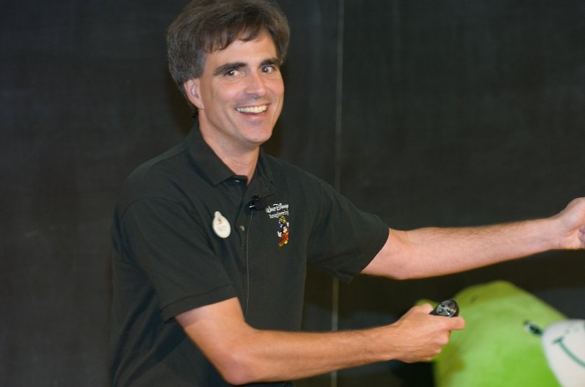
Challenge is the Crucible for Greatness
Brick Walls Test Commitment
Truth Seven
Challenges cause you to come face-to-face with yourself
Randy Pausch – Carnegie Mellon University
‘Last Lecture’ - 2007
“The brick walls are there for a reason. They’re not there to keep us out. The brick walls are there to give us a chance to show how badly we want something.”
- Randy Pausch

Slide 13
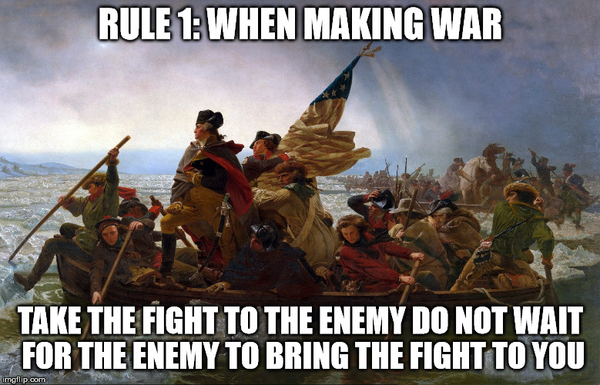
Challenge is the Crucible for Greatness
Strengthen Resilience
Truth Seven
Embrace the challenge – thrive under adversity
Control what you can
Be proactive

Slide 14
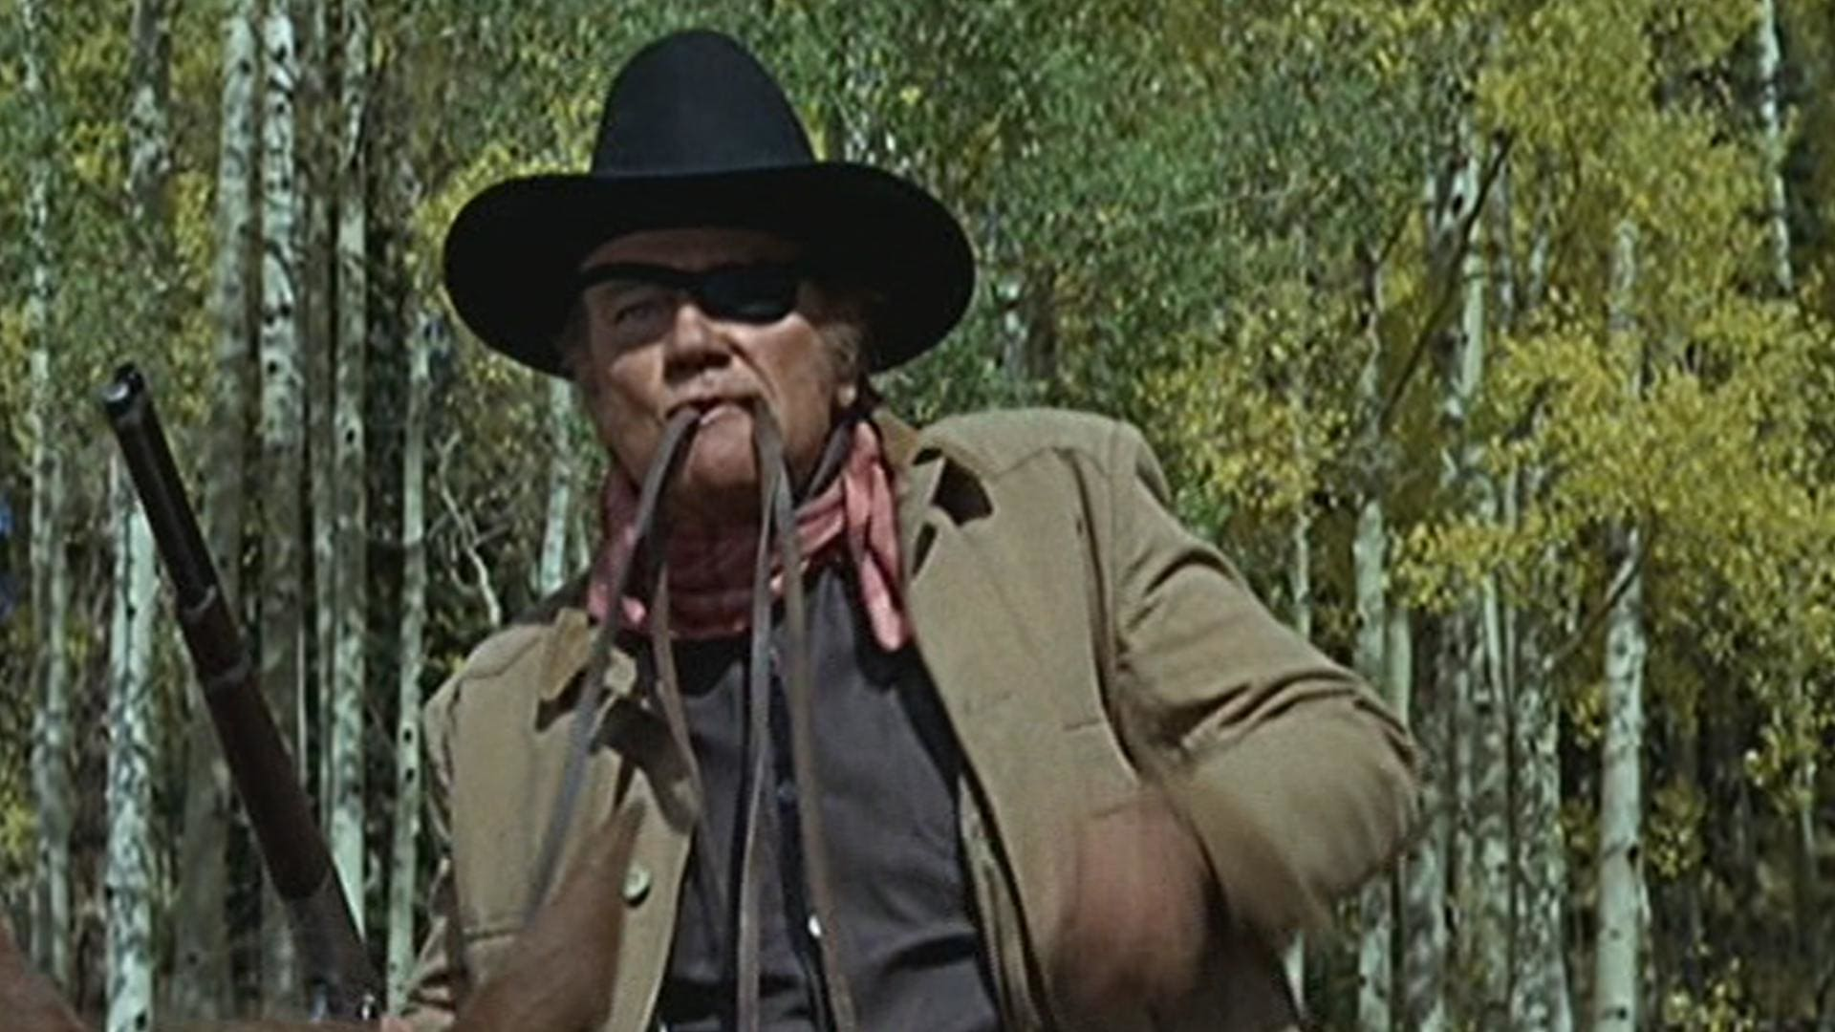
Challenge is the Crucible for Greatness
Get Gritty
Truth Seven
Avoid distractions and complete the task
Grit: perseverance and passion for long-term goals
Spelling Bee champs & West Point Cadets
Find a goal that sustains your focus
Positive self-talk

Slide 15
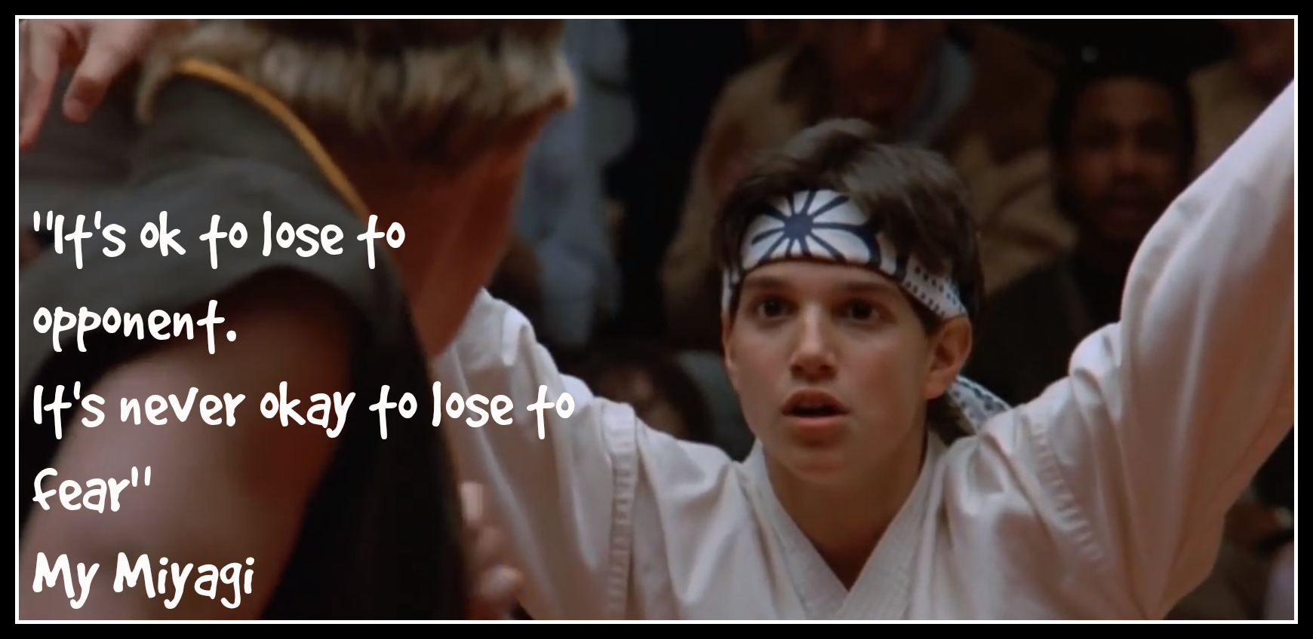
Challenge is the Crucible for Greatness
Failing is Learning
Truth Seven
Failure is inevitable
See failure as a learning opportunity
If you are not failing, you are not learning

Slide 16
You Either Lead by Example or You Don’t Lead at All
Seeing is believing
“Leaders have only two tools at their disposal: what they say and how they act. What they say might be interesting, but how they act is always crucial.”
-- Alan Deutschman
Truth Eight

Slide 17
You Either Lead by Example or You Don’t Lead at All
Leaders go first
“It can to me that if I wanted everyone else to be committed, then I had to be totally 100 percent, without doubt, committed personally”
-- Mary Godwin (in the book)
Truth Eight

Slide 18
You Either Lead by Example or You Don’t Lead at All
Admit your mistakes
On the Leadership Practices Inventory:
‘. . . the statement on which leaders consistently score the lowest is
“asks for feedback on how my actions affect other people’s performance.” ‘
Truth Eight

Slide 19
You Either Lead by Example or You Don’t Lead at All
What are ways in which the TAMU System could lead by example to improve effectiveness and address its core mission?
Truth Eight
Notes:
Print one per person: Don’t Waste Your Time On A Few Bad Apples - https://leaderonomics.com/business/dont-waste-your-time-on-a-few-rotten-apples
(Open discussion)

Slide 21
Credibility is the Foundation of Leadership
Results from Kouzes and Posner
Truth Two

