Slide 1
Adding Files to a Teams Folder

Slide 2
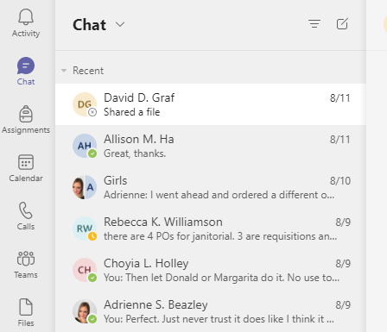
First go to the Teams

Slide 3
If you are a member of more than one Teams at the top you can pick All Teams

Slide 4
Pick the correct Team you are needing.

Slide 5
This should get you to the correct location to submit your monthly reports.
Click on Files
Then appropriate file folder
Then you can upload – file and choose the proper file or just drag and drop into the folder.

Slide 6
Naming your Monthly report
Please use the below format to name your monthly report
YR-MO MR Last name, First Name
2021-06 MR Smith, John

Slide 7
Sync Your Teams to your Computer
You can Sync your Teams folder to your computer, so you do not have to go into Teams to upload your files. This is just like you can add files to OneDrive
When you are in Teams click on Files and you will then be able to see Sync.
Just click on it and it will move an icon to your side navigation bar.

Slide 8
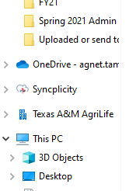
Sync Your Teams to your Computer (Cont.)
This is the symbol for Teams that it added to your navigation bar.
Just click on it like you would in OneDrive
Once you get to the correct folder you can drag and drop your files
Or you can just save directly to this folder.

