Slide 1
4-H Consumer 101
Presented and Lead by:
Micah Holcombe
County Extension Agent- 4-H & Youth Development

Slide 2
4-H Consumer 101 Session
How to write a scenario
Product Selection
Putting the class together
Age Groups
Practice
Judging classes/Coaching consumer
Reasons

Slide 3
Items in scenario
Name of person
Wants
Needs
Dislikes or “must not have” items- optional
Price Limit- optional
Concluding statement or question

Slide 4
Example
Name
Tricia wants to buy a photo frame for her dorm room. She wants a lot of internal memory and a frame that is small for her desk. She does not want music on the frame. Please help her find the best photo frame.
Wants/Needs
Does not want
Concluding Statement

Slide 5
Do Not’s for Scenarios
Do Not:
Add too much information- especially for jr/int
Include information they already know or should know- (information from study guide)
Be too specific
Include a price limit if there is not need for it

Slide 6
Bad Example #1
Ed likes to camp, swim, and go on adventures in the summer. He also likes to go hiking up the mountains in Colorado. Ed is very sensitive to the sun and needs a sunscreen to help protect him while hiking. Ed also needs a sunscreen that is waterproof while he goes swimming. Help him find the best sunscreen while he camps, swims, and does summer activities.
TOO MUCH
INFORMATION

Slide 7
Bad Example #2
Ed likes to camp, swim, and go on adventures in the summer. Ed is very sensitive to the sun and needs a sunscreen that is PABA Free. Ed also needs a sunscreen that is waterproof while he goes swimming. He has heard that SPF 30 is the best sunscreen. Help him find the best sunscreen.
INFO ALREADY KNOWN
TOO SPECIFIC

Slide 8
Finding Products
Ways to find products:
Internet
Store- buy products
Make them Up
Do Not:
Take pictures of items and expect them to see the item on the picture
When making up products make it realistic as possible

Slide 9
Tips when finding products and making classes
When buying products, make sure the product has all the information needed for scenario and it is easy to read.
Have plenty of products for all participants to see and look at during the 7 minutes.
Try to keep all the information on one page if possible (with all 4 products on 1 pg)
Use tables to help you put the products in an easy-to-read format

Slide 10
Writing Scenarios and Classes for Different Ages
Jr/Int:
Do not make the scenarios long.
Limit Product Information
Give enough information for them to place but not too much information.
Sr.
Do not give them too much information
Give them some challenging information-really make them use the knowledge they have to place the class.
When doing a reasons classes, make the class have a lot information for them to compare and make reasons.

Slide 11
Putting the Class together
Make sure your scenario and products match
Scenario needs to have the essential items but not too much
Products need to be easy to read and not too much information

Slide 12
Activity
Divide into groups of 5
Make a scenario with the products provided
You may change your product information given.
You may also make up your own project information if you would like.
Classes will be posted on the web later for you to use with your 4-H groups.

Slide 13
Judging and Coaching
Go through study guide provided by state.
Come up with key points from each class an make a short study sheet for the consumers (have them help).
Go over the study sheet after each class.
Hold a project meeting for 1-2 classes each week until you have covered them all.

Slide 14
Judging and Coaching Cont’d
Have the experienced members especially seniors teach the classes and make scenarios (classes and scenarios turned in the day or week before so you can look at them)
Have intermediates and seniors do reasons each week.
The member who teaches will help judge reasons.

Slide 15
Coaching Basics
Teach your 4-H members how to read a scenario.
Start the juniors/intermediates or first time participants to underline or highlight the major parts of the scenario
Then do the same with the information in the products.
Teach them a method for taking notes.

Slide 16
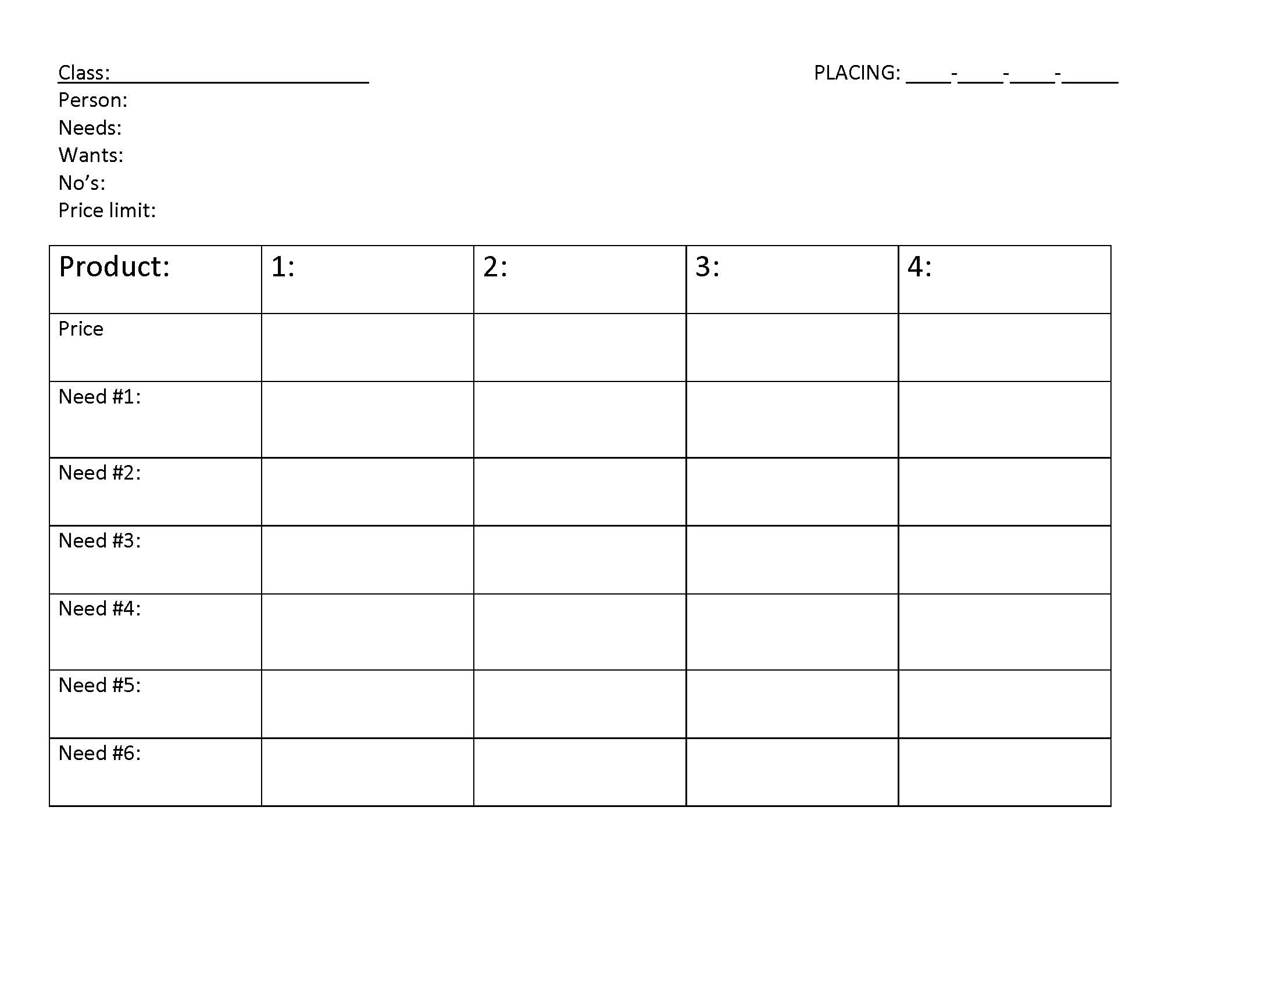
Note Taking Example

Slide 17
Coaching Reasons
You have ONLY 2 MINUTES to complete your reasons! Try to do it without notes!
Introduction:
Are the judges ready? Wait for response
I placed this class of ________________(nutritious snacks) 4-2-3-1
Thoughts:
I thought this class was….
Ex. An easy class with a definite top pair and a definite bottom pair.
Ex. Difficult class with an easy top pair and bottom pair and a difficult middle pair.

Slide 18
Coaching Reasons
Scenario:
Explain the scenario. Name major points or items you would looking for in the scenario.
Example Scenario: Kelly needs to buy a nutritious snack for her little sister. She has $10 to spend. Please help her find a snack that is low in sugar, has whole grains, and is overall nutritious.
What you should say: In this scenario, Kelly needs to buy a nutritious snack for your sister. She has $10 and she needs a snack low in sugar and whole grains.
(Make sure you talk about the items needed in the scenario and make sure you talk about them in the placing reasons.)

Slide 19
Coaching Reasons
When placing Use Pairs: Placing 1-2-3-4
Top pair: 1-2
Middle Pair: 2-3
Bottom Pair: 3-4
When talking about pairs in reasons, you will talk really about only one product:
Top pair: 1-2 (Talk about why 1 is the best)
Middle Pair: 2-3 (Talk about why 2 is better than 3)
Bottom Pair: 3-4 (Talk about why 3 is better than 4)
Last: 4 (Talk about why 4 is last)
The product you placed 1st is always good!
The product you placed last is always bad!

Slide 20
Coaching Reasons
Placings:
In my top pair…I placed 4 over 2 because
(4 is always good nothing bad)
In my middle pair…I placed 2 over 3 because
(add a criticism and a grant) Example: I criticize that 2 does not have whole grains but grant that it is lower in sugar than 3.
In my bottom pair….I placed 3 over 1
(add a criticism and a grant)
I placed ____ (1) last because
(The last is always bad nothing good)

Slide 21
Coaching Reasons
Grants and Criticisms:
Use grants and criticisms at least once in your reasons.
Grants and criticisms should be used in your middle products only (Example like above: 2 and 3).
If you criticize you MUST grant
Try to always criticize than grant. Negative followed by positive
If you use the word “but” in your reasons, you probably could have used a grant and criticism

Slide 22
Coaching Reasons
Conclusion:
Therefore I placed this class of ___________________(nutritious snacks) 4-2-3-1

Slide 23
Reasons Tips
Try to also use transitions such as:
• Next
• Finally
Use words like:
Grant
Criticize
Less/More expensive
Pairs
Do not use words like:
Cheap
Cheaper
Cheapest
Better overall
Like, um, and

Slide 24
Thank you so much!
If you have any questions, you can email me at: mlholcombe@ag.tamu.edu
Or check the Bell County 4-H Website Consumer Page: http://agrilife.org/bell4h/projects/consumerproject/

