Slide 1



Biosecurity for
Dairy Farm Workers
Ellen Jordan, PhD; Ralph Bruno, DVM, MS; Juan A. Hernandez-Rivera, PhD; and Kevin Lager, MS-
Texas AgriLife Extension Service
Mireille Chahine, PhD – University of Idaho
Robert Hagevoort, PhD – New Mexico State University
The entities involved in the development of this material do not support one product over another and any mention herein is meant as an example, not an endorsement.
Notes:
Dairy farm workers provide the first line of defense in keeping dairy cows healthy and content. An important part of those efforts is biosecurity. Biosecurity is traditionally defined as managing the herd to prevent the introduction and spread of infectious diseases.

Slide 2
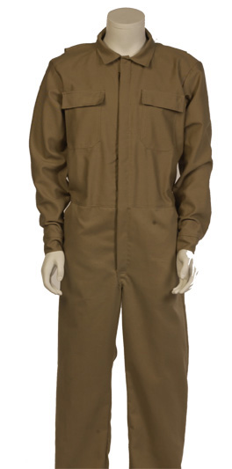
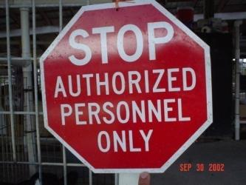
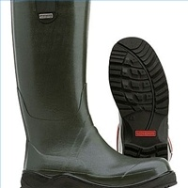
What Is Biosecurity?
The steps taken to prevent infectious diseases from affecting a herd of animals and the people who care for them
Notes:
Biosecurity includes all of the steps taken to prevent infectious diseases from affecting a herd of animals and the people who care for them.

Slide 3
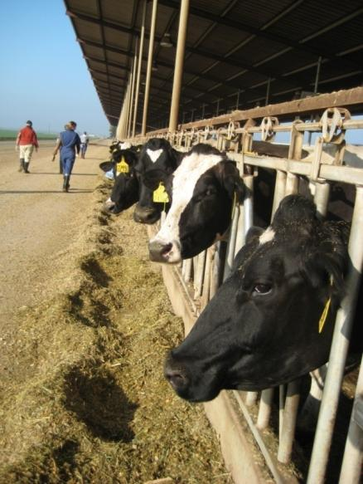
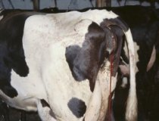
Goals for Biosecurity
Prevent spread of diseases
Improve animal welfare
Identify disease early
Protect the food supply
Notes:
There are four basic goals for any farm’s biosecurity program:
1) Prevent the spread of disease, both onto the farm and between animals on the farm,
2) Improve animal welfare by keeping the animals healthy,
3) Identify the disease early if it gets on the farm, and
4) Protect the safety of the food supply.

Slide 4
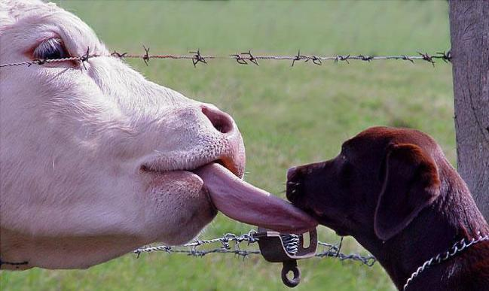
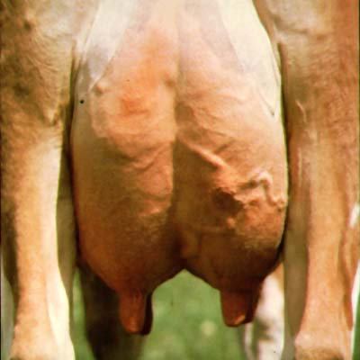
How Does Disease Spread?
Directly
  Animal to animal
Indirectly
  Contact with equipment or objects contaminated with a disease-causing organism
Notes:
To accomplish these goals you must understand how diseases spread. Diseases spread both directly and indirectly. Direct transfer occurs when the disease passes from one animal to another. Indirect transfer happens when some type of equipment or other object, contaminated with the disease-causing organism, carries the disease to an animal.

Slide 5
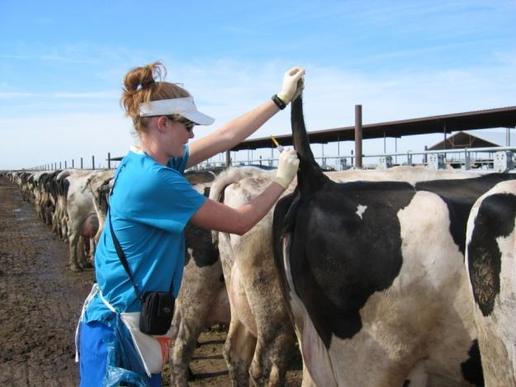
Examples of Disease Carrying Objects
Boots
Coveralls
Needles/syringes
Obstetrical chains
Skid steers
Tractors and loaders
Notes:
Some examples of disease carrying objects include: boots, coveralls, needles, syringes, obstetrical chains, skid steers, tractors, and loaders.

Slide 6
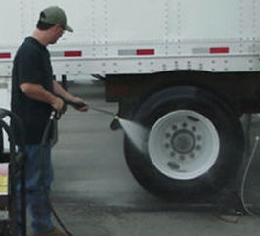
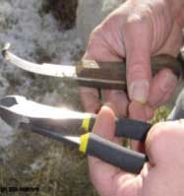
Your Role … Prevent the Spread of Disease
Clean Equipment
  Truck
  Farm equipment
  Veterinary supplies
  Hoof trimming tools
  Clothes
  Boots
Notes:
Your Role … Prevent the Spread of Disease
Keep all equipment clean to prevent the spread of disease. This means not only the trucks, tractors, veterinary tools, etc. on the farm, but also your own boots and clothes.
Think about the many vehicles that go in and out of dairies daily. They can carry disease from farm-to-farm if not cleaned between deliveries. Help enforce farm rules that restrict access to certain areas to reduce the risk. Farm equipment, such as skid steers and loaders, tracks manure from site-to-site on the farm.

Slide 7
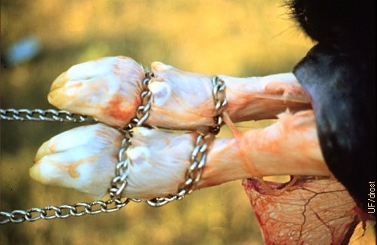
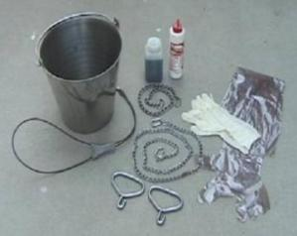
Clean Tools
Scrub ALL tools between cows/farms
AFTER tools are clean, disinfect them
If residual dirt left on tools, it can cause disinfectant to be ineffective
Notes:
Also, sanitize small equipment such as bolus guns, hoof trimming tools, and calving chains between animals. Start by scrubbing all the tools with a brush. Once they are clean of dirt and debris, disinfect them. Residual dirt left on tools can cause disinfectants to be ineffective.

Slide 8
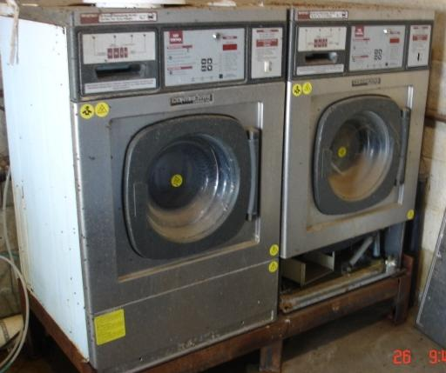
Always Have Clean Clothes
Make sure you have clean clothes for each farm
Use the hottest temperature possible
Tumble dry
Laundromat photo
Notes:
Wear clean clothes to work each day. If you work at more than one farm, make sure you have clean clothes for each farm. When washing your clothes, use the hottest temperature possible. Tumble dry.

Slide 9
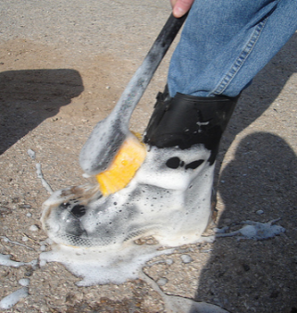
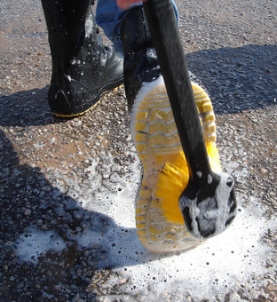
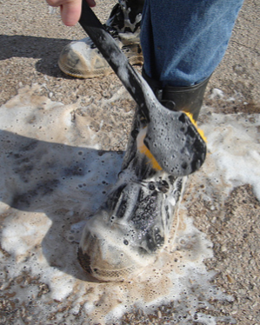
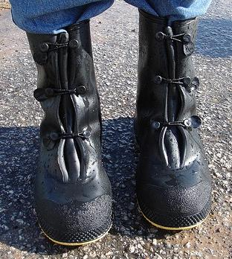
Boots
Make sure there is NO dirt on boots
Disinfect between pens (particularly after working in sick pen)
Try to work with youngest animals first
Wash your boots before you leave the farm
Notes:
Make sure there is NO dirt on boots. Disinfect your boots between pens, particularly after working in a “sick” pen. Work with youngest animals first as they are most susceptible to disease. To keep from taking some disease organism off the farm, always wash your boots before you leave the farm. Better yet, leave your boots at the farm and wear different shoes home. Don’t use the same boots at home that you wear at work.

Slide 10
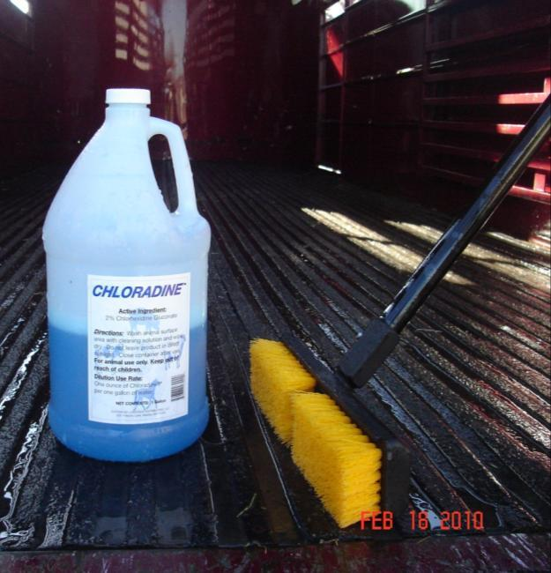
Some Common Disinfectants
Nolvasan solution
Household bleach
  1 part bleach:10 parts water
Chlorhexidine
Notes:
Some common disinfectants include Nolvasan solution, household bleach (1 part bleach:10 parts water), and chlorhexidine. Follow directions from your herd manager or veterinarian when mixing the disinfectant.

Slide 11
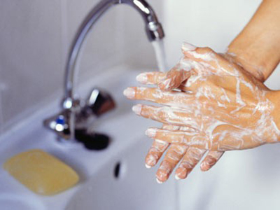
Wash Your
Hands Frequently
Before you go to a farm
Before you eat
After you finish at a farm
20 seconds
Notes:
To protect yourself and the animals, wash your hands frequently. This means before you start work, before you eat, before treating an animal, and after you finish work. It takes at least 20 seconds to properly wash your hands.

Slide 12
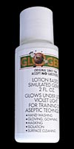
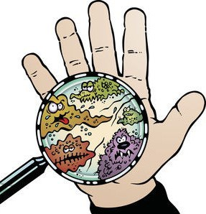
Hand Washing
Six Steps
Glo Germ™ Simulates
“Germs”
Wet Hands
Soap
Wash for 20 seconds
Rinse
Dry
Turn off faucet with paper towel
Notes:
There are really six different steps to properly washing your hands. First, you wet your hands. Next you add soap. Then you wash your hands thoroughly making sure you get the palm, heel of the hand, finger tips and back of the hand. Steps 4 and 5 are rinse and dry. Finally turn off the water with a paper towel, so you don’t contaminate your hands. Today we are going to use a product called “Glo Germ™” to simulate how what goes on our hands is not so easy to wash off unless we follow these steps.

Slide 13
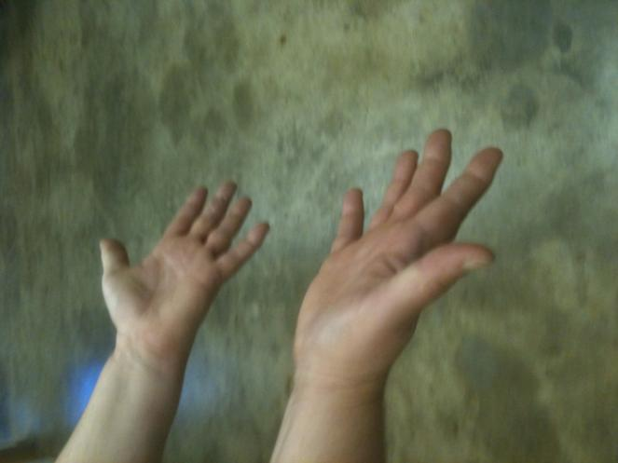
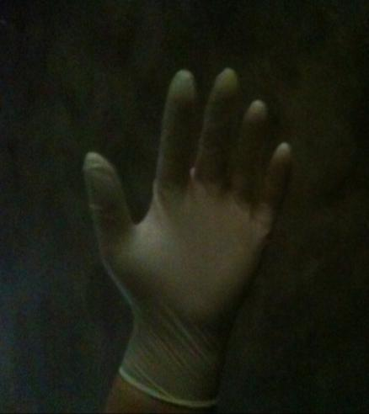
Bare Hands or Gloves
Much smoother surface on gloved hand, easier to clean
Many cracks and crevices for bacteria to hide
Notes:
On many dairies the herd owner wants employees to wear gloves to minimize the spread of germs from one animal to the next. Our hands have many cracks and crevices where the bacteria can hide, particularly when we work hard or during the winter when they become cracked and chaffed. A gloved hand is a much smoother surface, which is easier to clean.

Slide 14
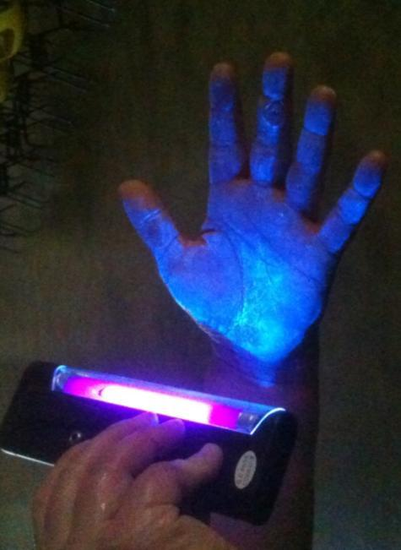
Dirty Hands Spread Bacteria
Cow to worker to cow
Equipment to worker to cow
Environment to cow
Notes:
A dirty hand can spread germs from cow to worker to cow or from equipment to worker to cow. The person whose hand is in this picture had put some “Glo Germ™” on their hand and we looked at it under a black light. See how the “Glo Germ™” gets in the crevices and in the area around the blister on the middle finger.

Slide 15
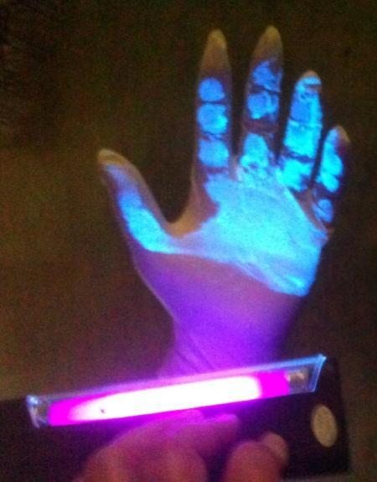
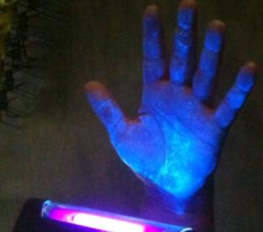
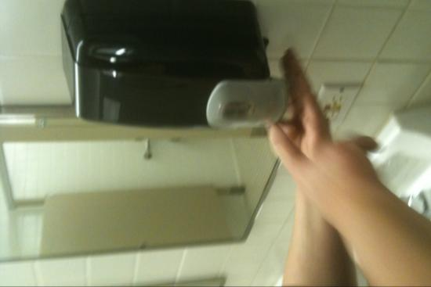
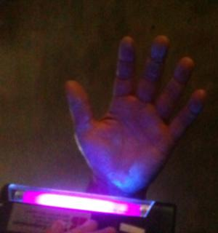

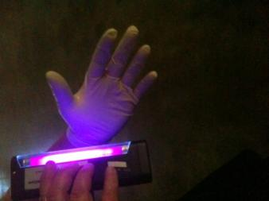
Rinsing Alone Isn’t Enough
Bare Hands
Gloved Hand
Notes:
Here is an illustration of the effects of using all six steps to wash either a bare hand or the gloved hand. Note that there is still a “glo” on the heel of the hand and on the tips of the finger on the bare hands after washing the first time. After a second wash almost everything came off, except a spot on the heel of the hand that was “missed”. It was easier to get everything off and have a clean hand when wearing gloves.

Slide 16

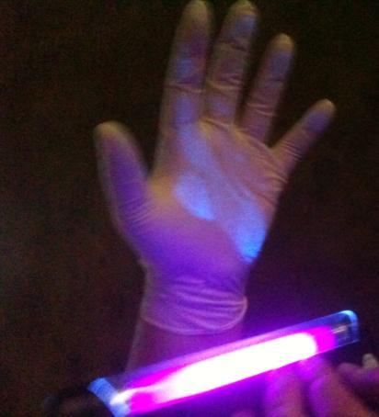
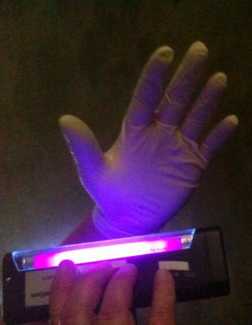
Gloved Hands Can Still Carry Bacteria, but Easier to Clean
Touching objects in parlor transfers “Glo Germ™”
The “Glo Germ™” transfers
to gloves, too
Notes:
But don’t let gloves give you a false sense of security. When you touch a pipe in the parlor you can still pick up dirt and “germs” on your gloved hand and transfer it to another object, such as a drying cloth, or the next cow you are milking unless you wash your hands thoroughly.

Slide 17
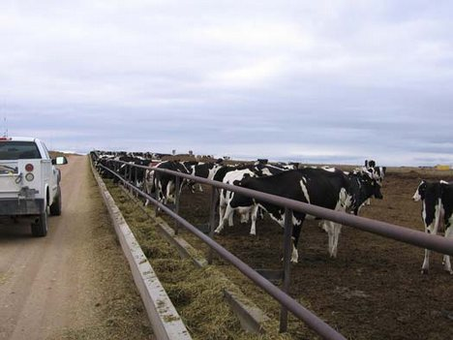
Be Aware of Visitors
Ask visitors to report to the office or to the owner
If you see someone you don’t recognize, TELL the boss
Notes:
Be aware of visitors. Ask visitors to report to the office or to the owner. If you see someone you don’t recognize, TELL the boss.

Slide 18
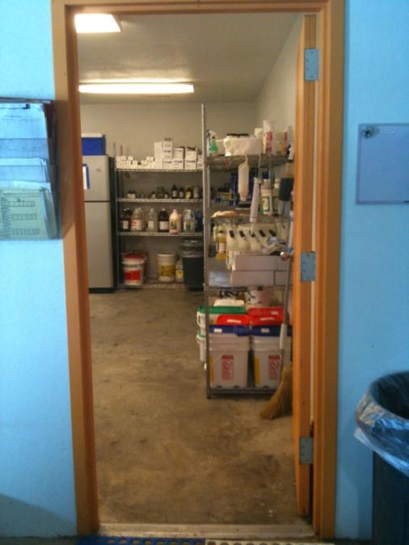
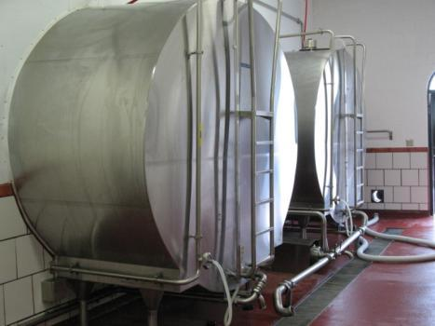
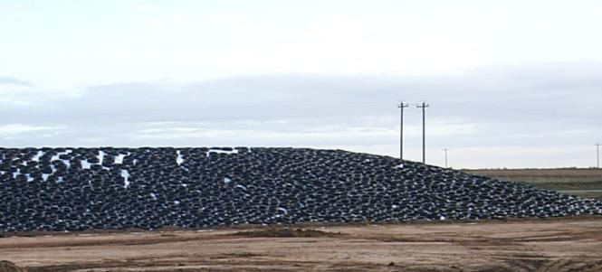
Lock Gates and Doors as Directed
Drug storage
Bulk tank area
Feed
Water sources
Hazardous chemicals
Notes:
For security, lock gates and doors as directed. Areas of restricted access include:
drug storage rooms/refrigerators, bulk tank area, feed storage areas, water sources, and hazardous chemical storage areas.

Slide 19
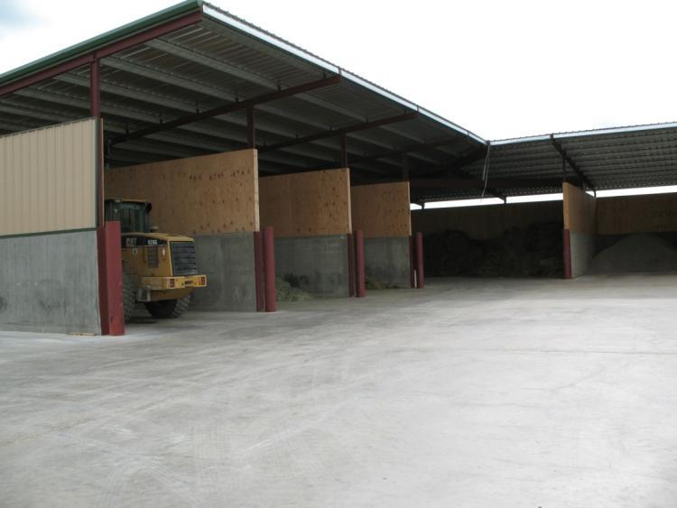
Clean Feed Storage Areas
Before Restocking
Moldy feed
Rodents
Rancid feed
Wet feed
Notes:
Clean out feed storage areas before unloading new feed. Check the corners and bottom of walls and bins for moldy feed. Clean up spilled feed to help control the rodent population. Destroy rancid and wet feed that could cause animals to become ill.

Slide 20
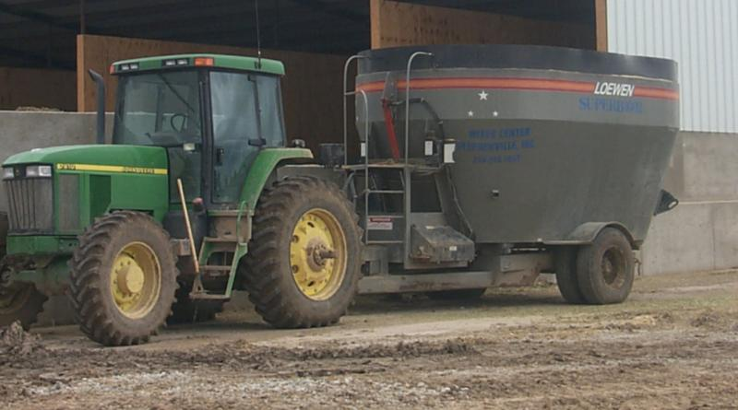
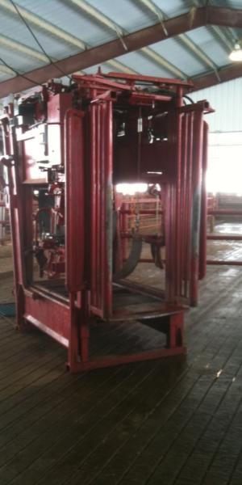
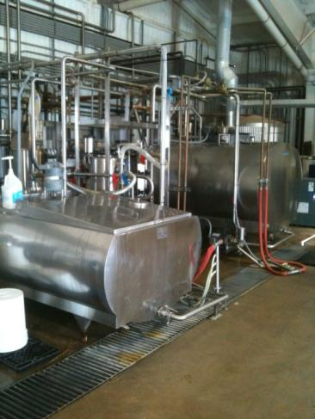
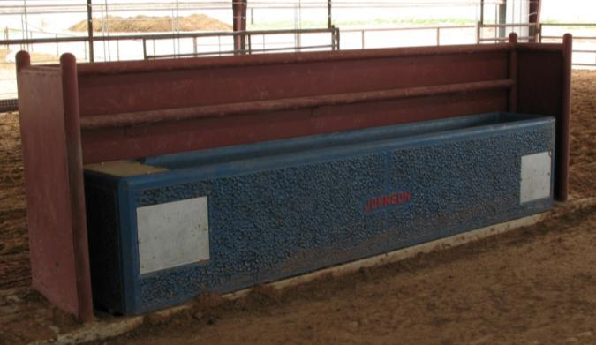
Follow Set Procedures When Cleaning Trailers, Tractors, Etc.
Notes:
Always follow set procedures when cleaning trailers, tractors, etc.

Slide 21
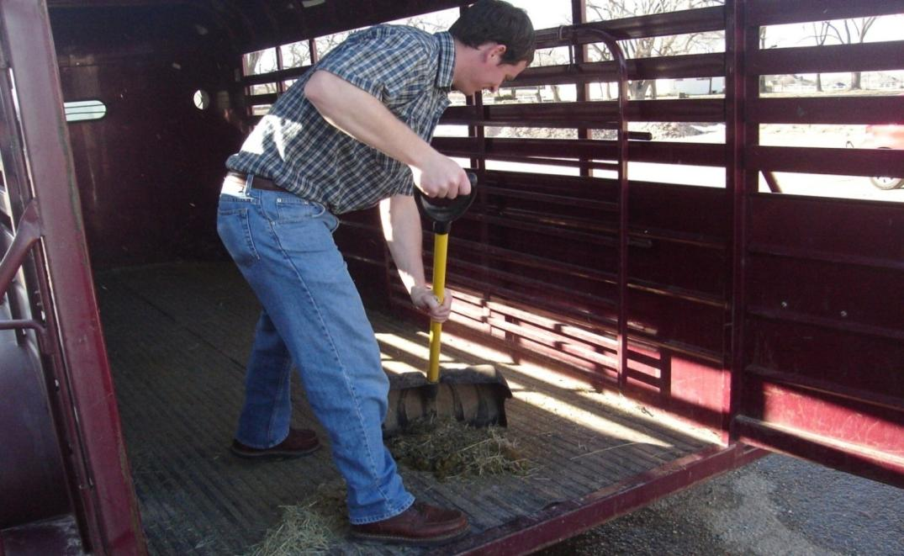
Start Cleaning by Removing Loose Dirt, Hay, Manure, Etc.
Notes:
Start cleaning by removing loose dirt, hay, manure, etc.

Slide 22
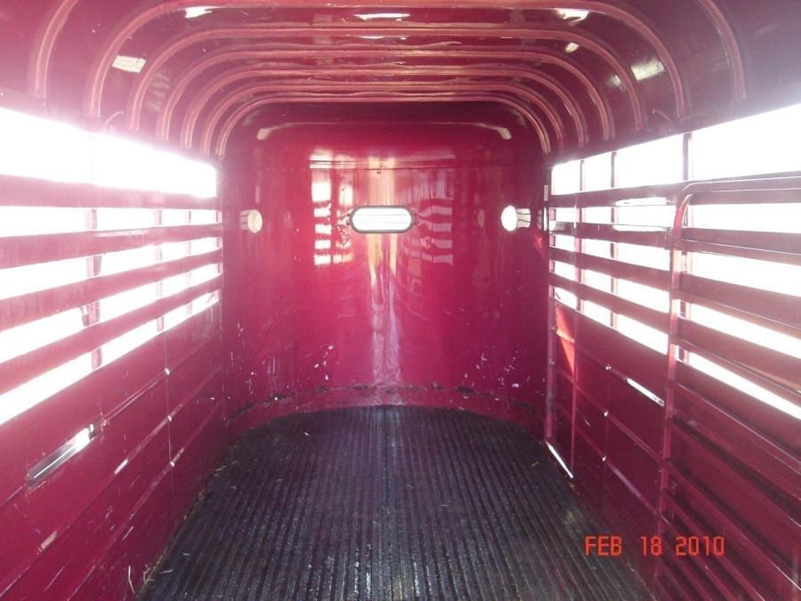
When Possible, Remove Mats as They Trap Debris
Notes:
When possible, remove mats as they trap debris

Slide 23
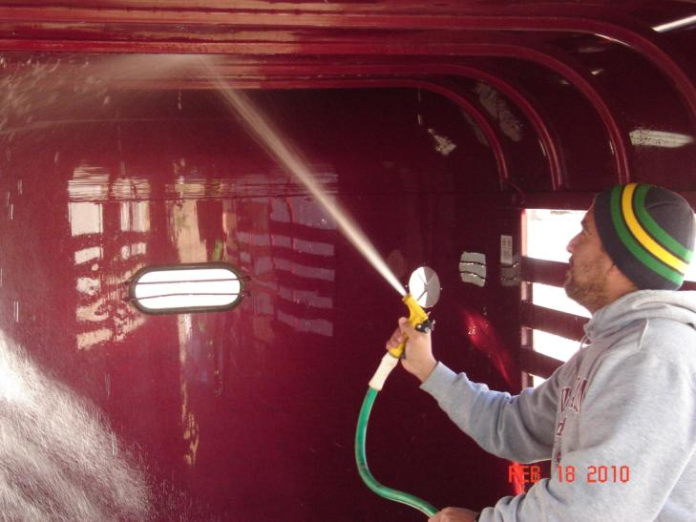
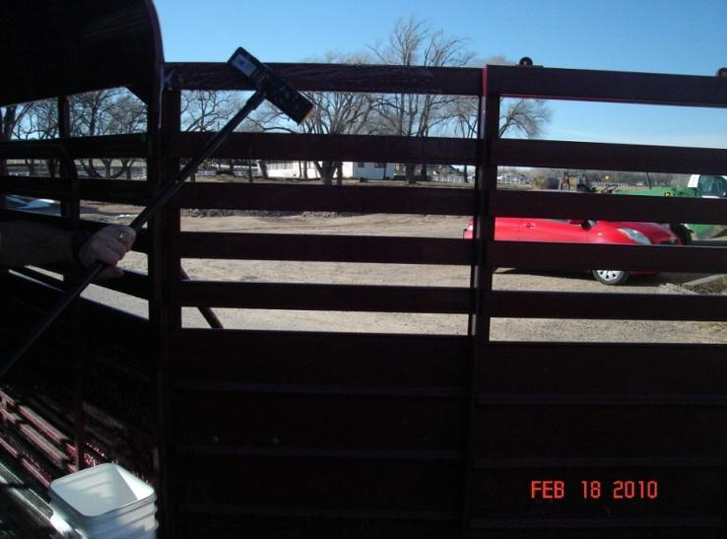
Start at the Front Ceiling and Work to the Back
Notes:
Start at the front ceiling and work to the back

Slide 24
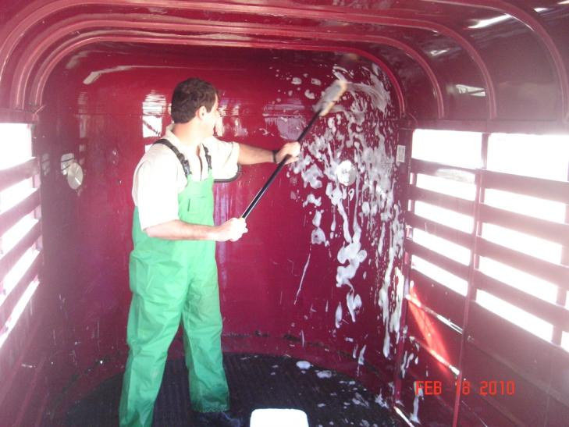
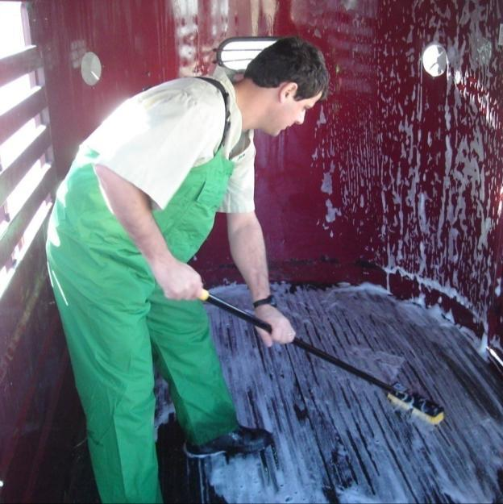
Work Your Way Down from the Top to the Bottom
Notes:
Work your way down from the top to the bottom
Pay particular attention to wheel wells and under carriage.

Slide 25
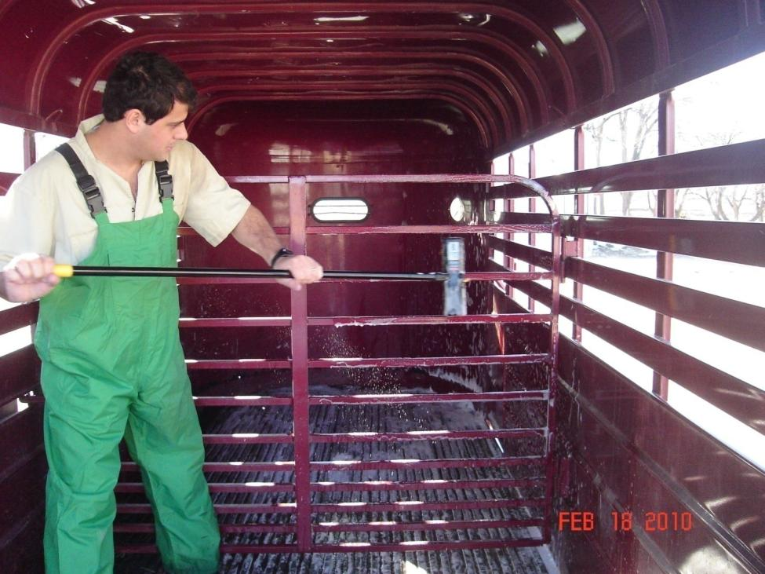
Don’t Forget the Gates
Notes:
Don’t forget the gates in trailers and tail gates in pick-ups

Slide 26
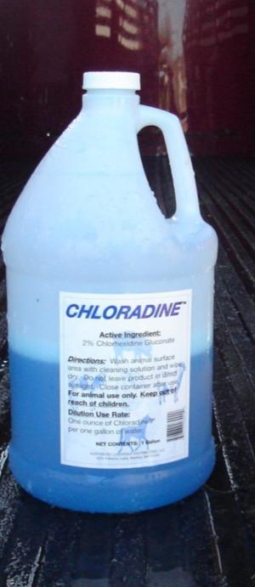
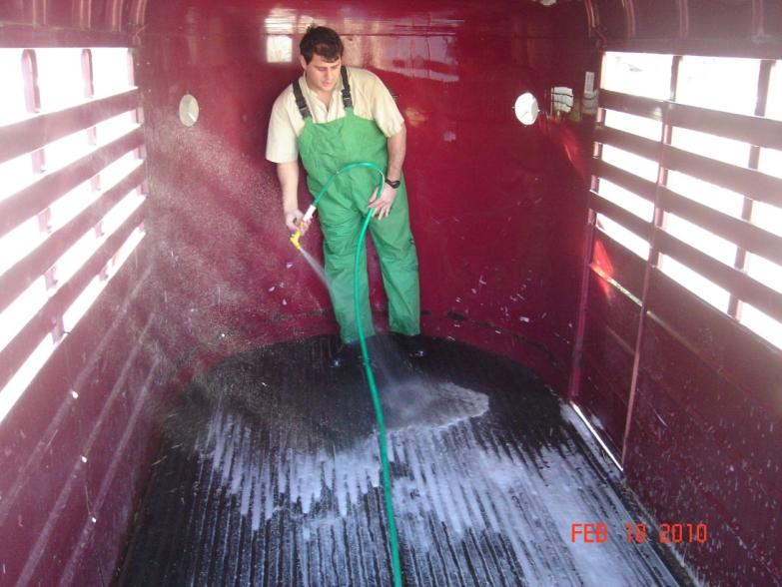
Leave Disinfectant on Trailer for 20-30 Minutes before Rinsing
Notes:
Leave disinfectant on for 20-30 minutes before rinsing.

Slide 27
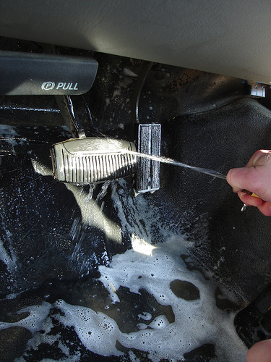



Clean and Disinfect Pedals in Trucks and Mats as Well
Notes:
In trucks, clean and disinfect pedals and mats as well.

Slide 28

After Cleaning Allow the Vehicle to Dry and Put Away Supplies
Notes:
After cleaning, allow the vehicle to dry and put away supplies

Slide 29


Repair Fences
Keep Wildlife and Other People’s Animals Out
Notes:
Repair fences immediately. This helps keep wildlife and other people’s animals out. Both are a source of disease causing organisms.

Slide 30

Report
Sick animals
Suspicious activity or people
Unusual events
Notes:
Remember, report sick animals to your supervisor immediately. Also, tell them about suspicious activity or people and any unusual events.

Slide 31






Your Job…
Improve Animal Welfare
Notes:
An important part of your job is to provide the best possible care. This improves the welfare of the animals on the dairy and helps keep them healthy.

Slide 32
Specific Procedures Vary for Different Areas
Provide a clean, low stress environment
Stress reduces an animal’s ability to fight disease
Vaccination programs help keep animals healthy
Handle animals gently and calmly
Notes:
Although specific procedures for providing the best animal care vary for different areas of the dairy, always provide a clean, low stress environment. Stress reduces an animal’s ability to fight disease. Although vaccination programs differ, they help keep animals healthy. Whether you are moving animals to and from the parlor or caring for baby calves, always handle animals gently and calmly.

Slide 33

If You Are Responsible for Caring for Newborn Calves
Provide clean, dry housing for calf
Keep calves separated from older animals
Work with them before older animals
Notes:
If you are responsible for caring for newborn calves: 1) provide clean, dry housing for the calf, 2) keep calves separated from older animals, and 3) work with them before older animals.

Slide 34

Caring for Newborn Calves, Continued…
Feed colostrum
  Antibodies in colostrum protect the calf from disease
Dip the navel in iodine
Notes:
Feed every newborn calf colostrum within four hours of birth. The antibodies in colostrum protect the calf from disease. Dip the navel in iodine to prevent disease causing organisms from entering the calf.

Slide 35





Vaccination Programs
Prevent certain diseases
Follow herd owner and veterinarian guidelines for when to give
Notes:
Vaccination programs prevent certain diseases caused by viruses and bacteria. Follow herd owner and veterinarian guidelines for when to give each vaccine.

Slide 36




Vaccine Handling
Note the expiration date
Store according to directions
Notes:
To insure success, handle vaccines properly. Note the expiration date; if it has passed, don’t use the vaccine. Store the vaccine according to the directions. Freezing can inactivate some vaccines, while too high a temperature also inactivates them.

Slide 37

Don’t Leave Vaccine on
Dash of Truck
Notes:
Never leave vaccines on the dash of a truck as even in the winter it gets too hot or can freeze.

Slide 38

Administer Vaccine Correctly
Dose
Route
  IM
  Subcutaneously
Notes:
Administer the vaccine correctly. That includes giving the right amount or dose, by the correct route (intramuscular or subcutaneous) in the correct location.

Slide 39


Properly Dispose of Needles and Discard Unused Vaccine at End of Day
Once opened vaccines need to be used immediately
Put needles in a puncture-proof container
Notes:
Once opened, vaccines need to be used immediately. When finished, dispose of the needles and discard unused vaccine at end of day. Put needles in a puncture-proof container.

Slide 40

Your Job…
Identify Disease Early
Observe the animal’s where you work
Report abnormal behavior or sick animals
Notes:
Your job also includes identifying disease early. Although you may not be on the dairy’s “health” team, observe the animals where you work. If you spot abnormal behavior or sick animals, report them to the herdsman, manager or veterinarian immediately.

Slide 41

Look Beyond
Typical Symptoms
International travel increases the potential to bring in foreign animal diseases.
  Example: Foot and Mouth Disease
Early detection of any disease can prevent its spread and minimizes the impact on the herd.
Notes:
When checking a herd, you should always watch for symptoms beyond what you are used to seeing each day. Many dairy employees are immigrants and may travel out of the U.S. In addition there is more and more international travel by citizens from around the globe. This increases the potential to bring in foreign animal diseases. One example of a foreign animal disease we don’t find in the U.S. is foot and mouth disease. Early detection of any disease, including foreign animal diseases, can prevent its spread and minimizes the impact on the herd.

Slide 42



Foot and Mouth Disease
Last reported cases in North America
  U.S., 1929
  Canada, 1952
  Mexico, 1954
Must maintain vigilance to prevent reintroduction
ARS, 1969
USDA-APHIS, 2007
Notes:
Foot and Mouth Disease was last reported in the United States in 1929, Canada in 1952 and Mexico in 1954. It is still found in South America and parts of Asia, Europe, and Africa.
Everyone in agriculture as well as our border security must work together to prevent the reintroduction of Foot and Mouth Disease.

Slide 43


Foot and Mouth Disease (FMD)
Impacts cows, sheep, pigs, deer and other cloven footed animals
Very contagious virus
Fever and blister-like lesions on teats, tongue, lips, and between hooves
Lost milk production
ARS, 1969
USDA-APHIS, 2007
Notes:
Foot and Mouth Disease is caused by a virus. It impacts cows, sheep, pigs, deer and other cloven hoofed animals. It is a very contagious virus. Animals may have a fever and blister-like lesions on teats, tongue, lips, and between hooves. Milk production decreases dramatically in dairy cows.

Slide 44


Visually Evaluate
Udder and Teats
Does she have mastitis?
Are there unusual lesions? Report to vet/owner
FMD lesion
Courtesy of Dr. Moeller
Notes:
When working, look at the udder and teats. Does a cow have mastitis? Are there unusual lesions on the teats?

Slide 45


When among Cattle –
Check the Feet and Legs
Normal Stance
FMD Lesion
Report to Owner/Vet
Courtesy of Dr. Moeller
Notes:
When you are out among the cattle also check the feet and legs. Are there unusual lesions on the feet? Are the cows walking “funny”?

Slide 46

Identify Something Wrong
FMD confused with several other diseases:
  Vesicular stomatitis
  Bluetongue
  Bovine viral diarrhea
  Foot rot
Don’t panic
Tell owner/manager
Let them diagnose WHAT is the problem
Notes:
Foot and Mouth Disease can be confused with other diseases that we do have in this country such as vesicular stomatitis, bovine viral diarrhea, foot rot or blue tongue. Do NOT panic if you don’t recognize something, tell the owner, manager, or veterinarian so they can diagnose the problem. Again, early identification is the key to treating and preventing the spread of any disease.

Slide 47

Your Job…
Protect the Food Supply
Quantity
Quality
Safety
Notes:
Dairy farm workers harvest food. Keeping cows healthy helps insure that an abundant supply is produced. But when cows get sick, dairy workers must take steps to insure the quality and safety of the food supply.

Slide 48

Record Problems, Diseases, and Treatments for Each Cow
Dystocia or difficult calving
Milk fever or hypocalcemia
Metritis
Ketosis
Retained fetal membranes or retained placenta or RP
Displaced abomasum or DA
Pneumonia
Mastitis
Lameness
Lesions
Notes:
Record problems, diseases and treatments for each cow. There are many different problems that may not be an infectious disease, but the treatment still must be recorded. These other problems can make the cow more likely to get a disease.

Slide 49





Maintain Records
Date
Cow ID
Diagnosis
Treatment
Withdrawal
Notes:
At a minimum, include the date, cow identification, diagnosis, any treatment, and withdrawal times on the farm record.

Slide 50

Records Help…
Identify new problems
Assist the herd owner determine what may be the cause of illness or disorder
Evaluate whether treatments are working
Track cows that need to be rechecked
Notes:
The records you create help…
identify new problems
assist the herd owner determine what may be the cause of an illness or disorder
evaluate whether treatments are working
track cows that need to be rechecked

Slide 51


If Any Antibiotics Are Used in Treatments…
Mark the cow
Follow discard protocols for milk
Note meat withdrawal time
Notes:
If antibiotics are used in treatments, mark the cow, follow discard protocols for milk,
and note meat withdrawal time in the record.

Slide 52



Remember, if You See Something Unusual – REPORT IT!
Lesions
Suspicious activity
Unknown visitors
Abnormal animal behavior
Notes:
Again, if you see something unusual – report it! Whether it is a lesion, suspicious activity, unknown visitor, or abnormal animal behavior doesn’t matter.

Slide 53

Protect Your Animals at Home
Change your clothes before working with your animals
Keep a separate pair of boots for when you work at home
Notes:
When you leave work remember to protect your animals at home from disease as well. Change your clothes before working with your animals. Keep a separate pair of boots for when you work at home.

Slide 54
If you travel out of the U.S., realize you may need to stay off farms when you return for a period of time.
For current animal disease concerns when traveling call:
1-866-SAFGUARD
Notes:
If you travel out of the U.S., realize you may need to stay off farms when you return for a period of time. Protecting the food supply means you don’t bring something to work from your travels. For current animal disease concerns when traveling call 1-866-SAFGUARD.

Slide 55
Practicing Biosecurity Is
Your Responsibility!
Keeps animals healthy on the farm where you work
Reduces the risk of you taking diseases home to your animals
Minimizes the chance of you getting sick
Helps you keep a JOB!
Notes:
By practicing basic biosecurity steps, you can help keep the animals on the farm where you work healthy. You also reduce the risk of taking diseases home to your animals. You minimize the chance that you or your family get sick. And finally, you help keep the dairy producer in business so you can keep your job!

Slide 56




Healthy Cows
Safe Food
Protected Consumers
For more technical articles visit:
http://texasdairymatters.org
Notes:
Remember, healthy cows provide an abundant safe food supply for our products consumer.

Slide 57
This project was a collaborative effort between:
Texas AgriLife Extension Service
New Mexico State University
University of Idaho
Funding provided by the National Center for Foreign Animal and Zoonotic Disease Defense, a Department of Homeland Security Science and Technology Center of Excellence
Ellen Jordan, PhD; Ralph Bruno, DVM, MS; Juan A. Hernandez-Rivera, PhD; and Kevin Lager, MS -
Texas AgriLife Extension Service
Mireille Chahine, PhD – University of Idaho
Robert Hagevoort, PhD – New Mexico State University
The entities involved in the development of this material do not support one product over another and any mention herein is meant as an example, not an endorsement.

