Slide 1


Dementia
& Caregiving
Presenter: Andrew B. Crocker
Education Chair: Cita Honeycut
Texas Extension Education Association
Author: Andrew B. Crocker
Extension Program Specialist III – Gerontology and Health
Texas A&M AgriLife Extension Service
2016
Educational programs of the Texas A&M AgriLife Extension Service are open to all people without regard to race, color, religion, sex, national origin, age, disability, genetic information or veteran status. The Texas A&M University System, U.S. Department of Agriculture, and the County Commissioners Courts of Texas Cooperating
Notes:
A diagnosis of dementia can be frightening for the person receiving the diagnosis, their family members and caregivers. Learning more about dementia can help. This program will provide a broad overview of various types of dementia and give some tips for caregiving and dementia.

Slide 2



What is Dementia?
Image Source: http://www.thebluediamondgallery.com/pictures/dementia.jpg (labeled for noncommercial reuse – last accessed: 04 May 2016).
Notes:
Dementia involves the loss of the ability to think, remember or reason, among other functions, to the extent that it interferes with daily life and activities. Dementia is the direct result of once-healthy nerve cells in the brain (neurons) not working and losing connection with one another. When this happens the nerve cells die. While everyone loses some nerve cells as they age, people with dementia experience far greater loss.
Researchers are still trying to understand the underlying disease processes involved in the various disorders that cause dementia. There are some theories about mechanisms that may lead to different forms of dementia, but more research is needed to better understand if and how these mechanisms contribute to the development of dementia.
Memory loss, though common, is not the only sign of dementia. For a person to be considered to have dementia, s/he must meet the following criteria:
◾ Two or more core mental functions must be impaired. These functions include memory, language skills, visual perception, and the ability to focus and pay attention. These also include cognitive skills such as the ability to reason and solve problems.
◾ The loss of brain function is severe enough that a person cannot do normal, everyday tasks.

Slide 3
Types of Dementia
FrontoTemporal Dementia
Creutzfeldt-Jakob Disease
Corticobasal Degeneration
Progressive Supranuclear Palsy
Many Others
Vascular Dementias
Multi-infarct Dementia
Binswanger’s Disease
Dementia with Lewy Bodies
Parkinson’s Disease
Diffuse Lewy Body Disease
Vascular Dementias and Alzheimer’s Disease
Alzheimer’s Disease and Lewy Body dementia
Alzheimer’s Disease
~5%
~10%
~70%
~5%
~7%
~8%
Notes:
Alzheimer’s disease is the most common form of dementia in those over the age of 65. As many as 5 million Americans age 65 and older may have Alzheimer’s, and that number is expected to double for every 5-year interval beyond age 65. But Alzheimer’s is only one of many types of dementia. An estimated 20 to 40 percent of people with dementia have some other form of the disorder. Among all people with dementia, many are believed to have a mixed type of dementia that can involve more than one of the disorders.
Age is the primary risk factor for developing dementia. For that reason, the number of people living with dementia could double in the next 40 years with an increase in the number of Americans who are age 65 or older. While dementia is more common with advanced age, it is not a normal part of aging.
Various disorders and factors contribute to the development of dementia. Most types of dementia – Alzheimer’s disease, frontotemporal disorders and Lewy body dementia result in a progressive and irreversible loss of brain cells and brain functions. Currently, there are no cures for these disorders.
However, other types of dementia can be halted or even reversed with treatment. Some drugs, vitamin deficiencies, alcohol abuse, depression, infections, excess fluid in the brain and brain tumors can cause brain disorders that resemble dementia. Most of these causes respond to treatment.

Slide 4

Risk Factors for Dementia
Some risk factors may include
  Age
  Excessive alcohol use
  Hardening of the arteries
  Diabetes
  Genetics
  High blood pressure
  Smoking
Notes:
The risk factors for dementia are many and varied. But one is constant: Age. The risk for developing some form of dementia goes up with advanced age.
Other risk factors, some you might can control, others you might not be able to, include but are not limited to
Alcohol use. Most studies suggest that drinking large amounts of alcohol increases the risk of dementia.
Hardening of the arteries (Atherosclerosis). Build up of fats and cholesterol in the lining of arteries can restrict blood from getting to the brain, which can lead to stroke or another brain injury.
Diabetes. People with diabetes appear to have a higher risk for dementia but it should not be considered a direct cause. Poorly controlled diabetes, however, is a risk factor for stroke and cardiovascular disease-related events, which in turn increase the risk for vascular dementia.
Genetics. The likelihood of developing a genetically linked form of dementia increases when more than one family member has the disorder. But in the case of Alzheimer’s disease, specifically, only about 10% of cases can be linked to a family history. Your risk from advancing age is far greater than the genetic risk.
High blood pressure (Hypertension). High blood pressure has been linked to cognitive decline, stroke, and types of dementia.
Smoking. Smokers are prone to diseases that slow or stop blood from getting to the brain.
This list is not exhaustive, of course, but provides some of the main risk factors associated with dementia. You’ll see that many of them are things that are talked about with regard to maintaining overall health and well-being.

Slide 5

Diagnosis of Dementia
Exclude other things before diagnosing dementia
Diagnosis may include
  Physical assessment
  Lab work
  Scans
  Cognitive testing
Notes:
Diagnosis of dementia should not be hard – testing and other diagnostic criteria get more sophisticated every day. But it should not be easy either.
A health provider should first try to assess what else might be happening, especially an underlying, treatable condition such as depression, brain tumor, abnormal thyroid function, etc. Early diagnosis is important, as some causes for symptoms can be treated. In many cases, the specific type of dementia that a person has may not be confirmed until after the person has died and the brain is examined.
A thorough assessment generally includes:
Patient history and physical exam. Questions about family history, past illnesses, etc. Taking blood pressure and other vital signs.
Neurological evaluations. Assessing balance, sensory function, reflexes, vision, eye movements, and other functions helps identify signs of conditions that may affect the diagnosis or are treatable with drugs.
The following procedures also may be used when diagnosing dementia:
Brain scans. These tests can identify strokes, tumors, and other problems that can cause dementia. Scans also identify changes in the brain’s structure and function. The most common scans are computed tomographic (CT) scans and magnetic resonance imaging (MRI). Other types of scans let doctors watch the brain as it functions. These scans are used to look for patterns of altered brain activity that are common in dementia.
Cognitive tests. These tests measure memory, language skills, math skills, and other abilities related to mental functioning.
Laboratory tests. Many tests help rule out other conditions. They include measuring levels of sodium and other electrolytes in the blood, a complete blood count, a blood sugar test, urine analysis, a check of vitamin B12 levels, cerebrospinal fluid analysis, drug and alcohol tests, and an analysis of thyroid function.
Psychiatric evaluation. This will help determine if depression or another mental health condition is causing or contributing to a person’s symptoms.

Slide 6
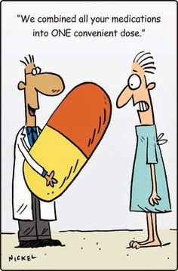
Treatment for Dementia
Most medications serve to help manage symptoms and slow progression
For Alzheimer’s disease, there are two types of drugs that work two different ways
Eventually the disease will probably outpace the medication
Notes:
Some dementias are treatable. However, therapies to stop or slow common dementias, such as Alzheimer’s disease, have largely been unsuccessful. Though some drugs are available to manage certain symptoms.
Most drugs for dementia are used to treat symptoms. For Alzheimer’s disease, one class of drugs called cholinesterase inhibitors includes donepezil (Aricept), rivastigmine (Exelon), and galantamine (Razadyne). These drugs can temporarily improve or stabilize memory and thinking skills in some people with the disease.
The drug memantine (Namenda) is in another class of medications called NMDA receptor agonists. This drug can help prevent declines in learning and memory. NMDA receptor agonists work by regulating the activity of a neurotransmitter that, when present in large amounts, may cause brain cells to die.
The two drug types can be taken together. In fact, there is a new medication available (Namzaric) which combines memantine and donepezil for added benefits (and it’s one less pill to take). These drugs are sometimes used to treat other dementias as well. None of these drugs can stop or reverse the course of the disease.

Slide 7
Assessment Strategies
Recognize abilities
  Recognize, respect and encourage individual abilities
  Support making decisions independently
  Involve in decision-making while capable
Plan for the future
  Discuss openly and frankly issues relating to future health care, personal care, financial and legal decisions
  Follow expressed wishes
  Make the decision based on what is thought the person would want
Notes:
It’s important to remember that the disease, not the person with dementia, causes changes/problems. The caregiving “journey” can be a difficult one so the remainder of this lesson will address caregiving for someone with dementia.
Dementia is being diagnosed at earlier stages. This means that many people are aware of how the disease is affecting their memory. Here are tips on how to help someone who knows that he or she has memory problems:
Take time to listen. The person may want to talk about the changes s/he is noticing.
Be as sensitive as you can. Don’t just correct the person every time s/he forgets something or says something odd. Try to understand that it’s a struggle for the person to communicate.
Be patient when someone has trouble finding the right words or putting feelings into words.
As people lose the ability to talk clearly, they may rely on other ways to communicate their thoughts and feelings.
When someone is diagnosed with dementia, you need to start getting his or her health, legal, and financial affairs in order. You want to plan for the future, if possible, with help from the person while he or she can still make decisions. You need to review all of his or her health, legal, and financial information to make sure it reflects the person’s wishes.

Slide 8
Analyzing Behaviors
Problem behaviors may be divided into three stages
  Antecedent
    Trigger or cause
  Behavior
  Consequence
Antecedent
Look for prior events that may have triggered behavior.
Behavior
What is the behavior?
Consequence
What happens as a result of the behavior?
Notice when, where how, etc.
Understanding causes can help determine action to take.
Describe the action(s).
Notes:
Because dementia causes brain cells to die, the brain works less well over time. This changes how a person acts. You will notice that s/he will have good days and bad days.
Here are some common personality changes you may see:
Getting upset, worried, and angry more easily
Hiding things or believing other people are hiding things
Imagining things that aren’t there
Pacing a lot of the time
While it may never be possible to stop these behaviors, you can try to analyze them to see if you can spot patterns. Do this by Looking at ABCs – Antecedent, Behavior & Consequences. Ask yourself: what happens before that could possibly be a trigger? When s/he experiences this trigger, what behavior occurs? And what are the consequences, for yourself and for the person.
If you can start to establish patterns, you can try to run interference. You may not be able to control the behavior but you can certainly try to control the trigger (antecedent). Also, you may find the consequences of a “problem behavior” aren’t so bad after all and that’s one less thing you need to worry about.

Slide 9
Caregiver Burnout
Ignoring personal needs is detrimental
  To you
  To the person for whom you care
  Caregiver exhaustion leads to many premature facility placements
Notes:
If you give care for another person, chances are good that you feel stressed at times. As this stress compounds and situations get worse, you may start to experience caregiver burnout. This level of stress in your life is not good for your body or for your health. It also severely affects the level of care you are able to provide for your loved one.
Sadly, caregiver burnout leads to many nursing home placements, sometimes prematurely, simply because there are no other alternatives.

Slide 10
The Caregiving Journey
Be Informed
  Understand yourself
  Understand the other people in your life
  Find things that help you in your situation
Common Sense
Humor
Solve Problems
  Do not run from problems
  Change small things first
  Realize that you cannot address every need
Rest
Notes:
The more you know about the nature of dementia, the more effective you will be in devising strategies to manage your caregiving journey. By understanding the person with dementia, you will be able to better address his or her needs. This type of understanding can only be developed after working closely with him or her. Even if the person for whom you’re caring is a loved one, such as a mother or a father, you may have to “re-learn” things about this person. Understanding a person as your parent and understanding a person as a care recipient may be two completely different things.
Common sense and imagination are your best tools. Adaptation is the key to success. If a thing cannot be done one way, ask yourself if it must be done at all. If the answer to that question is yes, look for alternative solutions. Above all else, be flexible in your decision making and the way you try to address problems. Remember to try to include your care recipient whenever possible in situations where decisions must be made.
“Laughter is the best medicine” is probably an expression with which you are quite familiar. Your care recipient may still have a sense of humor and will appreciate being able to laugh. Humor also detracts from the seriousness of the situation. By finding happiness or humor in your work, you may be able to keep better focus on your situation and make your caregiving more effective.
Problems should not be run from or put off to be addressed later. If you are at the end of your rope, single out one thing that you can change to make life easier and work on that. Sometimes changing small things makes a big difference.
And remember that sleep/rest is important – for you and for the person with dementia. Among other things rest/sleep help us focus better, help our immune systems and help us deal with stress and stress by-products in the body.

Slide 11
Involving Others
Share concerns
Ask for help!
  Everyone has something they can contribute
  Involve
    The person for whom you care
    Close family
    Extended family
    Health providers
    Community resources
Notes:
As discussed earlier, when the person with dementia is only mildly or moderately impaired, s/he may be able to take part in managing care. You may be able to share with each other your grief and worries. Together you may be able to devise strategies to help maintain independence.
It may take professional help to devise these strategies – don’t be afraid to seek the opinions of others, professional or not. Sometimes a third-party perspective may help you see your situation in a new light.
If there were a common theme for all caregiving information it would be not to be afraid to ask for help. There are community resources as well as professional services that may help make your caregiving responsibilities much easier. The problem is that you are the only person who can seek these services out. You have to be willing to help yourself.
Find these services in your area and establish a care network for yourself. Know who you need to call or visit when certain problems arise. Have an “out” for yourself when you need some time away from your care recipient. Develop your resources whether they be family and friends, community agencies or the local hospital or nursing home.

Slide 12
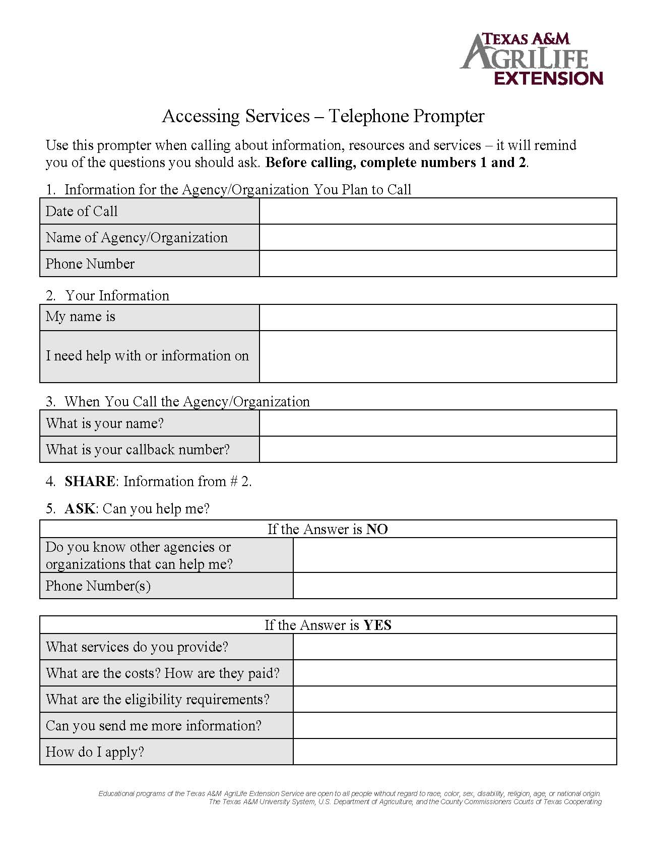
Locating Services
Use a telephone prompter or something similar when talking to professionals about services
  “Accessing Services – Telephone Prompter”
http://fcs.tamu.edu/files/2015/01/accessing-services-telephone-prompter.pdf
Notes:
Asking for help can be hard enough but keeping track of all the information might be even harder. Texas A&M AgriLife Extension Service has a telephone prompter available for download to help you keep track of phone calls to various agencies/organizations when seeking support services. This is also very helpful when multiple caregivers are involved as it can help prevent duplication.

Slide 13

Area Agencies on Aging
Provides planning, coordination and implementation of services
Programs may include
  Congregate and home delivered meals
  Emergency response services
  Adult day care
  Transportation
  Minor home repairs/modifications
  Homemaker and personal care services
  Legal assistance/representation
  Benefits counseling
  Nursing home ombudsman
http://www.dads.state.tx.us/services/contact.cfm
800.252.9240
Notes:
While there are many sources of support in your community, the Area Agency on Aging (AAA) is probably a good “one-stop-shop” for older adults and their caregivers. While not all of the AAAs operate in exactly the same way, they all have the same basic mission for the communities they serve.

Slide 14

The Moral of the Story
Take care of yourself
Take care of your family
  Be a parent, be a spouse
Build a team
  Everyone has something to contribute
Let the person for whom you care help
Talk to others
Utilize resources in your area
Notes:
Let’s go over some of the key takeaways from the lesson…

Slide 15
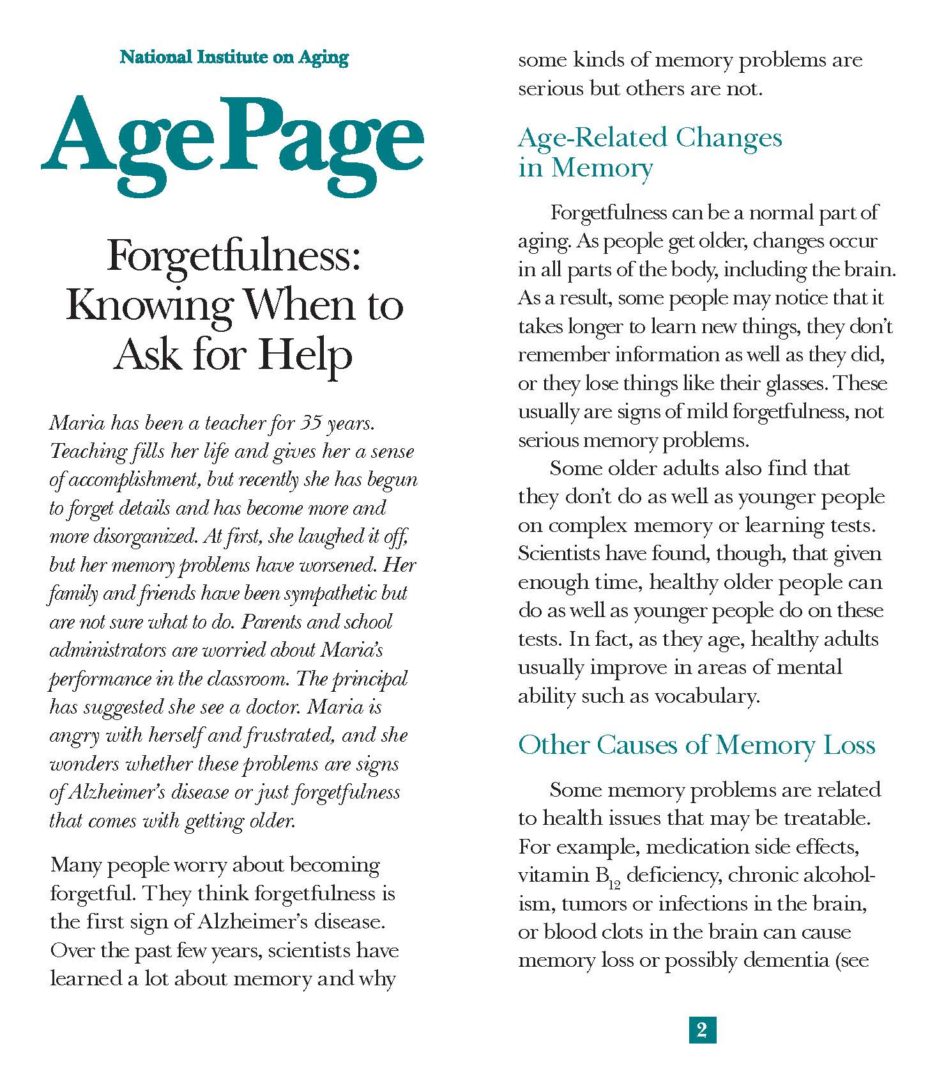
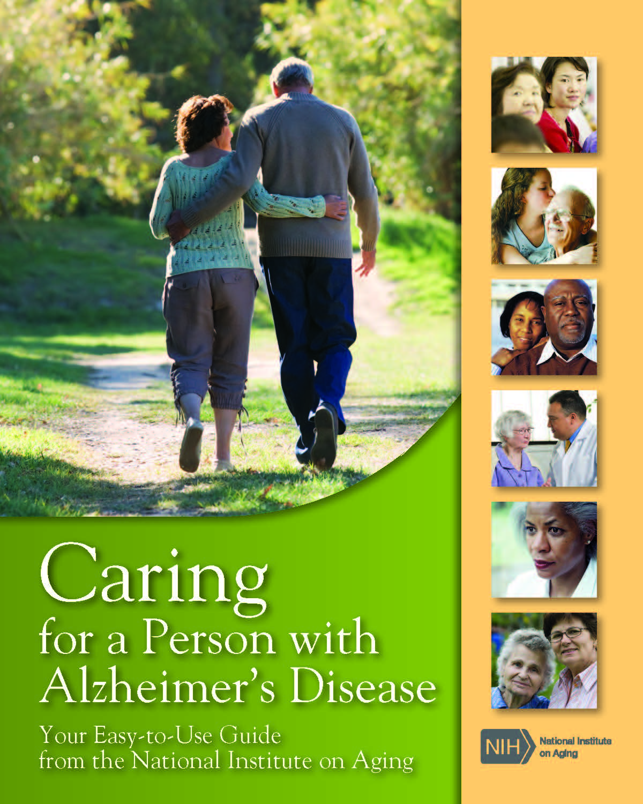
Resources
https://www.nia.nih.gov/health/publication/forgetfulness
https://www.nia.nih.gov/alzheimers/publication/caring-person-alzheimers-disease/
Notes:
The National Institute on Aging has great resources to help better understand memory loss, dementia and caregiving. Here are a couple of good examples of their FREE online materials.

Slide 16

What Questions Would You Like to Ask?
References
Alzheimer’s Association. (n.d.). “Alzheimer’s & Dementia” http://alz.org/alzheimers_disease_1973.asp Last Accessed: 08 May 2016.
Alzheimer’s Disease Education and Referral Center. (September 2012). Preventing Alzheimer’s Disease: What Do We Know? Publication Number: 12-5503. Available from https://www.nia.nih.gov/alzheimers/publication/preventing-alzheimers-disease/ Last Accessed: 08 May 2016.
American Psychological Association, Presidential Task Force on the Assessment of Age-Consistent Memory Decline and Dementia (1998). Guidelines for the evaluation of dementia and age-related cognitive decline. Washington, DC: American Psychological Association.
National Institute on Aging. (October 2015). Understanding Memory Loss: What to Do When You Have Trouble Remembering. Publication Number: 15-5442. Available from https://www.nia.nih.gov/alzheimers/publication/understanding-memory-loss/ Last Accessed: 08 May 2016.
National Institute on Aging. (May 2015). Caring for a Person with Alzheimer’s Disease: Your Easy-to-Use Guide from the National Institute on Aging. Publication Number: 15-6173. Available from https://www.nia.nih.gov/alzheimers/publication/caring-person-alzheimers-disease/ Last Accessed: 08 May 2016.

