Slide 1
MCS Fillable Report form
Copy and paste the pieces you need into a blank slide.
Home>NewSlide>Blank
When printing, select “print current page only”.

Slide 2
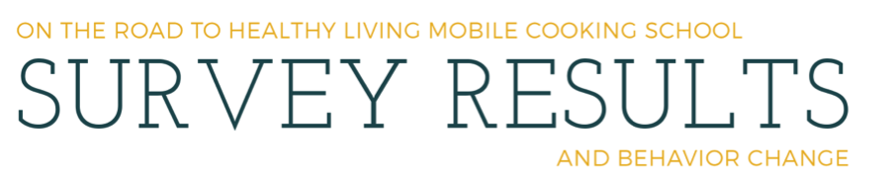
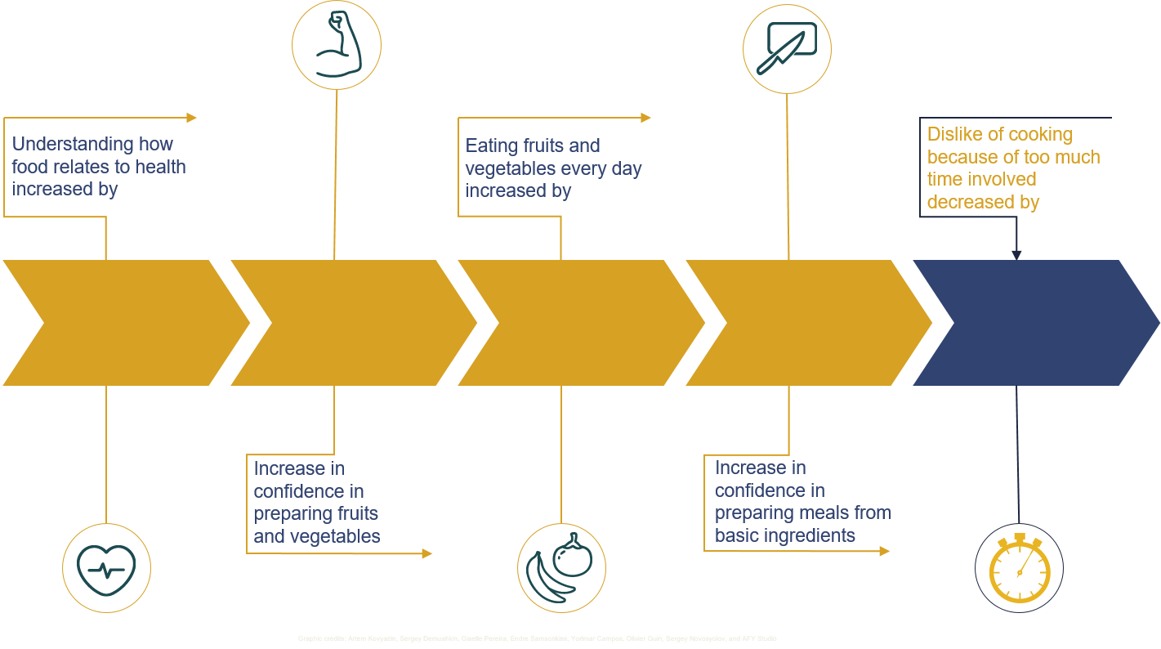
This shows you what the layout should ideally look like.
Increasing stats have arrows going up - yellow
Decreasing stats have arrows going down and are blue
9
6
1
XX
3
XX
98
XX
XX
%
%
XX
%
%
%
Icons inside circles on opposite side of arrow from text
If photos desired, one large, good photo is better than several smaller photos. Can use arrow/text for pull quotes.
2016
Small graphic credit in complimentary font
YEAR

Slide 3
Header image – copy and paste, resize
Year – copy and paste
YEAR-YEAR

Slide 4
Arrows – copy and paste
Copy those you need, paste. Shift+Click, then group before to copy all.
Use shift+control, pull from a corner anchor point to resize group, otherwise the arrows won’t dovetail perfectly.
Use Home>Arrange>Align>Distribute Horizontally to space perfectly, Home>Arrange>Align>Top to align perfectly.
Insert text box over shape for most control of where text is placed.

Slide 5
Icon circles – copy and paste this, then copy and paste your icon onto the circle, send icon to back.
Circle and line are 3 point
Ungroup these to edit if needed.

Slide 6










Icons – MUST COPY GRAPHIC CREDITS WHEN YOU USE THESE (can be in very light colored small font)
Graphic Credits: Artem Kovyazin, Sergey Demushkin, Giselle Pereira, Endre Samsonkiss, Yorimar Campos, Olivier Guin, Sergey Novoskyolov, and AFY Studio
To center icon in circle:
Shift+Click on icon and circle to select both
Arrange>Align>Center
Arrange – send icon to back
Then it’s wise to group the icon with the circle/line group.

Slide 7
Text and arrow/boxes SET 1- yellow
text is Open Sans
Copy and paste
Understanding how food relates to health increased by
Increase in confidence in preparing fruits and vegetables
Eating fruits and vegetables every day increased by
Increase in confidence in preparing meals from basic ingredients
Dislike of cooking because of too much time involved decreased by
Understanding how food relates to health increased by
Increase in
confidence in preparing
fruits and vegetables
Eating fruits and vegetables every day increased by
Increase in confidence in preparing meals from basic ingredients
Dislike of cooking because of too much time involved decreased by

Slide 8
Text and arrow/boxes SET 2 - yellow
text is Open Sans
Copy and paste
Increase in perception of the ease of preparing food at home
Understanding of proper temperatures for food safety increased by
Perception of cooking as “too much work” decreased by
Increase in confidence in preparing meals that follow USDA MyPlate guidelines
Increase in perception of the ease of
preparing food at home
Understanding of
proper temperatures for food safety increased by
Perception of cooking as “too much work” decreased by
Increase in confidence in preparing meals that follow USDA MyPlate guidelines

Slide 9
Text and arrow/boxes SET 1- blue
Text is Open Sans
Copy and paste
Understanding how food relates to health increased by
Increase in confidence in preparing fruits and vegetables
Eating fruits and vegetables every day increased by
Increase in confidence in preparing meals from basic ingredients
Dislike of cooking because of too much time involved decreased by
Understanding how food relates to health increased by
Increase in
confidence in preparing
fruits and vegetables
Eating fruits and vegetables every day increased by
Increase in confidence in preparing meals from basic ingredients
Dislike of cooking because of too much time involved decreased by

Slide 10
Text and arrow/boxes SET 2- blue
Text is Open Sans
Copy and paste
Increase in perception of the ease of preparing food at home
Understanding of proper temperatures for food safety increased by
Perception of cooking
as “too much work” decreased by
Increase in confidence in preparing meals that follow USDA MyPlate guidelines
Increase in perception of the ease of
preparing food at home
Understanding of
proper temperatures for food safety increased by
Perception of cooking
as “too much work” decreased by
Increase in confidence in preparing meals that follow USDA MyPlate guidelines

Slide 11
Total numbers
Copy and Paste
Insert new text box below for numbers.
Shift+Click text and number, Home>Arrange>Align>Center to align perfectly
People
instructed
Number of
classes
Educational
contacts

Slide 12





AgriLife Logo – copy and paste, resize
Brand guideline: Our logo is primary to all other logos

Slide 13
Yellow
R 215
G 161
B 36
Green
R 68
G 83
B 36
Navy
R 14
G 19
B 32
Teal
R 25
G 50
B 52
Red
R 167
G 33
B 32
Ensure that you are using the proper colors:
Design>Colors>MCS Fillable Report Form
Or right click any color scheme, then Edit. Text/Background 2 = Aggie Maroon, Accent 1 Yellow, 2 Green, 3 Navy, 4 Teal, 5 Red, 6, Cool Gray
Cool Gray
R 113
G 112
B 116
Aggie Maroon
R 80
G 0
B 0
TITLE 1 OPEN SANS
TITLE 2 Open Sans
SUBHEADS Open sans
Ensure that you are using the proper fonts:
Design>Fonts>Open Sans
Body copy Open Sans

