Slide 1

Eat Healthy. Stay Active. Make a Difference!
Patty Littlefield and Lisa Losasso

Slide 2


Playbook
First Down
About Dairy MAX & Fuel Up to Play 60
Benefits of eating right and physical activity
Second Down
The Program: 6 Steps to Fuel Up to Play 60
Extra Fun: Student Site, Ambassadors, Campaigns
Third Down
Free Tools for You!
Funds
Touchdown
Are You In?

Slide 3

Brain Break!!
When you see this…

Slide 4




About Dairy MAX
Your local dairy council
Dairy farm families
Our goal with Fuel Up to Play 60

Slide 5
About FUTP60
In-school nutrition and physical activity program launched in 2009 by National Dairy Council and NFL with support from USDA
Notes:
You can use the FUTP60 Video PSA here

Slide 6
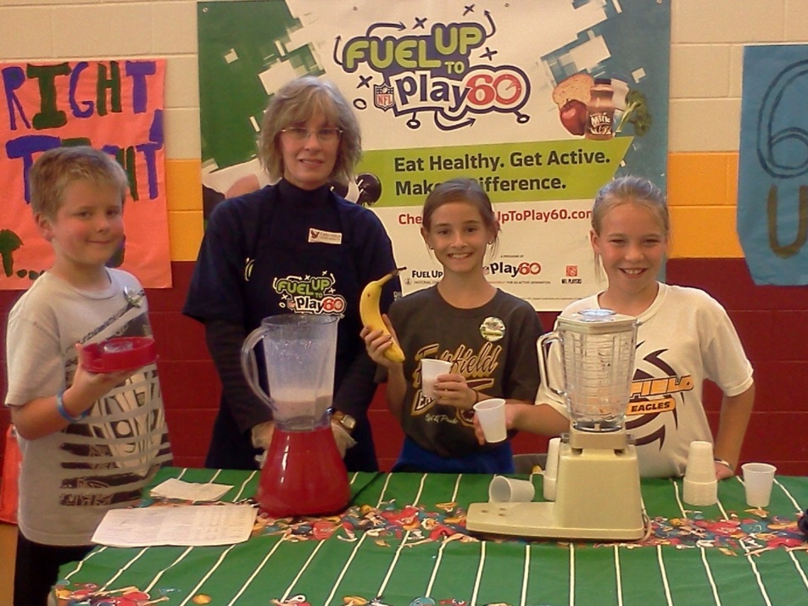
What is Fuel Up to Play 60?
Linked With…
A fun way to help you and your school become more active and healthy!
Notes:
The NFL and NDC want to help you make your school an even better place. You get to create a game plan for you and your friends to eat healthy foods and find new ways to keep moving throughout the day.

Slide 7
What is Fuel Up to Play 60?
Encourages Kids to:
Eat Healthy
  Fuel Up on nutrient-rich foods
Get Active
  60 minutes of activity each day
Make a Difference
  Create a healthy school!
Notes:
4 minute student-user created video here or at the start of your presentation. Note for the audience that this is an example of creativity from students and supporters. RECOMMENDED: show the first 2 minutes or so because it might get a little long!

Slide 8
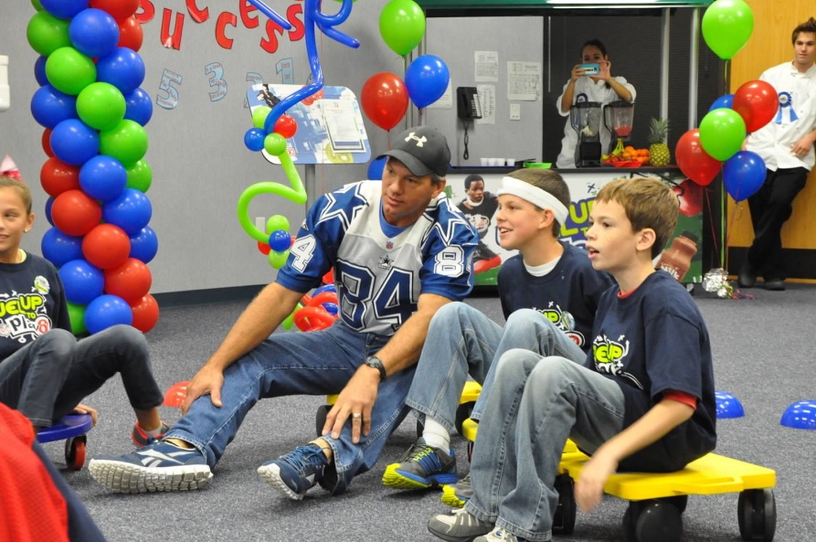
Why Fuel Up to Play 60?
It’s Fun!
Creates healthier schools!
Student Led
  Let the students be the coach and make the calls!
Prizes & Rewards
Notes:
This is a student led program!
Pick out healthy eating plays and physical activity plays from the FUTP60 Playbook online
Participate in different campaigns
Chances to win visit from a NFL player or alumni

Slide 9

5 of 8 CSH
Health Education
Physical Education
Health Services
Nutrition Education
Community and Parent Involvement
Staff Health
Healthy School Environment
Counseling, Psychological and Social Services
Notes:
FUTP60 helps schools accomplish 5 of the 8 Coordinated School Health Requirements, a mandate in Texas
It can also help schools accomplish other wellness efforts

Slide 10

Healthy Eating & Physical Activity are
Linked With…
Academic Success Health & Well-Being
Risk for: Obesity Chronic Conditions Chronic Disease
Notes:
Point out Wellness Impact Report infographic handout.
GENYOUth Foundation in partnership with National Dairy Council, American College of Sports Medicine, and American School Health Association -- The Wellness Impact: Enhancing Academic Success through Healthy School Environments.

Slide 11
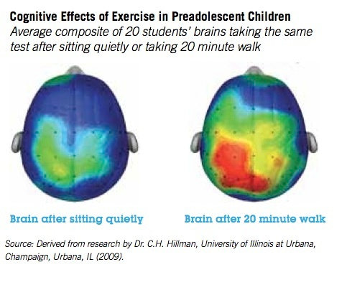
Tracking Cognitive Effects of
Physical Activity
Notes:
From Report (based on Charles Hillman research):
Recent controlled studies involving brain imaging are casting new light on the effects of exercise and obesity on cognition. They’re providing visual evidence of the neurophysiological impact of physical activity – or the lack thereof — on children.
Dr. Charles Hillman of the Department of Kinesiology and Community Health at the University of Illinois at Urbana-Champaign is teasing out the relationship between physical activity and processes involved in attention, memory and academic performance in children. With the help of neuroimaging we’re learning that:
Physical fitness may benefit cognitive and brain health, as well as academic performance.
Even single bouts of aerobic exercise have been shown to benefit cognitive performance.
Research indicates aerobic fitness levels of school children may be associated with cognition and its neural underpinnings.
Obesity is linked to adverse cognitive performance in school-aged children and teens; and in older adults obesity is actually found to change brain structure.
There exists a positive association between fitness and key aspects of learning – thus, early intervention is crucial toward lifespan health and effective function of brain and cognition. .
Sources:
Hillman CH, Erickson KI, Kramer AF. Be smart, exercise your heart: Exercise effects on brain and cognition. Nat. Rev. Neurosci. Nature Reviews Neuroscience. 2008;9(1):58-65.
Hillman CH, Pontifex, M. B., Raine, L., Castelli, D. M., Hall, E. E., & Kramer, A. F. The effect of acute treadmill walking on cognitive control and academic achievement in preadolescent children. Neuroscience. 2009;159:1044-1054.
Hillman CH, Buck SM, Themanson JR, Pontifex MB, Castelli DM. Aerobic Fitness and Cognitive Development: Event-Related Brain Potential and Task Performance Indices of Executive Control in Preadolescent Children. Developmental Psychology. 2009;45(1):114-129.
Castelli DM, Hillman CH, Hirsch J, Hirsch A, Drollette E. FIT Kids: time in target heart zone and cognitive performance. Preventive Medicine . 2011;52:55-59.
Burkhalter TM, Hillman CH. A narrative review of physical activity, nutrition, and obesity to cognition and scholastic performance across the human lifespan. Advances in Nutrition . 2011;2(2).

Slide 12
Brain Break!!

Slide 13
6 Steps to Success
Join
Build a Team
Kickoff
SWI
Game Time
Scoreboard
Notes:
“What do we do?” Complete the 6 steps to a healthier school!

Slide 14

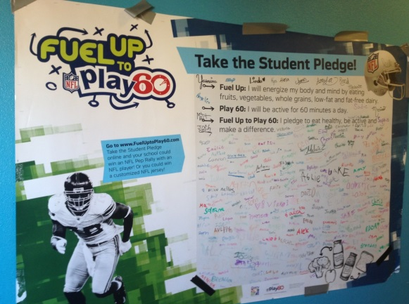
Step 1
Join the League
Do one or more of the following:
Display FUTP60 signage in a prominent place
  Hint! Use your FREE posters shipped to your school
Encourage students to join FUTP60
Notes:
Step 1 is completed by doing either one:
Students can sign a pledge banner or take the online pledge (shipping to schools Aug 2013)
Display FUTP60 signage.
We’ll give you an opportunity to join today!
Starting Aug 19-Sept 30th, 10 schools nation-wide will receive a X-Box Kinect system for their school. Open your FUTP60 Starter Kit, find your code, enter on your Dashboard to win!

Slide 15

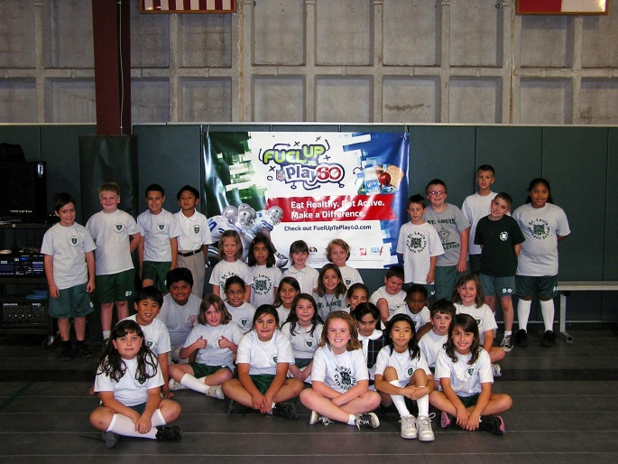

Step 2
Build Teams & Draft Players
  Do one or more of the following:
  Form a Student Team
    Hint: Use your Student
    Team Starter Kit!
  Involve Adults
    Who will be your Program Advisor?
Notes:
What makes the program successful? The FUTP60 Student Team!!
Step 2 is completed when either one of these are checked off.
SPECIAL NOTE: When an adult agrees to become a Program Advisor (most often, it is PE Coaches), then they automatically receive a Program Advisor and Student Team Starter Kit
Forming a Student Team is CRITICAL to the program’s success
Child Nutrition Director
PE Teacher
Principal
School Nurse
Health Coordinator
Teacher
Parent
Look for current wellness teams
Student Council
Yearbook class

Slide 16

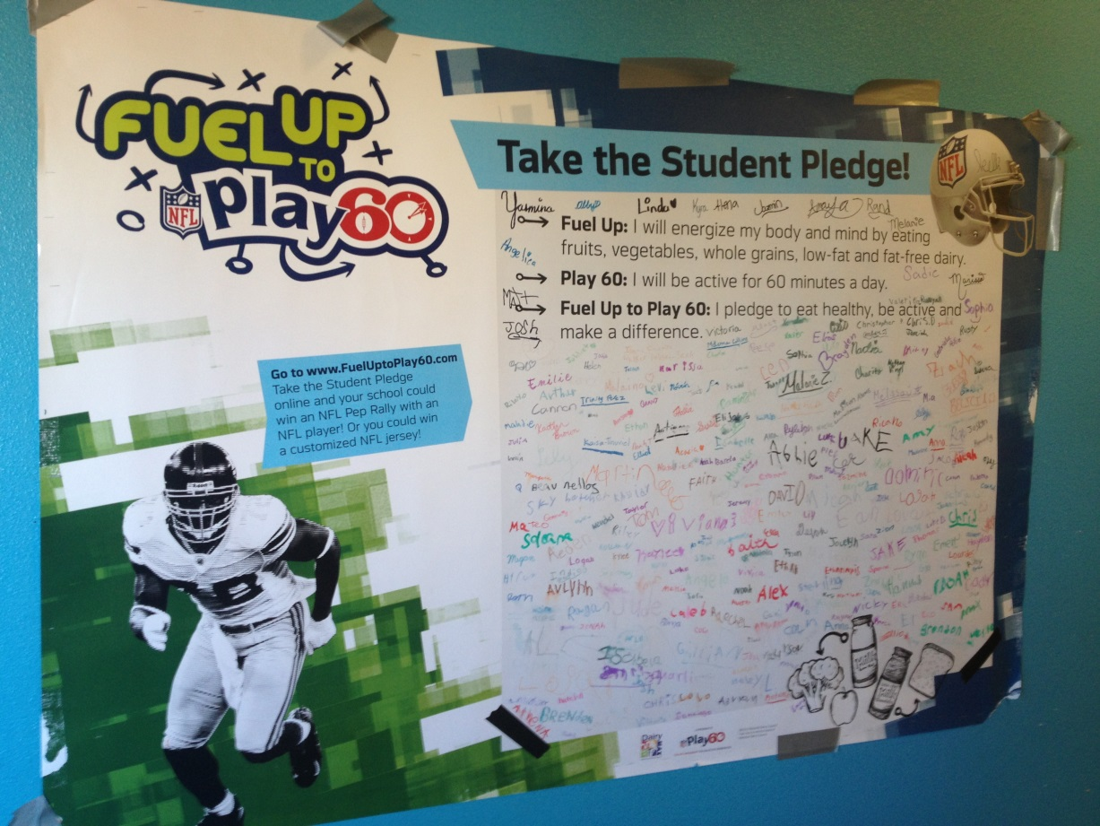
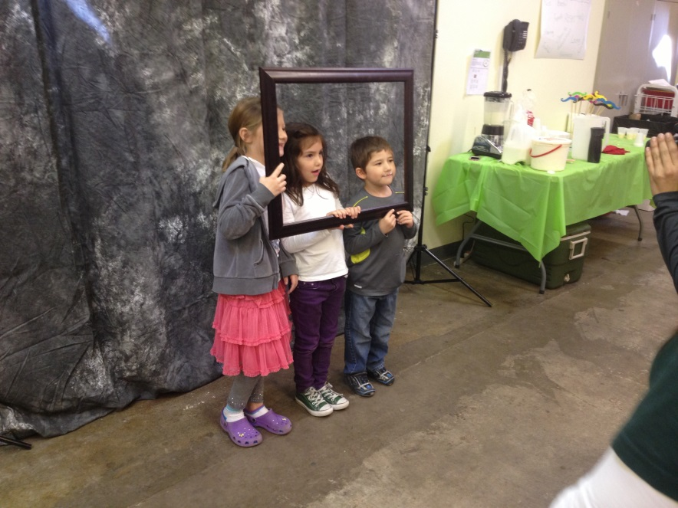
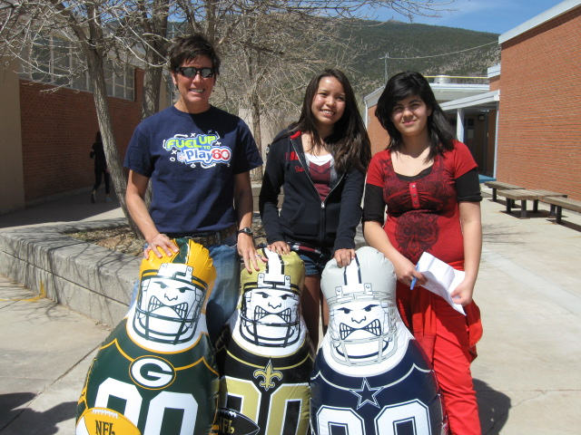
Step 3
Kickoff!
Notes:
Generate Excitement!!
Pep Rallies
Morning Assemblies
Morning Announcements
Bands, Cheerleaders, Classrooms / Roles and Involvement
Student Team Planning
Student-Created Posters, Videos, Banners
Student Pledge Banner Event

Slide 17

Step 4
Survey the Field
Survey online (access through your dashboard)
  Revised to match the CDC’s School Health Index
  Aligns with the Playbook
  Asks for Average Daily Participation in NSBP & NSLP, PE and physical activity, etc.

Slide 18

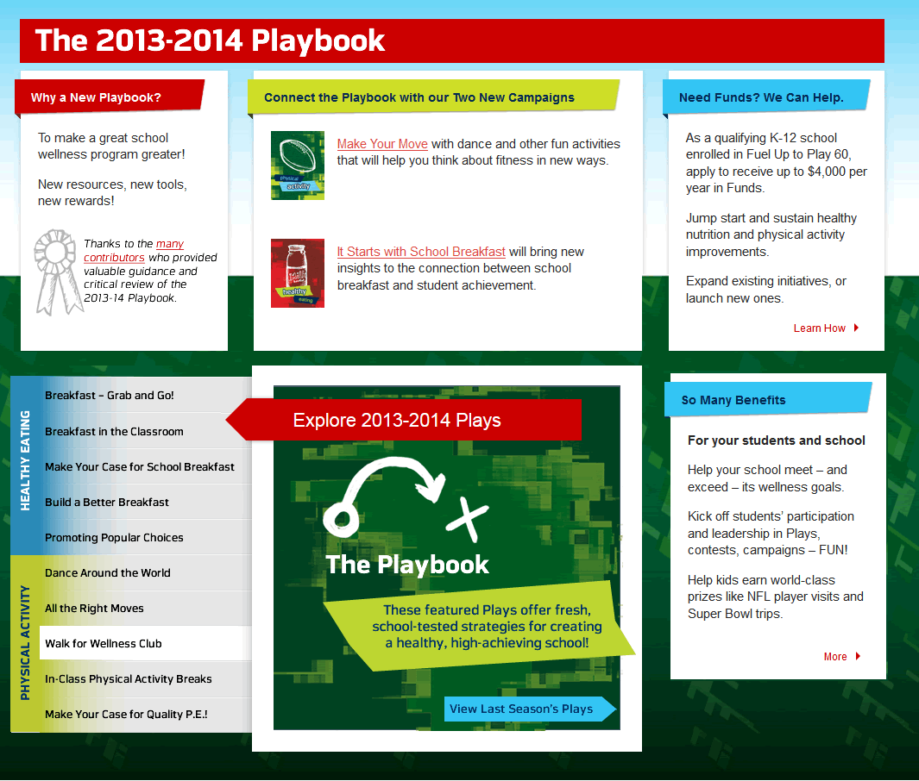

Step 5
Game Time!
Notes:
You have your team, you’ve generated excitement on campus, now it’s time to act! Whatever physical activity and nutrition activity you want to do, make it happen!
Healthy Eating Play. You can choose from the current and archived Plays in the online Playbook or create your own.
To apply for grants, you can ONLY do the Fundable Plays

Slide 19
Train Winning Plays: Healthy Eating
Brain Food
Grab n Go
Goal: Improve accessibility of breakfast at School
Add Variety
Have Fun!
Build Your Own Shake-Up
Goal: Increase availability of low-fat dairy and fruit
Drink Milk and Recycle
Goal: Increase knowledge of drinking 3 servings every day
Breakfast in the Classroom
Milk Mustache Booth
Point-of-Purchase Promo
Notes:
Here’s why to connect with CND

Slide 20
Train Winning Plays: Physical Activity
Walking
Walk/Bike to School Program
Goal: Opportunity to fit walking into their daily routine
Fitness
Breaks
Create Your Own Fitness Center
Goal: Provide access to equipment and new activities
Stop and Go Signs
Goal: Encourage activity outside of PE class
School Wide Walk It! Club
In-Class Physical Activity Breaks
After School Fun Fitness Activities

Slide 21
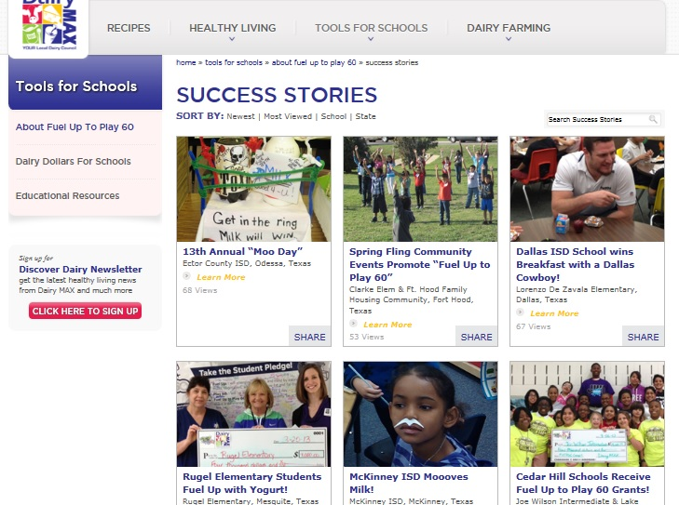
Successes!

Slide 22
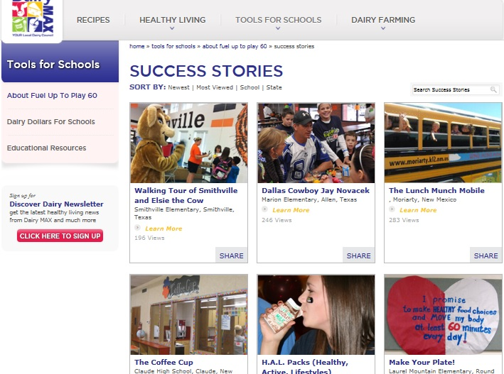
Successes!

Slide 23
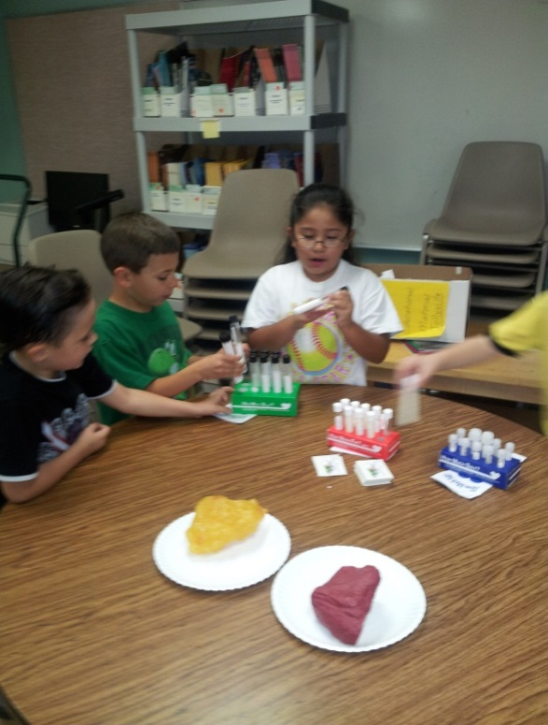
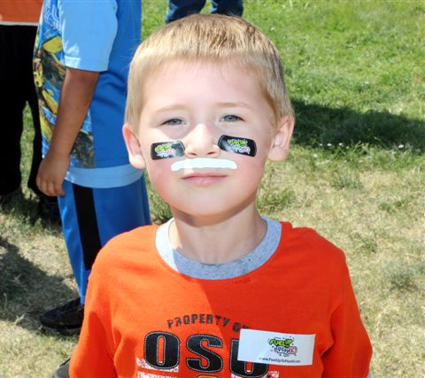
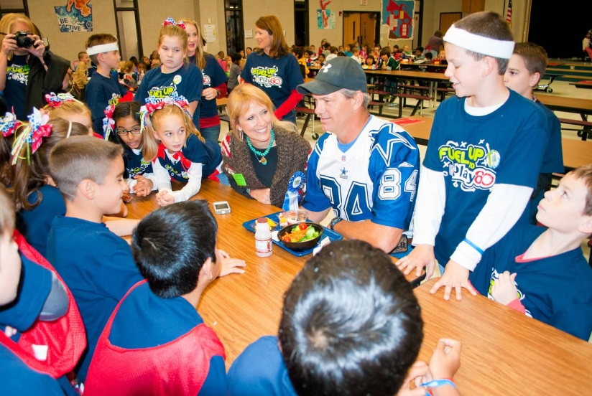
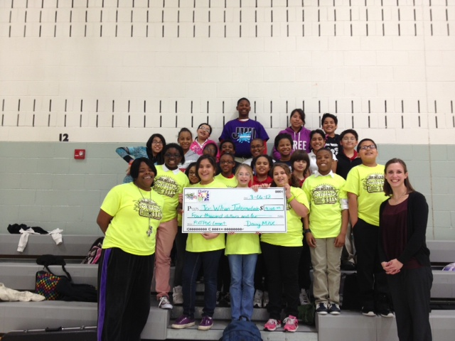
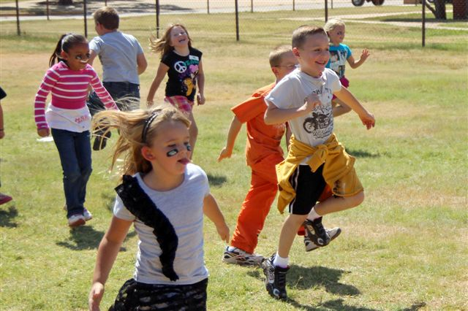
Step 6
Light Up the Scoreboard!
Share Your Success!

Slide 24

Our Thanks to You!
Receive a $100 gift card when you complete the 6 Steps!
Notes:
24
Review what a Playbook is but that they can come up with their own ideas
Review again that the involvement with students is also a part of creating ideas and implementing plays

Slide 25
Get Your Kids Involved!
Notes:
We want to see more students actively involved on the FUTP60 student website. It has a new look and students will have a chance to win National and Local prizes if they join and take the pledge!

Slide 26
Non-Funded Implementation
AgriLife Activities

Slide 27
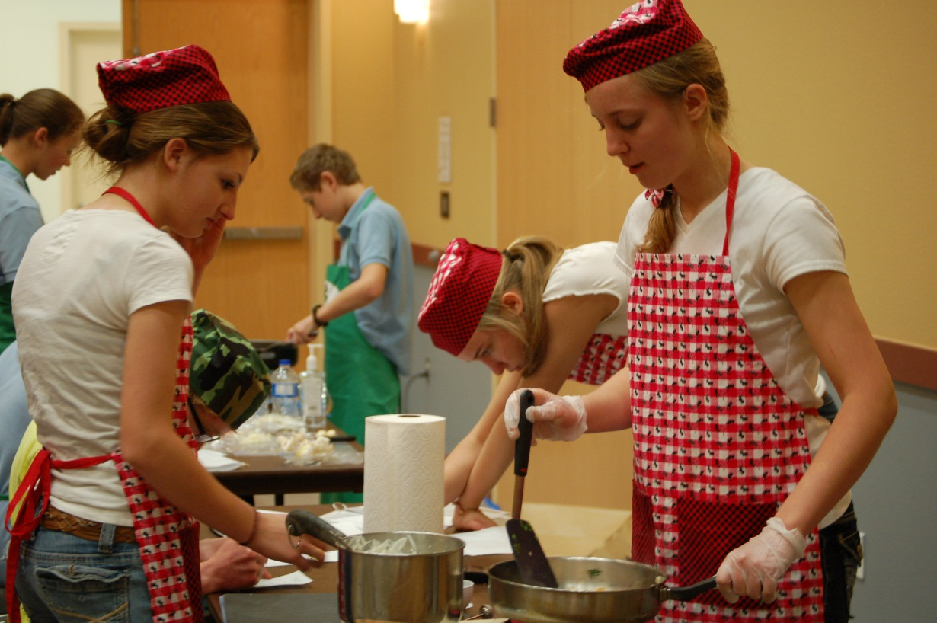
Food Challenge-Collin County

Slide 28
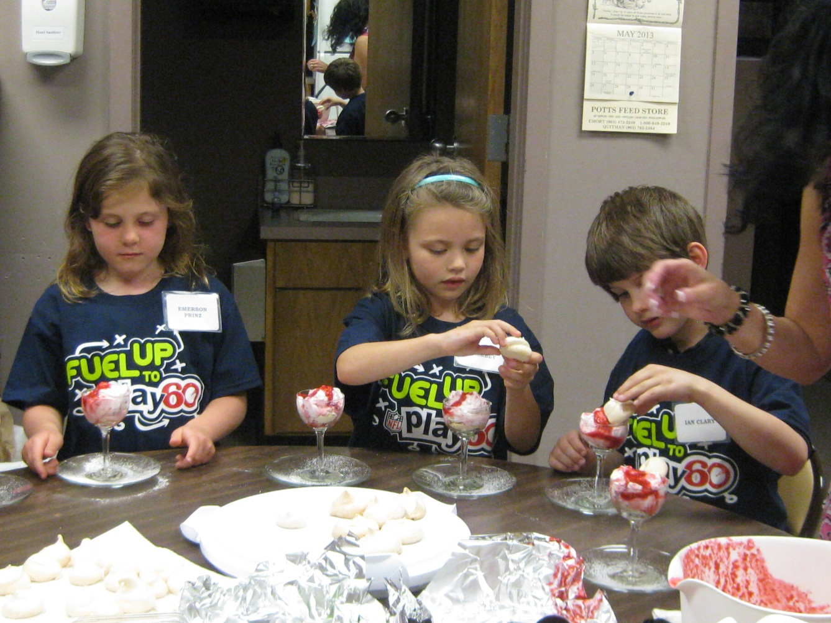
Young Chefs-Rains Co.

Slide 29
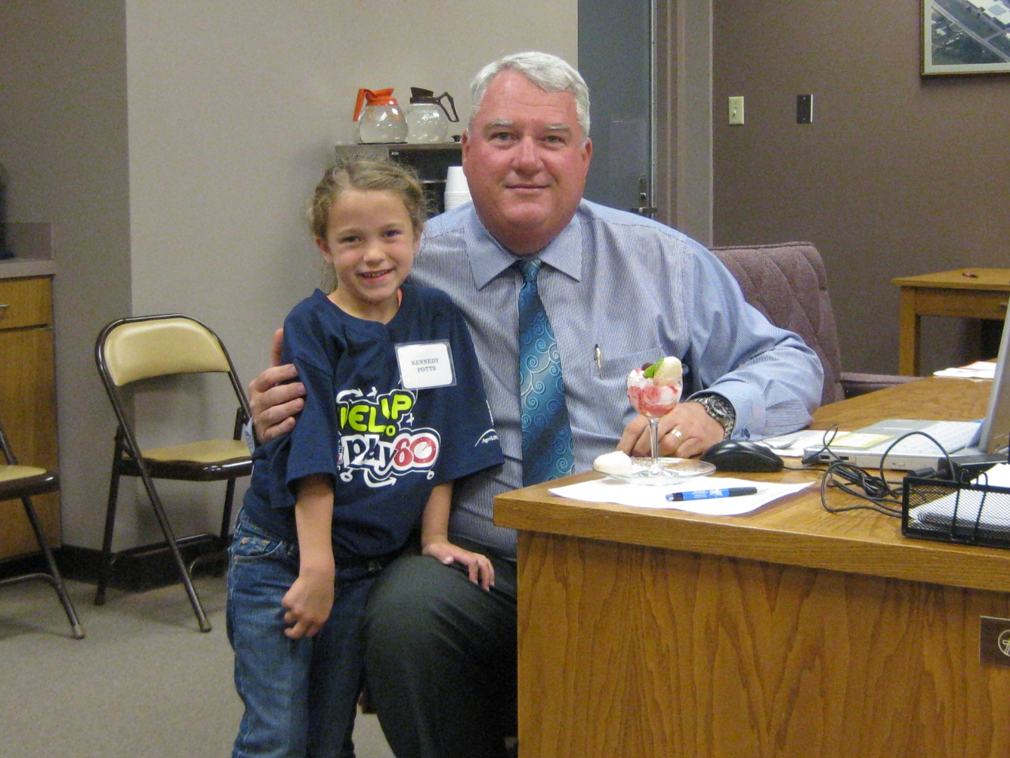
Healthy Snacks

Slide 30
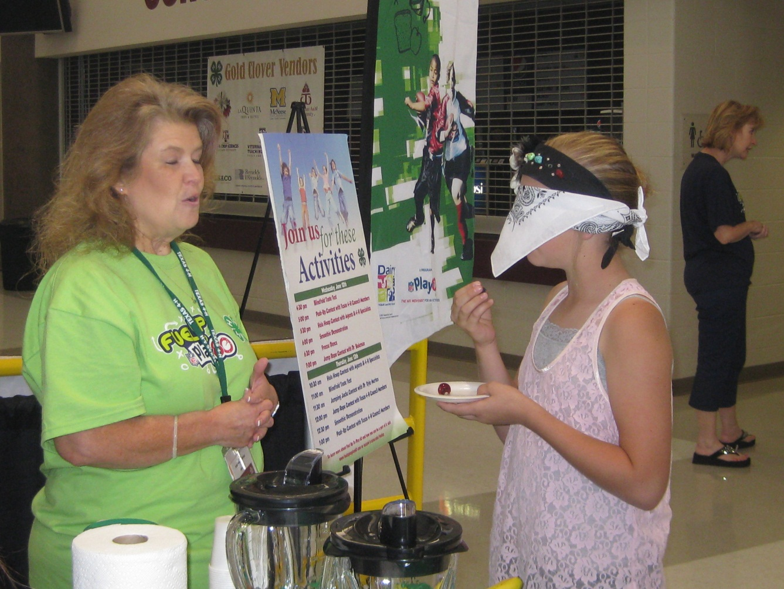
Mystery Food Tasting

Slide 31
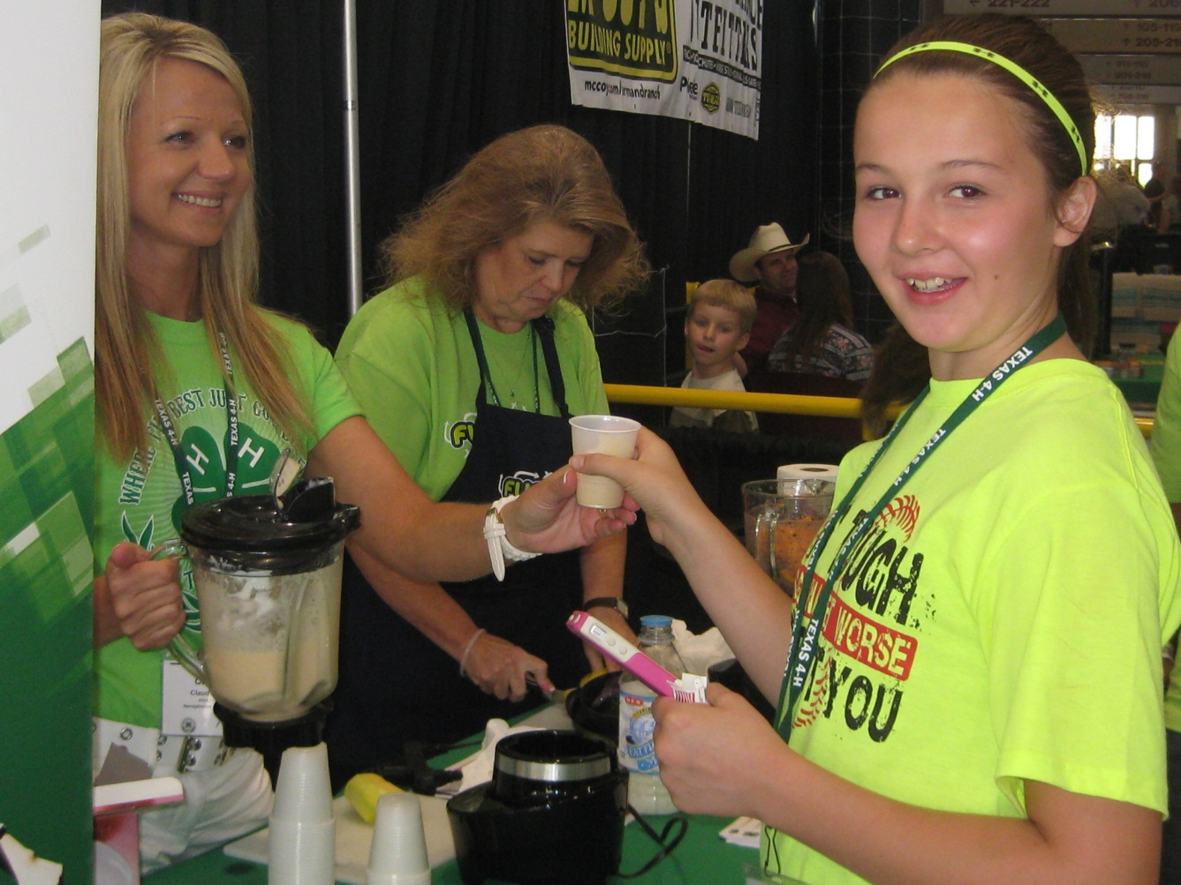
Smoothie Taste Test

Slide 32
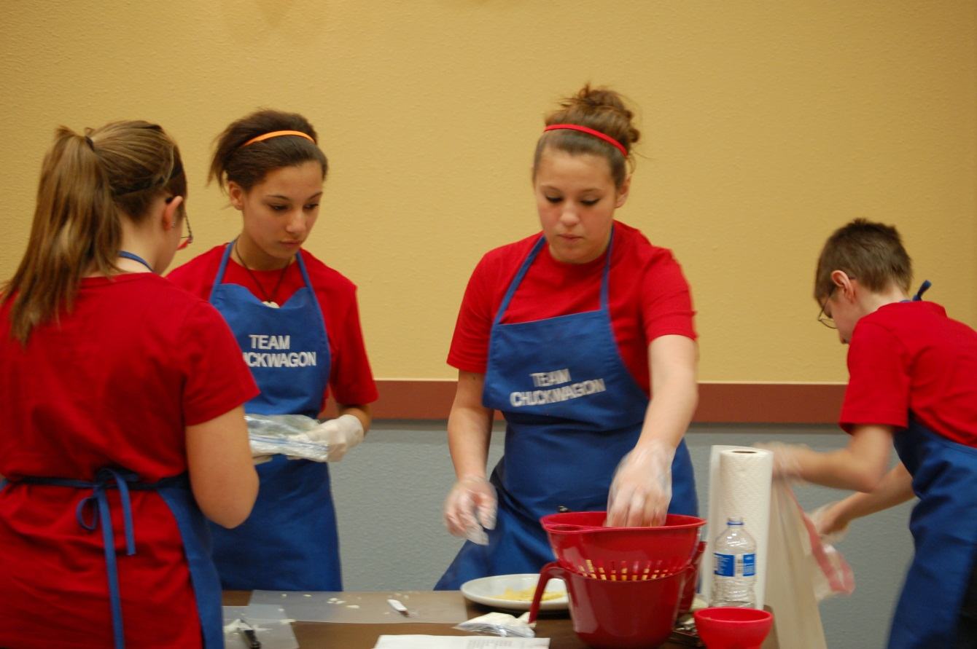
Recipe Rally

Slide 33
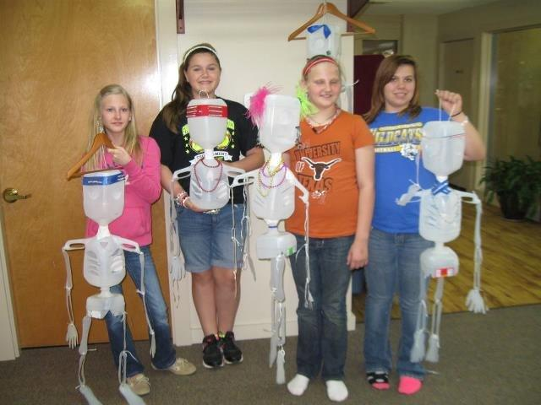
4H Foods & Nutrition

Slide 34
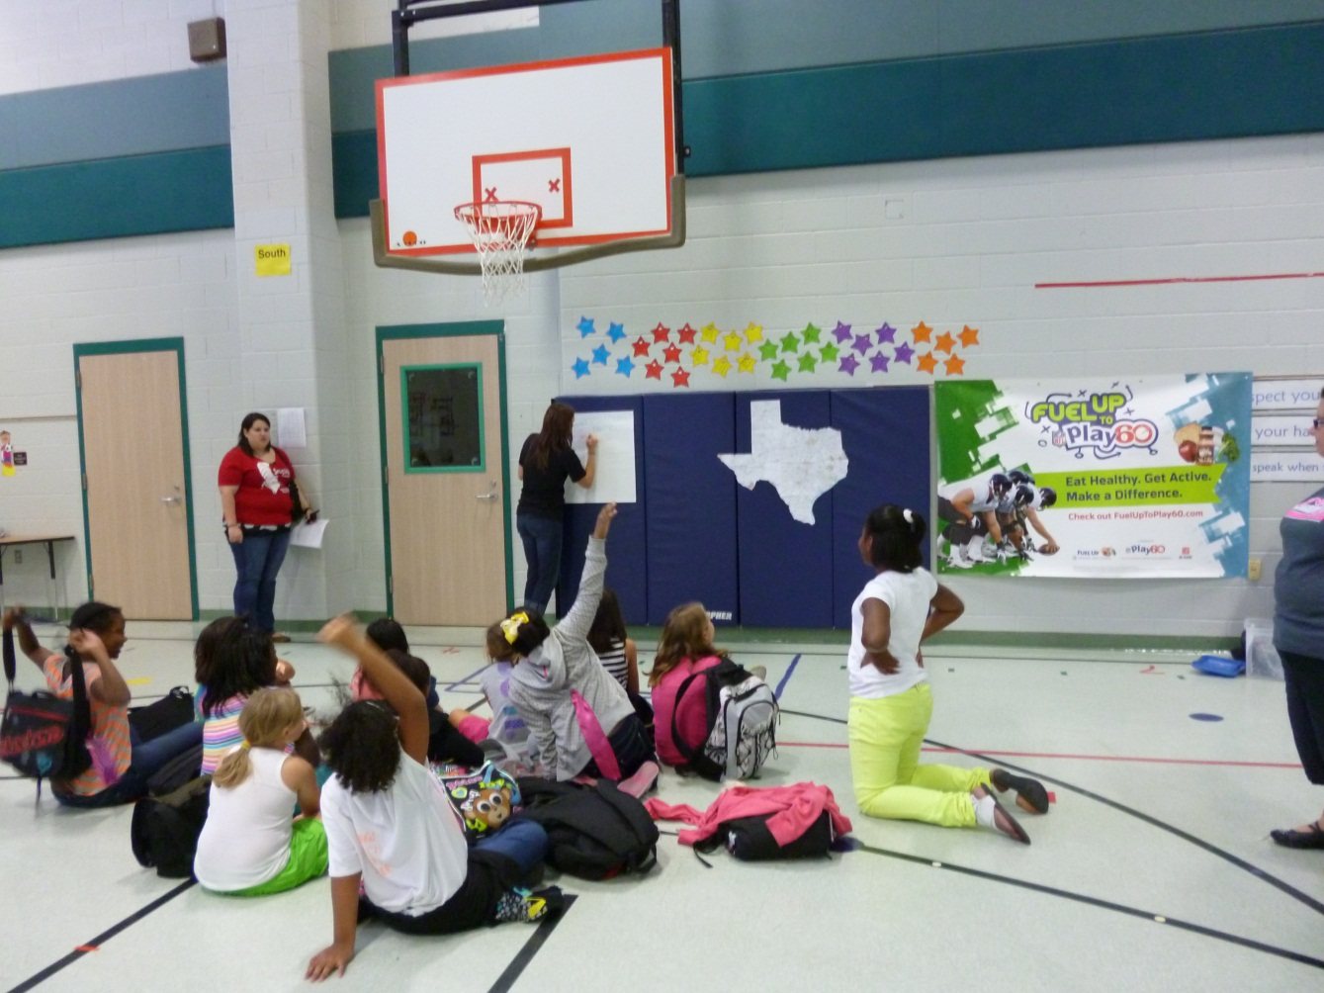
After School Planning

Slide 35
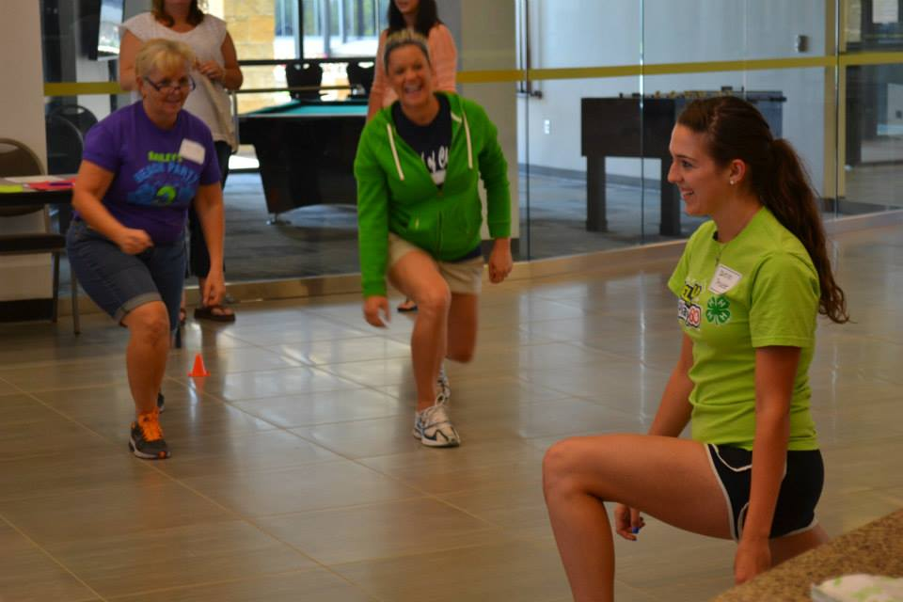
Simon Says Fitness

Slide 36
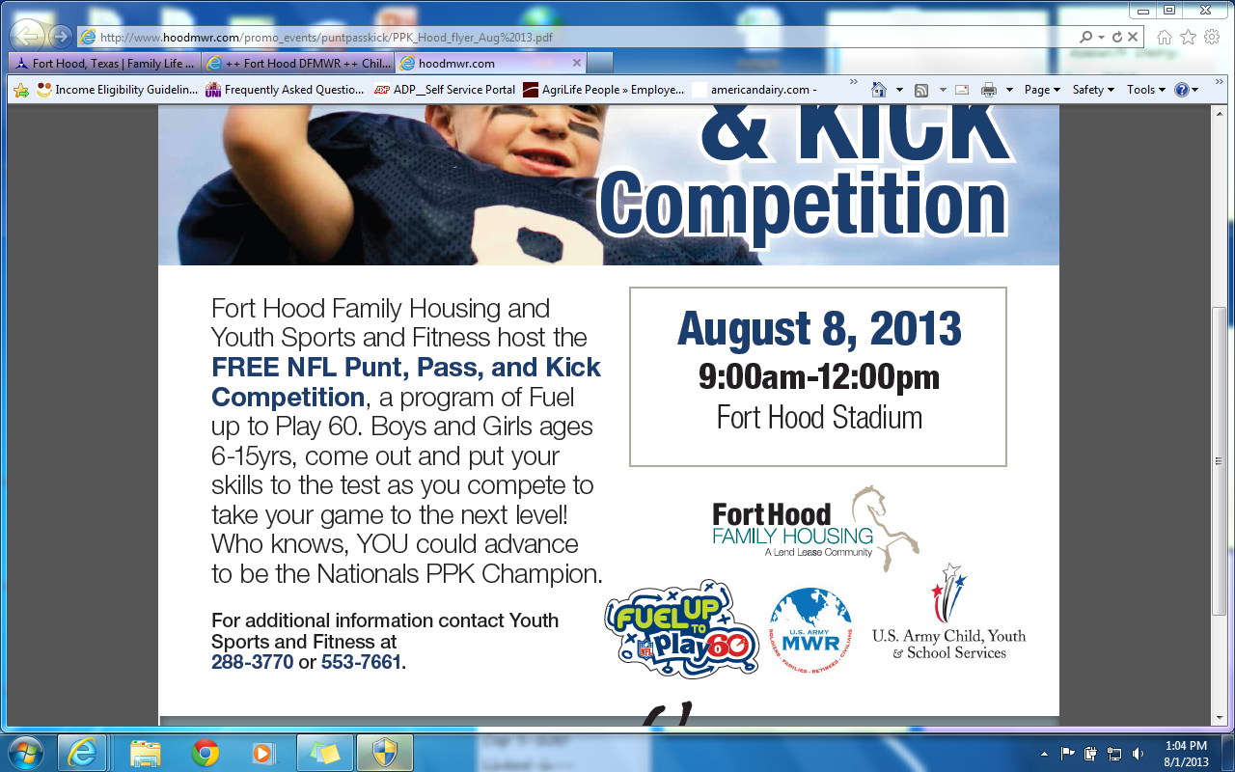
Kick Pass & Punt

Slide 37
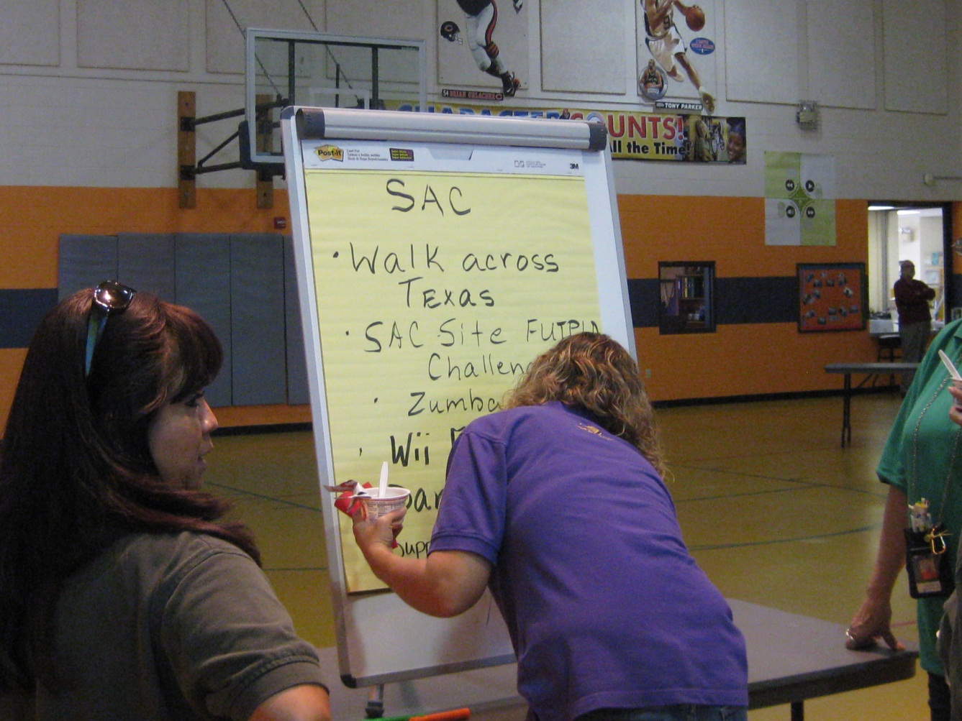
Ft Hood Fitness Centers

Slide 38
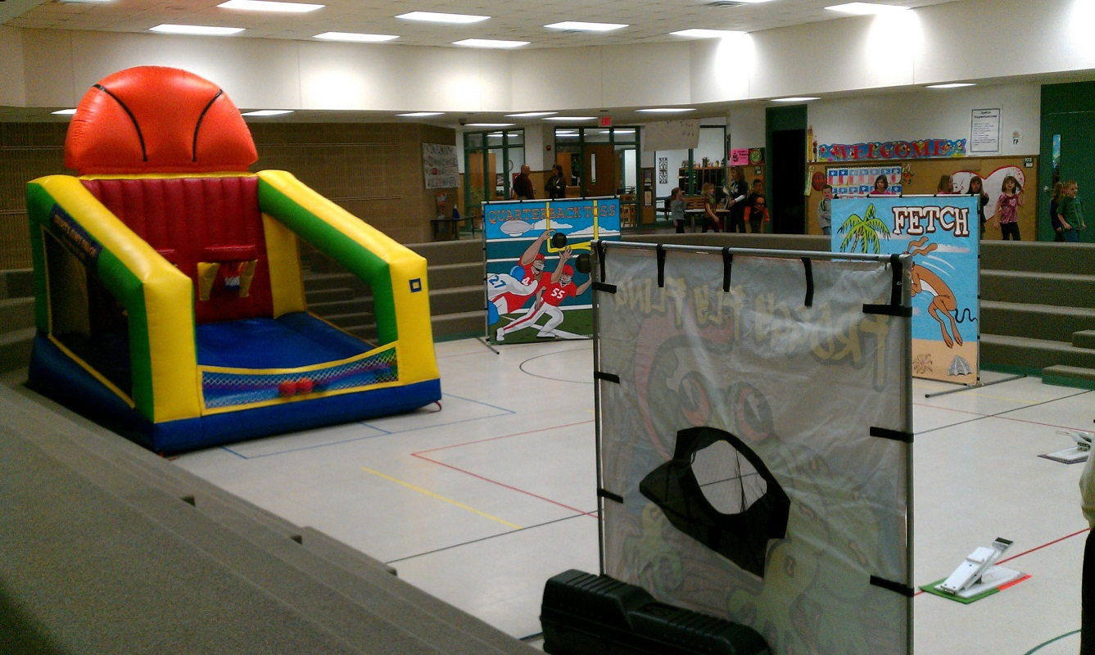
Local Equipment Sourcing

Slide 39
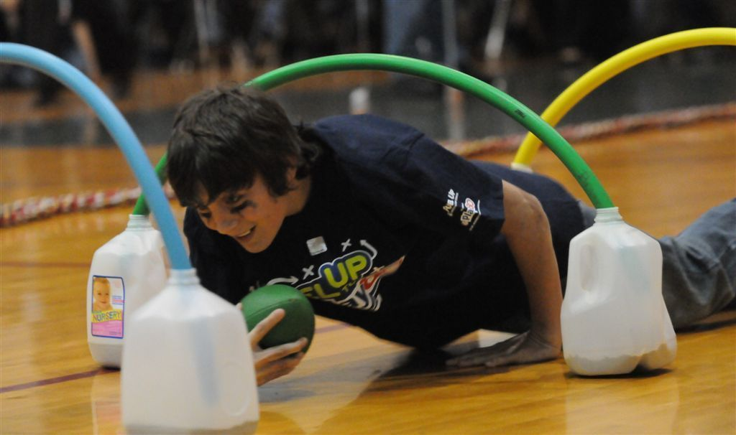
Creative, Low Cost

Slide 40
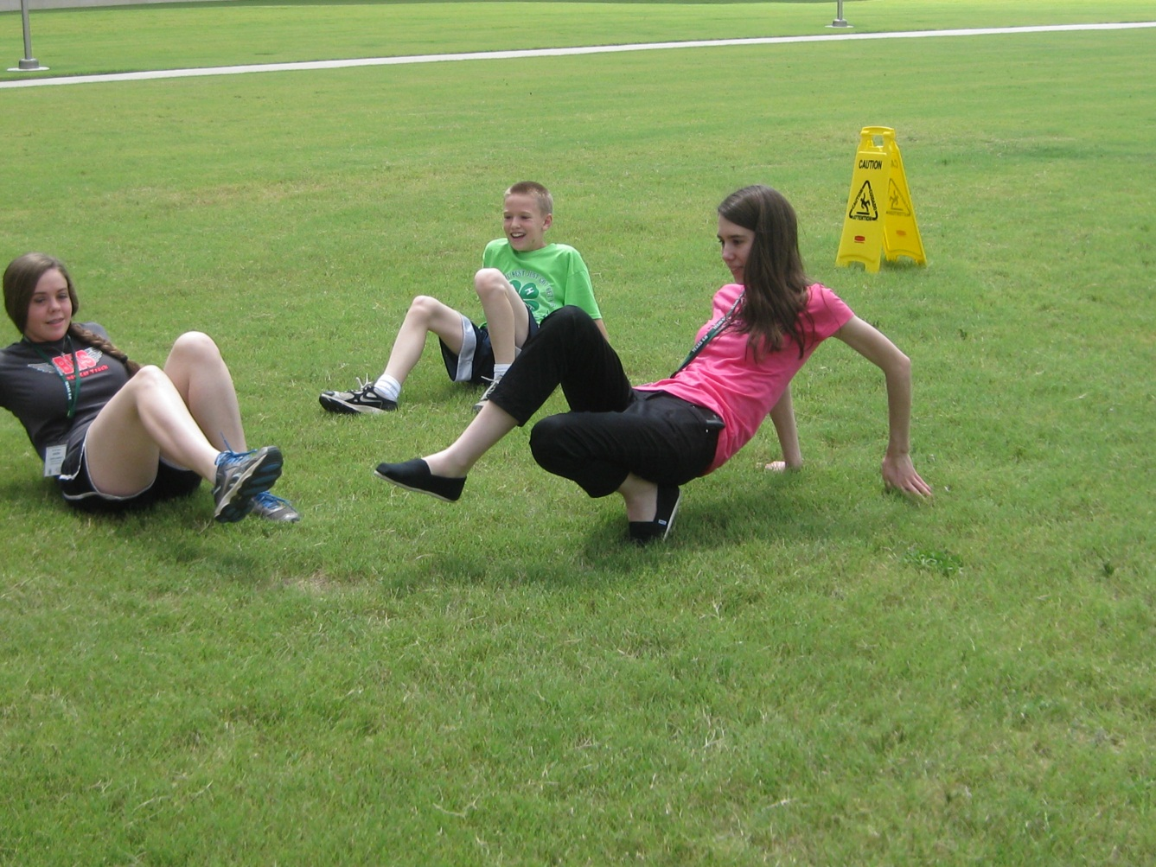
Fitness Challenges

Slide 41
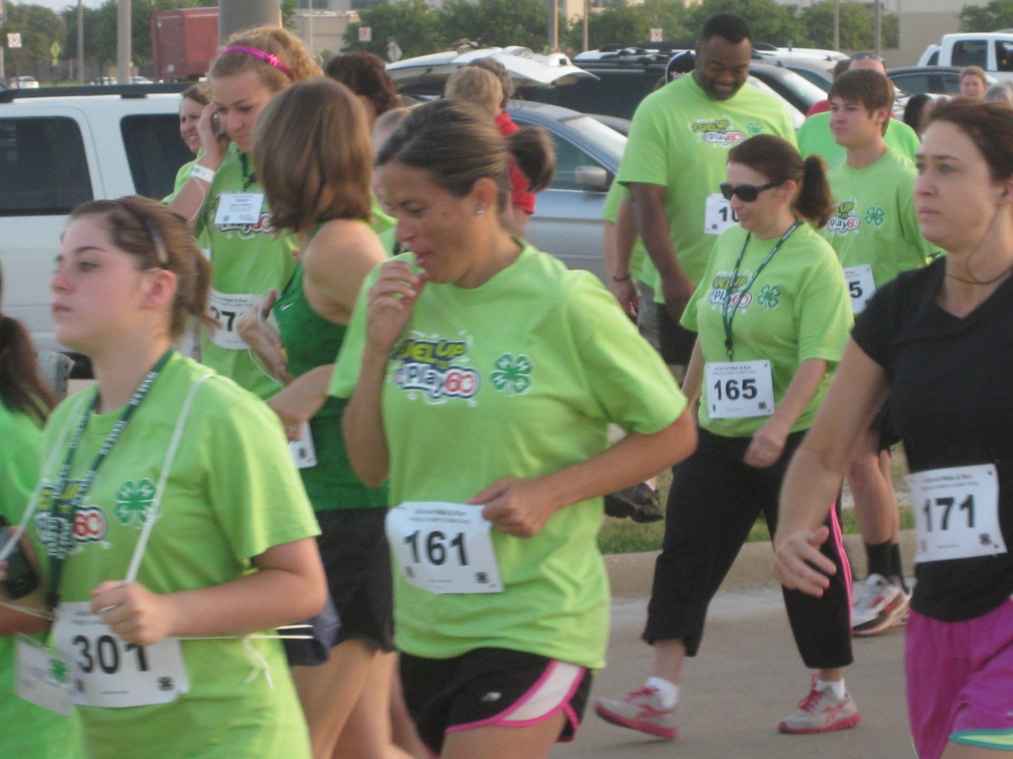
4K Run-Walk Across Texas

Slide 42
Outreach
SHAC
Wellness Volunteers
County Plan
County Network
Diabetes
Weight Mgmt
Balancing Food & Play
Fitness Challenge

Slide 43
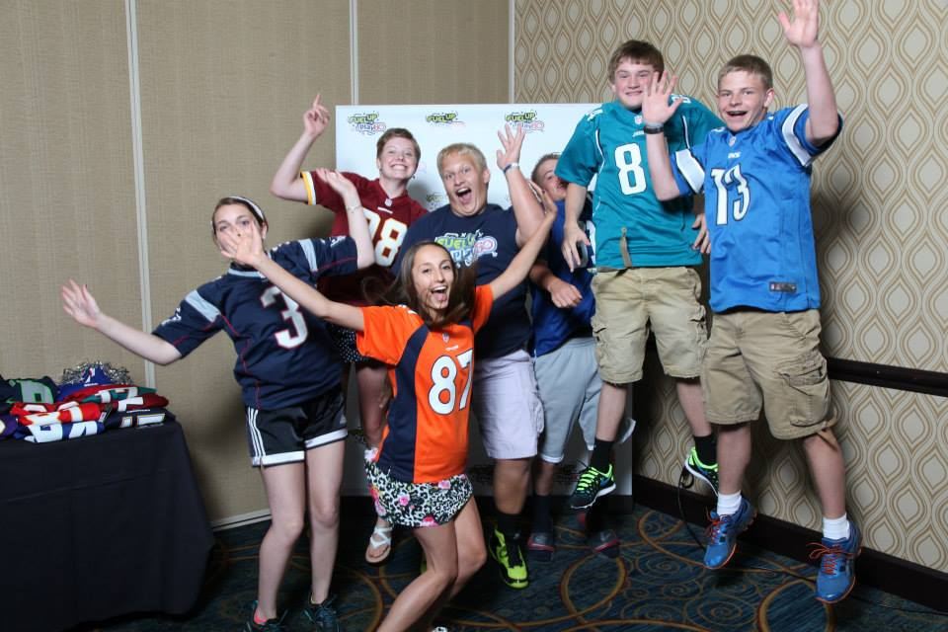
Extra Fun! Campaigns
Make Your Move
  November 2013
  Focus on Dance
  National and Local Prizes!
Notes:
During the month of November, schools can promote dance as a fun, motivating, inclusive way to encourage physical movement. Students can participate by
Watching a promotional video and taking part in the activity of dancing
Help to implement a Play in school
Report Campaign activity minutes
Work with PA to report activity on the Dashboard to help their school earn recognition/rewards
School Breakfast Campaign-

Slide 44
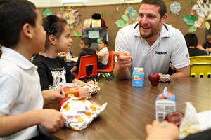
Extra Fun! Campaigns
It Starts with Breakfast
  February-March, 2014
  Eat school breakfast!
  National and Local Prizes!
Notes:
How:
Check a box to say “I ate school breakfast” (entered to win a prize)
Do a Play from the Playbook
Report Campaign activity minutes
Work with PA to report activity on the Dashboard to help their school earn recognition/rewards

Slide 45
Prizes!
Campaign | Dates | Prize
Are You In? | August 19-October 11, 2013 | National: 2 tickets and travel to 1 NFL game Dairy MAX: $5000 Best Buy gift card for your school
Make Your Move Campaign | Fall 2013 | National: NFL Player visit for 1 winning school Customized NFL Jersey (1 winner from each state) Dairy MAX: $5000 Best Buy gift card for your school
It Starts with Breakfast Campaign | Fall 2013 & Spring 2014 | National: NFL Player visit for 1 winning school Customized NFL Jersey (1 winner from each state) Dairy MAX: $5000 Best Buy gift card for your school
Notes:
Let’s talk prizes! Take a look at what you or your school could win by participating in the FUTP60 program!

Slide 46
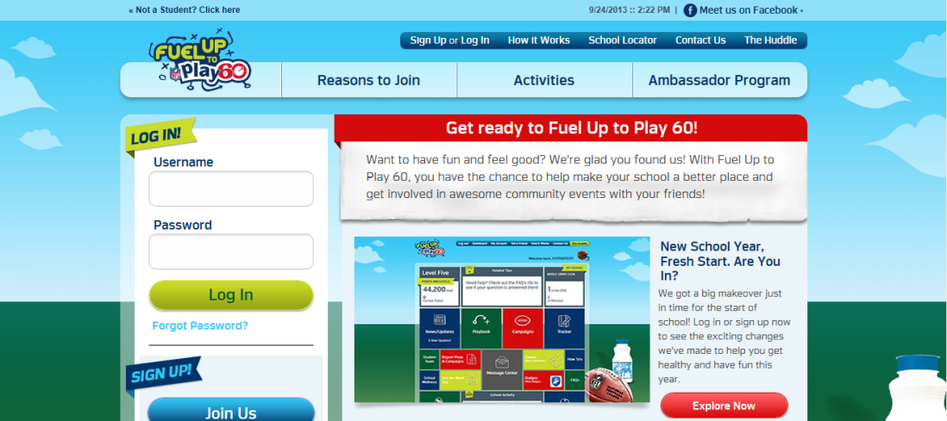
Extra Fun!
New Student Site!
Students can earn points for rewards
Strive for local, state and national Ambassador status
Trackers, games and FUTP60 info
Student email required. Under age of 13 – parental email
Great way to engage computer teachers!
Notes:
The new student site should make it easier for students to join and get active with the program.
They can earn points by completing program activities:
Register
Do Plays
Campaigns
Get others involved
Work with a Program Advisor
The Tracker
BONUS Points!

Slide 47
FREE Tools for YOU!

Slide 48


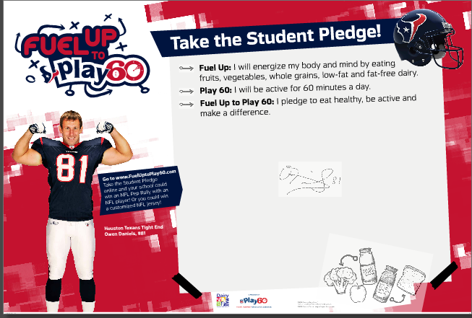
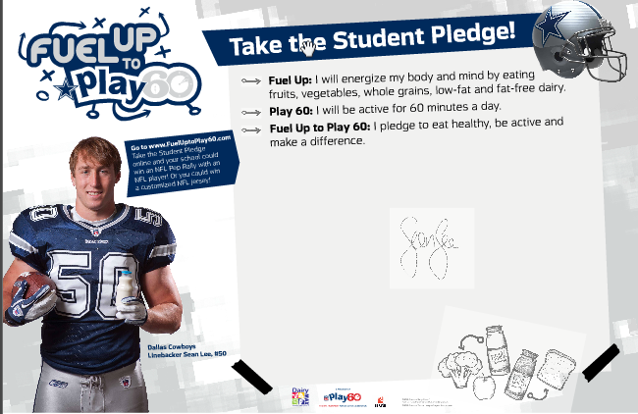
FREE Back to School Kit!
Notes:
When you sign up as a Program Advisor, you automatically receive 2 MORE FUN and FREE Kits
If you’re already a Program Advisor, you WILL receive the two kits.
Proud to Be a Program Advisor and Student Team Starter Kits
The Student Team Kit has 12 buttons and wristbands, and one deck of Student Idea cards

Slide 49


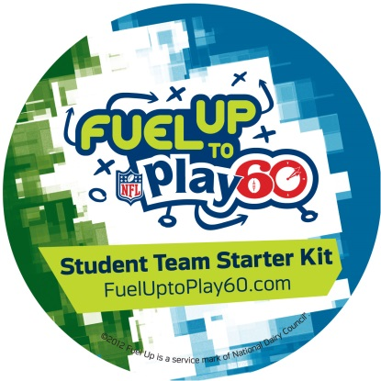
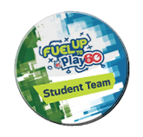
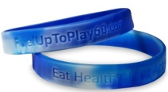
FREE PA and Student Team Kits
Notes:
When you sign up as a Program Advisor, you automatically receive 2 MORE FUN and FREE Kits
If you’re already a Program Advisor, you WILL receive the two kits.
Proud to Be a Program Advisor and Student Team Starter Kits
The Student Team Kit has 12 buttons and wristbands, and one deck of Student Idea cards, NFL Player Cards and our very own cow cards

Slide 50
Dairy MAX Webinars
Various topics discussed throughout the year
  6 steps, building teams, funding, etc…
Watch at your convenience
  All webinars are archived and available at www.dairymax.org

Slide 51
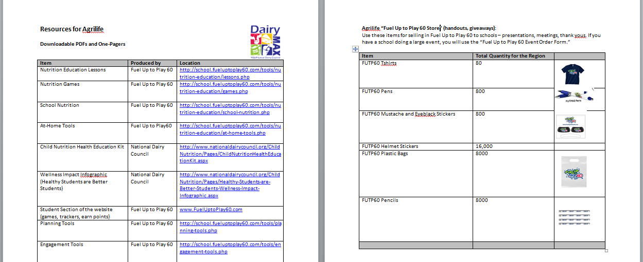
FREE Agrilife Resources

Slide 52
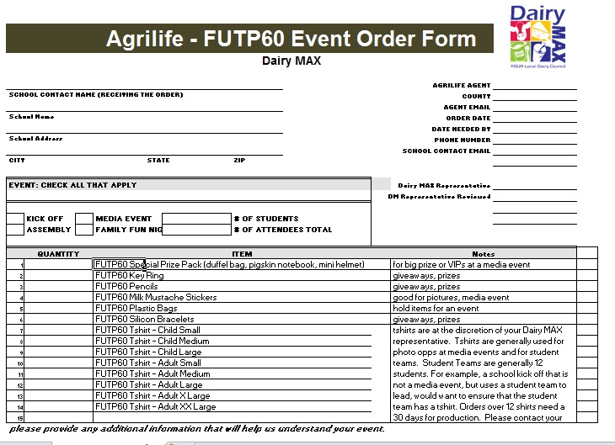
FREE Agrilife Resources

Slide 53
Brain Break!!

Slide 54
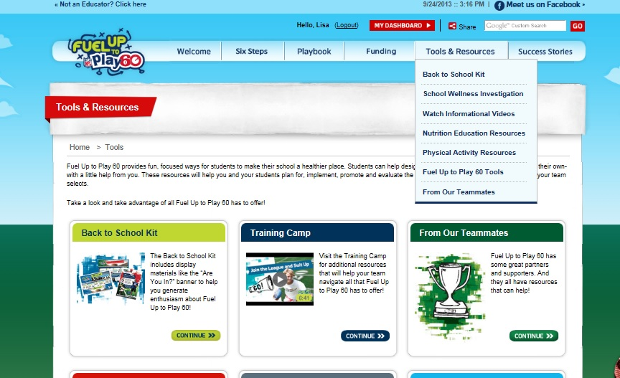
FREE Agrilife Resources

Slide 55
Grants-The Fundable Plays
Nov 1st Deadline
  Up to $4,000 per school
  5 Healthy Eating Plays
  5 Physical Activity Plays
  Connected to “Make Your Move” and “It Starts with Breakfast” Campaigns

Slide 56
Technology Training

Slide 57
Are You In?
Notes:
Invite teachers to sign up on laptops located around the room

